Slide 1
Youth Services: New Pathways to Access
Presented by: Jill Rothstein, Crystal Stewart, Chancey Fleet, Himelda Mendez, and Stephanie Wambaugh

Slide 2
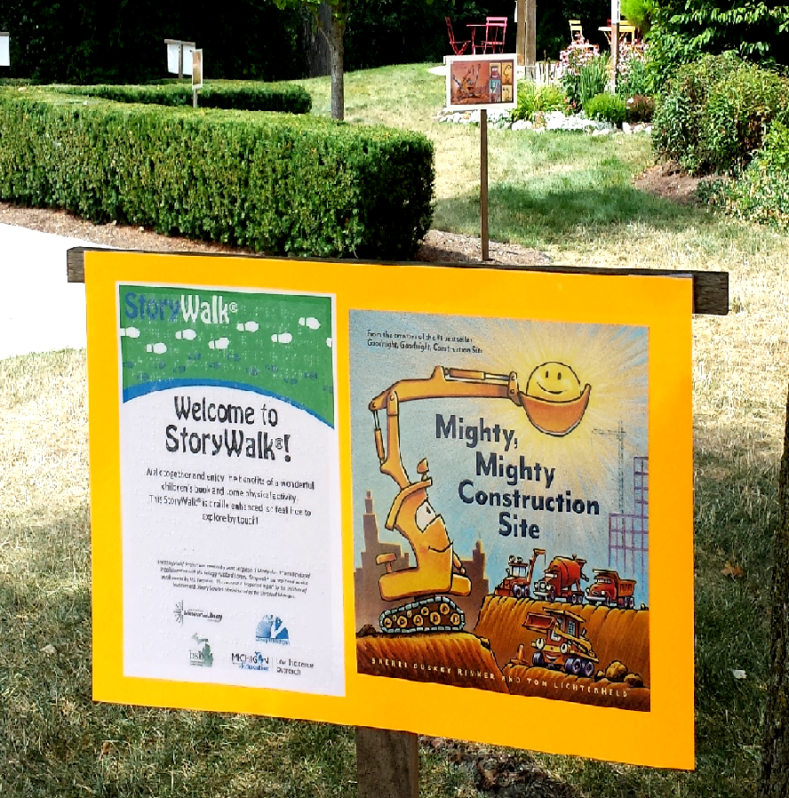
Braille Enhanced StoryWalk® in Michigan
A StoryWalk® is a fun, educational activity that places a children’s story along a popular walking route in your community. A Braille Enhanced StoryWalk® simply adds a braille overlay on the posters. By including braille, the libraries help embrace accessibility and equal access to information, and create community conversations about disability awareness.

Slide 3
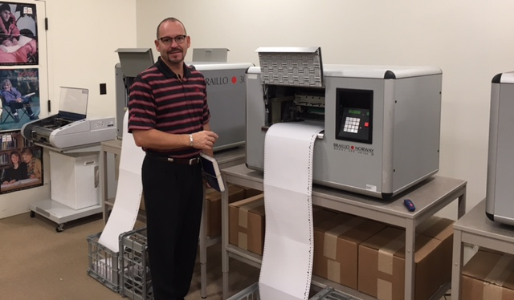
Braille Enhanced StoryWalk® in Michigan
The Team:
Library of Michigan
Department of Education— Low Incidence Outreach (MDE-LIO)
The Michigan Braille and Talking Book Library (BTBL)
Made possible with grant funding from the Institute of Museum and Library Services.
The Process: 5 easy steps!
Book Selections
Library Survey Sign-Up
Purchasing
Brailling / Laminating
Mailing
Notes:
Braill

Slide 4
Braille Enhanced StoryWalk® in Michigan
Survey and Impact Results
2017
100% said it improved their ability to provide services to the public
The combined service areas of all participating locations totals 1,793,850 people!
2018
“Customers like feeling the braille! Even the mounted police officer and her horse checked it out!” -Detroit Public Library
The combined service areas of all participating locations totals 2,636,495 people (and at least one horse)!
2019 in planning process!

Slide 5
