Slide 1
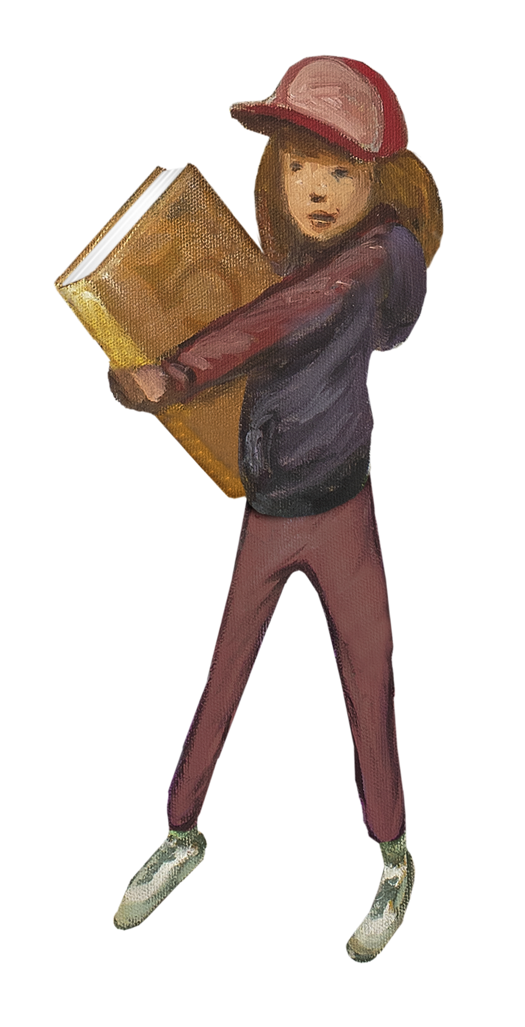
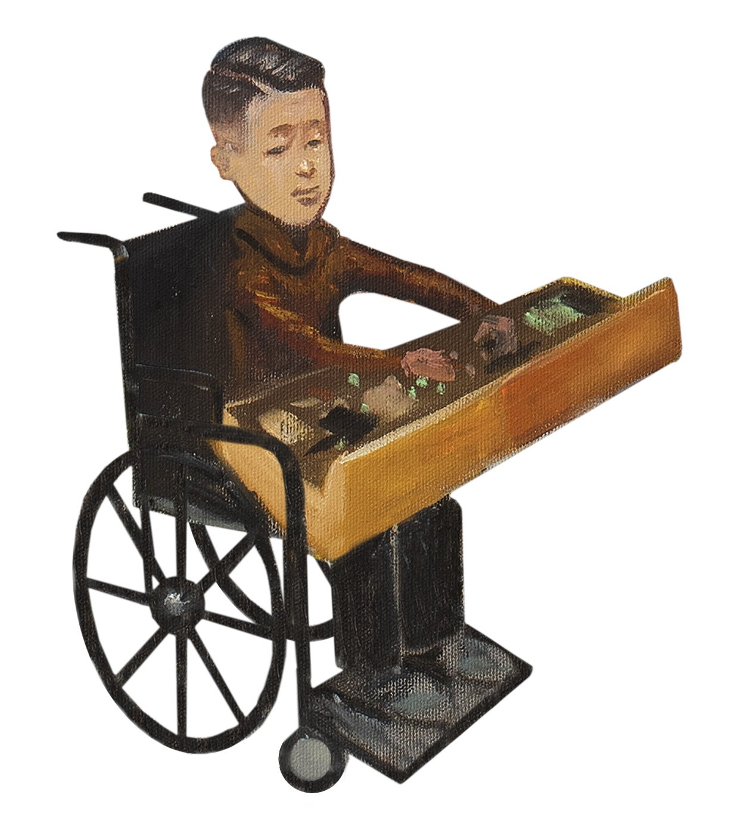
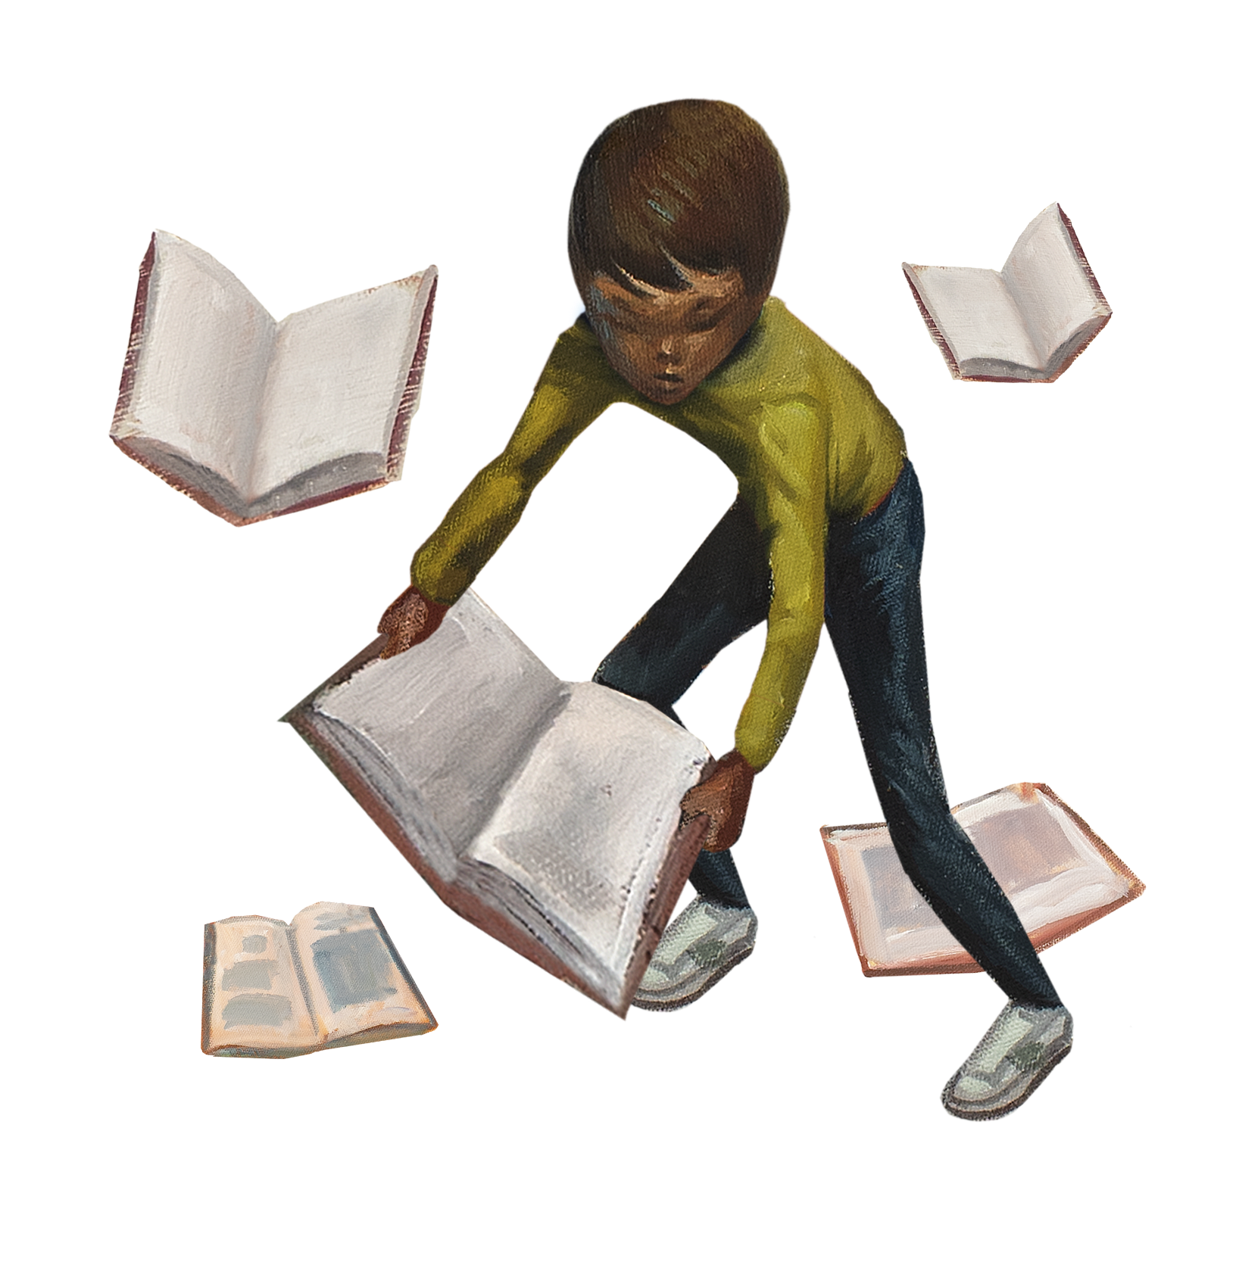
Summer Reading Program 2023 |
Presented by the NLS Network Summer Reading Committee
Notes:
LaShawn

Slide 2
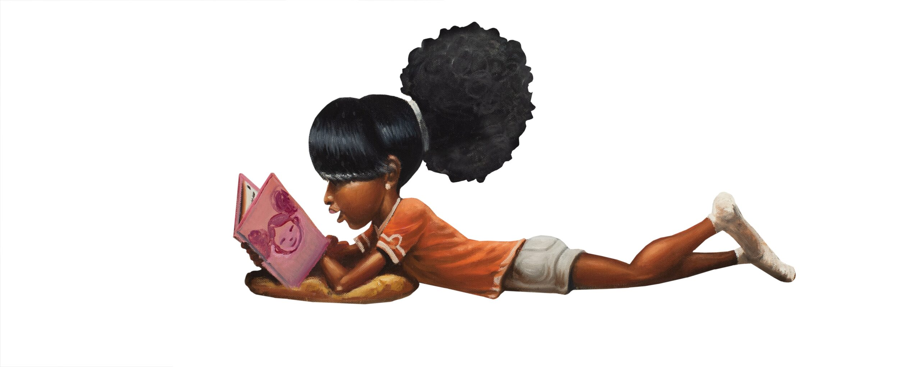
2023 NLS Northern-Southern Regional Conference
LaShawn Myles is the Youth Librarian at the Maryland State Library for the Blind and Print Disabled (LBPD). On a good day, you will find her creating accessible programs, building partnerships, and expanding services for youth with print disabilities across the state. Before starting a career with LBPD, LaShawn worked as 18 years as an educator and School Library Media Specialist.
Mary Beth Parks is the Patron Services Manager at the Library of Accessible Media for Pennsylvanians (LAMP). She supports an amazing team of Reader Advisors and LAMP's Youth Services Librarian in providing accessible programs and services to LAMP patrons throughout the state of Pennsylvania.
Notes:
Both

Slide 3
https://www.menti.com/alzbya76bpqg
Notes:
LaShawn

Slide 4
Notes:
LaShawn

Slide 5
Theme – All Together Now Kindness/Friendship/Unity
NLS Summer Reading Planning Team
Collaborative Summer Library Program (CSLP)
iRead libraries can still participate!
Program Goals
Shared Resources
Program Planning
Notes:
Mary Beth IRead website: https://www.ireadprogram.org/ Find Your Voice Theme

Slide 6
Program Goals
To help school-aged library users retain or improve their reading and comprehension skills while they are out of school during summer
To provide a fun and engaging activity for adults
To promote a love of reading for all NLS patrons
Notes:
Mary Beth

Slide 7
What can network libraries expect from the NLS?
Resource Page
Guide to Summer Reading
Booklists
Programs
Sample Materials
Each network library is still in charge of their own program.
Notes:
Mary Beth

Slide 8
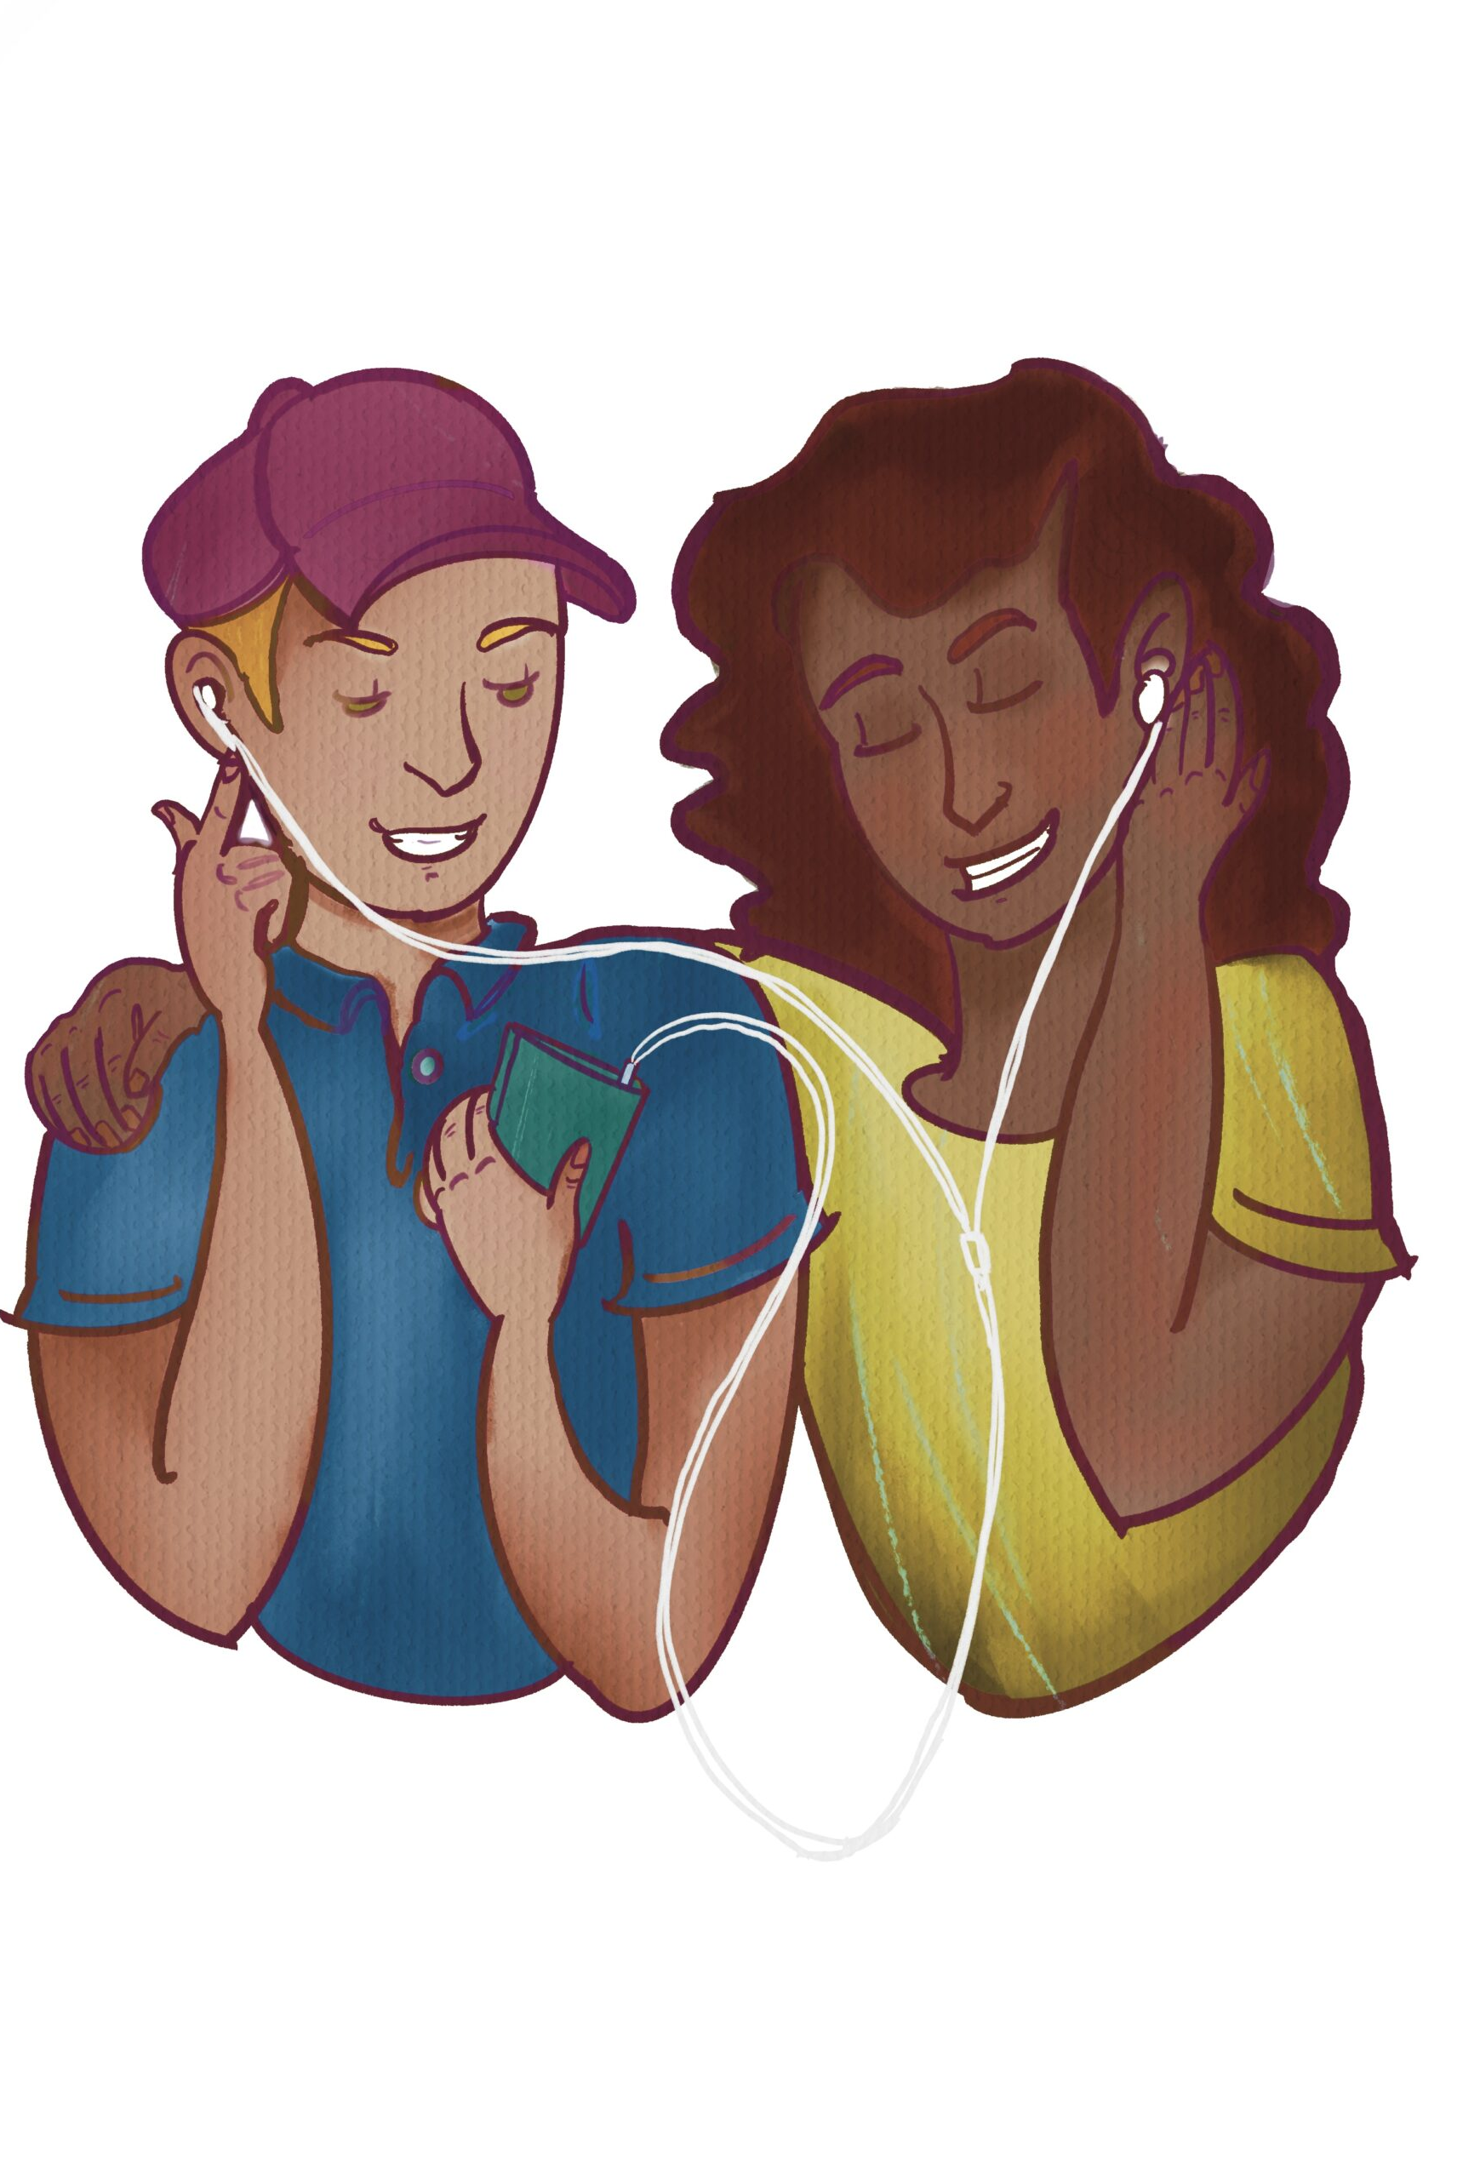
Important Dates Summer Reading will begin on June 26, 2023 and end on August 11, 2023
Monday, June 26 @ 4:00 PM NLS Kickoff Event
Thursday, June 29 @ 7:00 PM Adult Author Shelby Van Pelt
Thursday, July 6 @ 7:00 PM Turtle Dance Music (Grades K-3)
Tuesday, July 11 @ 7:00 PM Author Celia Perez (YA)
Saturday, July 22 @ 1:00 PM Authors Annette Bay Pimentel and Jennifer Keelan- Chaffins (Grades K-5)
Thursday, July 27 @ 7:00 PM Author Kwame Alexander (YA)
Thursday, August 3 @ 7:00 PM Author Jenny Torres Sanchez (YA)
*These programs will be livestreamed only and will not be recorded.
Notes:
Mary Beth

Slide 9
Additional Programming Resources
Summer Reading Working Group
Wiki: https://lbphwikiaadl.org/
Contact: Maggie Witte @ Maggie.Witte@ks.gov
CSLP Manual cslpreads.org
Programming ideas with material lists, tips, and adaptations.
Share your favorite resources!
Notes:
LaShawn- code to access, program ideas with adaptations will be available on Wiki or NLS site. Maggie Witte Outreach Librarian, Kansas Talking Book.

Slide 10
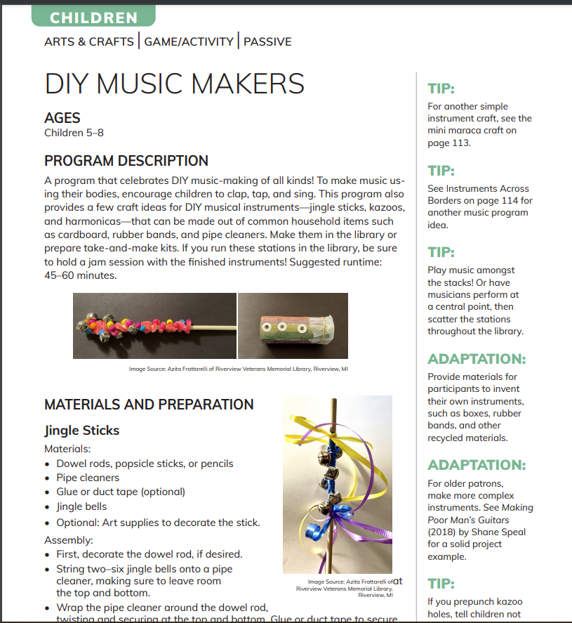
Children's Programming Example – DIY Music Makers
How can you adapt this activity?
Will you mail materials to registered participants?
Will you offer this activity as a passive program in your library?
Notes:
LaShawn

Slide 11
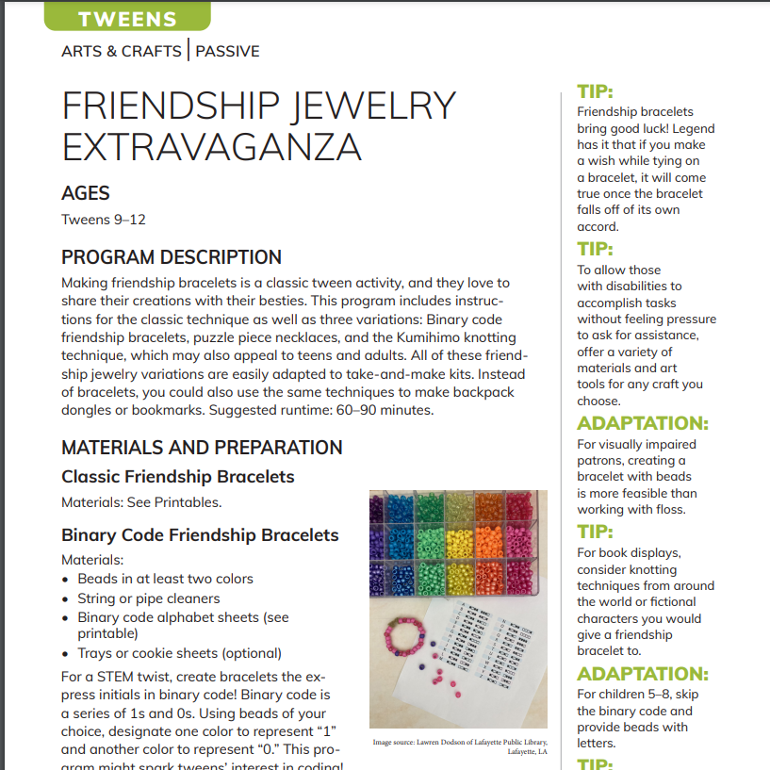
Teen Programming Example – Friendship Jewelry Extravaganza
How can you adapt this activity?
Will you mail materials to registered participants?
Will you offer this activity as a passive program in your library?
Notes:
LaShawn

Slide 12
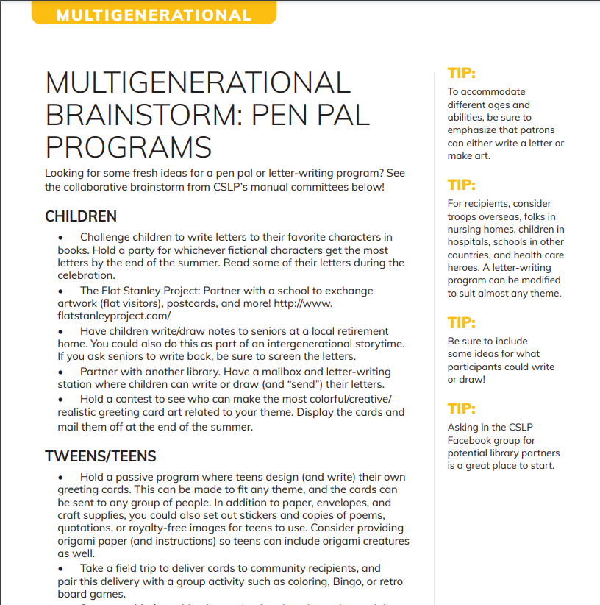
Multi-Generational Programming Example – Pen Pal Program
How can you adapt this activity?
Will you mail materials to registered participants?
Will you offer this activity as a passive program in your library?
Notes:
LaShawn

Slide 13
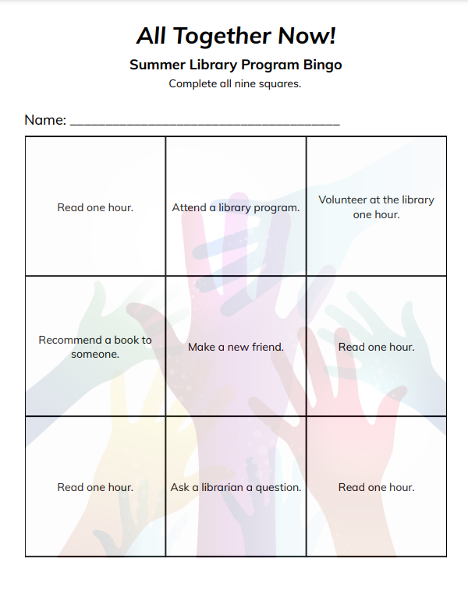
CSLP Printable Example
Notes:
LaShawn

Slide 14
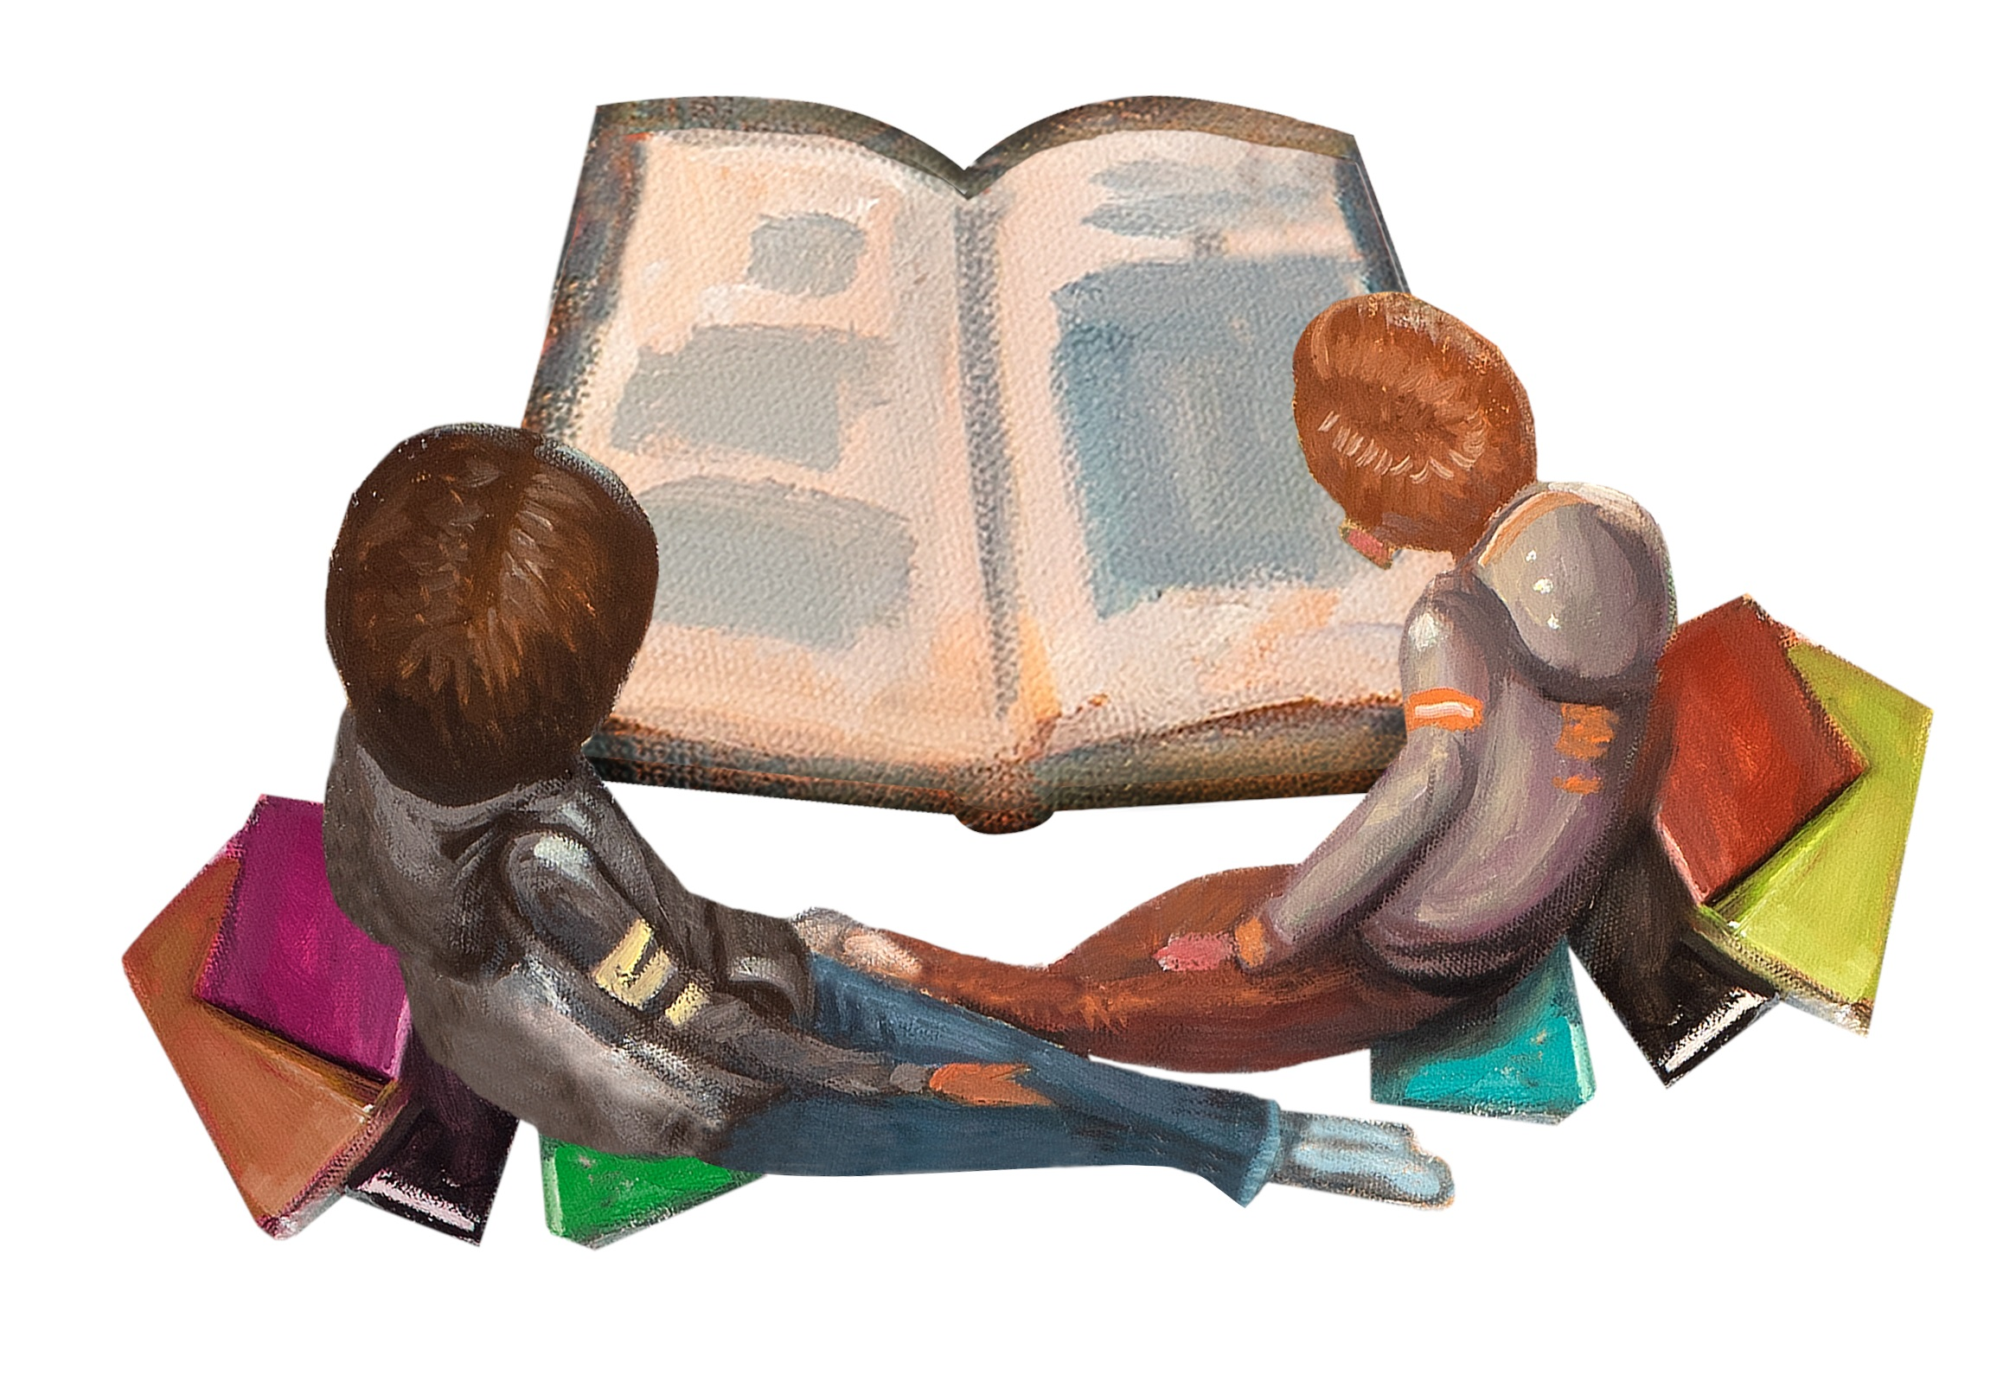
How do we track books read?
Spreadsheets
Book Logs
Beanstack
Notes:
Mary Beth

Slide 15
Beanstack
Notes:
LaShawn

Slide 16
Notes:
LaShawn: Example of Promotional mailer from last year’s summer reading program.

Slide 17
What has worked well for your SR Programs?
Notes:
Mary Beth and LaShawn Examples of what has worked well in our programs or not.

Slide 18
I want to host a Summer Reading Program at my library. How do I get started? Where do I begin?
Email Donna Koh @ doko@loc.gov to confirm your library is participating.
Decide on a tracking method and what you will track.
Promote the program!
Determine prizes.
Notes:
Mary Beth~ program can be adapted to be more advanced but for first timers this can be a base.

Slide 19
Questions?
LaShawn Myles
lashawn.myles@maryland.gov
Mary Beth Parks
parksm@mylamp.org
Notes:
Both

