Slide 1
Podcasting 101
A basic beginner’s guide for libraries

Slide 2
Getting Started!
Notes:
Welcome to a Basic beginner’s guide to podcasting for libraries. That audio clip you heard at the beginning was the opening of my show, Craig’s Desk. Thanks for listening. That’s my catch phrase for each show’s episode. Before we begin, a little bit of background. I sent an email around to the Southern Conference listserv asking who or what other libraries had a podcast. I got mostly crickets back at me. Then I expanded that to the rest of the Regional Libraries where I got a couple of responses but not much else. My main focus was to get information together to start a podcast network for NLS libraries. A place or a way where we could share our shows across the network, country and galaxy with anyone who wanted to hear stories or information from anywhere our network touched. When we realized there weren’t many doing this, we thought, why not? Let’s create some kind of crash or lightweight course in how to podcast for libraries. So here we are.

Slide 3
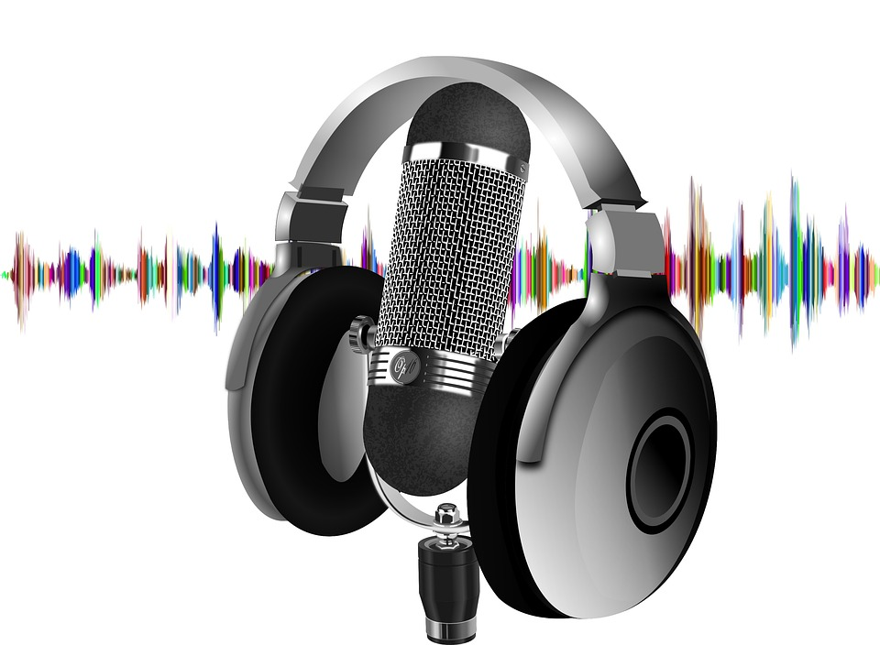
What is a Podcast?
On Demand Programming that can be accessed via smartphone, tablet, or computer.
Similar to old time radio programs, these tend to be episodic and informational as well as entertaining.
Notes:
A podcast is an audio program of some sort. It is much like a radio program that is usually episodic. It can be some informative like learning to speak a new language (i.e. Coffee Break Language Series), news and information from the library, book reviews and such, or it can be a fun way to entertain listeners with programming. The type of “radio” program you make available will be intended for your purpose. Unlike a live radio program on a radio station, it is recorded so you can listen to it whenever and wherever you choose. Most people subscribe to them on smart devices using podcasting/pod catching apps, but there are people who listen to them solely on a desktop computer using a dedicated software program called a pod catcher

Slide 4
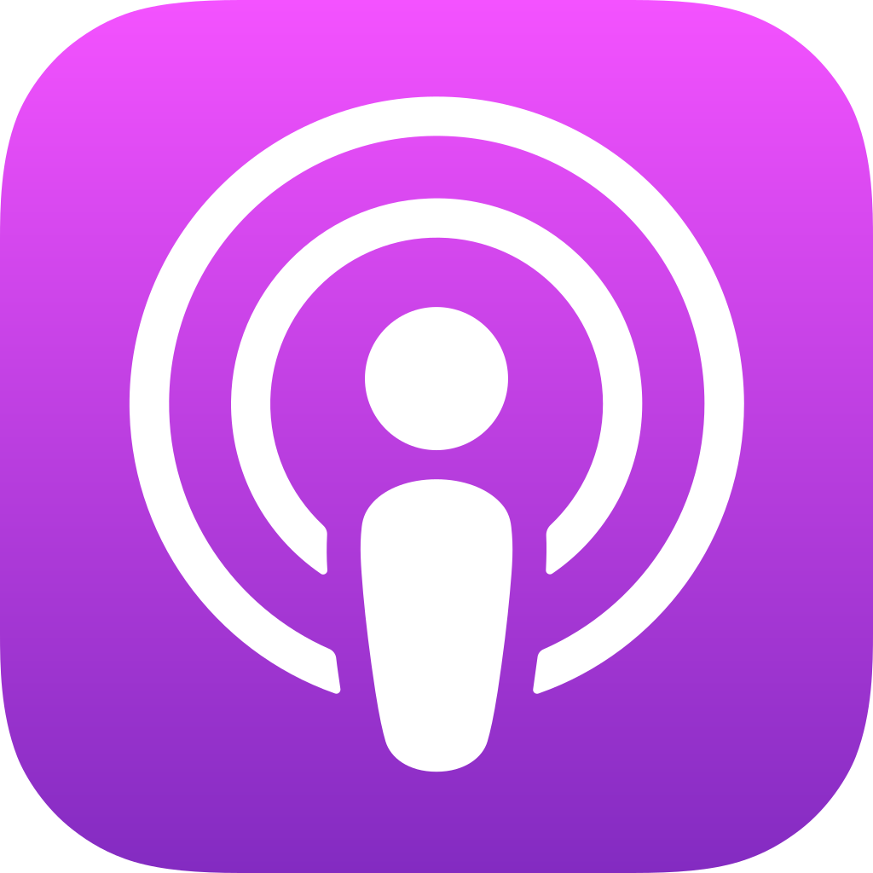
What is a Podcatcher?
Program or application that allows someone to listen to a podcast.
Examples:
Google Podcasts
Apple Podcasts
Stitcher
Amazon Music
Spotify
Notes:
A pod catcher is a program or app for receiving and listening to podcasts. Podcasting apps made for mobile devices, like Apple Podcasts, Spotify, Stitcher and even Amazon Music, are mobile pod catchers. For standalone desktop and laptop computers, dedicated pod catching software is used, so that you can sit in one place and listen. These pod catchers are more single purpose programs with less features than their mobile counterparts. Some accessible standalone podcatching programs that work well with Windows 10 include Accessible Podcatcher, gPodder and QCast.

Slide 5
Terms to Know:
Podcast Channel
Podcast Platform/Host/Provider
RSS Feed
Digital Audio Workstation
Mix Down
Bed
Frequency Response
Gain
Waveform
Pop-filter
Notes:
Podcast Channel
A designated place that acts as a website for your podcast. Here you can upload your podcast episodes and people can access your podcast. A channel is kind of like a radio station on a radio network. It’s the place where people connect their virtual radio and tune into your podcast. Where it all originates. - ceh
Podcast Platform/Host/Provider
Your podcast will be hosted by a podcast platform provider. There are many different ones to choose from. When starting out, you will probably want to go with a free provider rather than a free trial of a provider. This will allow you to experiment and test out your show, without having to worry about time constraints. Some easy to use and free to use podcast platform providers include PodBean, Buzzsprout, and Anchor. - ceh
RSS Feed
RSS stands for Really Simple Syndication. This is a way of getting your podcast episodes “broadcast” to alert listeners about new episodes. An RSS Feed’s update is a way for listeners to find the latest episodes of your podcast.
Digital Audio Workstation or DAW
A DAW or Digital Audio Workstation is a piece of audio production software used to record the audio of your program and put all of the pieces (dialogue, music, announcements and such) for your podcast together. These include audio recording programs like Adobe Audition, Audacity, Sound Forge and even Hindenburg. - ceh
Mix Down
A mix down is basically the completed and “mixed together” version of your podcast episode using all the pieces of audio that have been separately recorded, put together, cleaned up and then exported as a final version of your show. This mix down exported audio file should be an MP3 audio recording, so that it is compatible with your podcast platform. - ceh
Bed
A bed is usually a piece of music that you run underneath someone talking as background material. For this kind of music, you generally won’t be able to use commercial tracks due to copyright issues. If you are fortunate enough, you may have a friend or family member who could write and compose some music for your show. For most, YouTube is a good resource for some free, community commons music and sound effects. One such place on YouTube is the channel Keep Calm and Podcast. Here there is music organized by theme and musical genre. This is a good place to start. The website Zap Splat.com has some interesting sound effect tracks to use, if you want to incorporate some of nature into your shows. This brings up to something you could call a bridge. Think of a bridge as a connector between segments in a show. Music and sound effects can be used as transitions or a bridge from one section to the next. - ceh
Frequency Response
Gain
This is in reference to the sensitivity of your microphone, so the gain is what you use to adjust the sensitivity. Think of it as turning up or down the volume of the recording as you record it. Add gain to get a stronger signal, reduce the gain to get a weaker signal. This can be as simple an action as turning up or down the main volume on your computer or running your microphone into a mixer box where you can control all kinds of different audio frequencies or the high and low parts of the audio you hear. The goal is to adjust your gain levels before you start recording, not during. - ceh
Waveform
The waveform is the display you see on your DAW of how your audio is recording. You will see peaks and valleys that show you how loud or soft your audio is. Also, any noise in your recording will be displayed for you. This will help to see any issue with your recording and give you an idea of what needs to be cleaned up in your final version. - ceh
Pop Filter
A device placed in between the front of the recording microphone and the narrator’s mouth that helps eliminate the natural pops and clicks produced while someone speaks. This can aid in reducing the amount of audio cleanup to produce the final show. - ceh

Slide 6
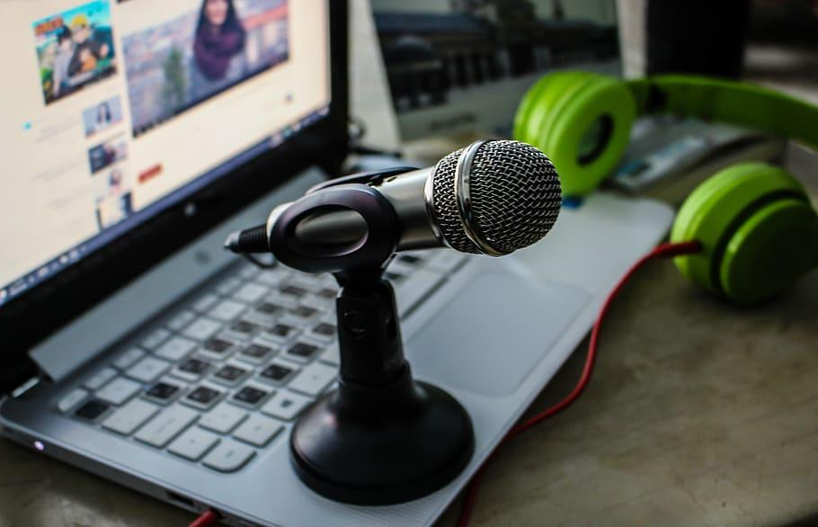
Hardware
Computer
Microphone
Ribbon
Condenser
Dynamic
Headphones
Notes:
For computer hardware, you will need a computer itself, some sort of microphone to record audio and some way to adjust the volume (or what’s called gain) on the microphone itself. One other piece of “hardware” for this purpose would be a quiet place to record your audio. This will act as the “booth” for your recording. Your setup can be as simple as an ordinary laptop and an inexpensive $30 USB microphone to something higher end like a dedicated desktop workstation computer, with what’s called a USB mixing interface and a top end condenser microphone
Ribbon Microphone
A ribbon microphone is quite rare outside of a professional audio studio setup. A high-quality ribbon mic can capture the most faithful representation of sounds – for example, voices and instruments – but their delicacy and need to be perfectly positioned means that ribbon mics are not suited to live or recording environments where they could be knocked and the ribbon damaged. These are typically the most expensive microphones. - ceh
Condenser Microphone
A condenser microphones picks up sound waves with the diaphragm of the microphone and then converts them to an electrical signal. These are used mainly by voiceover artists and in film conditions. They usually require external power, and microphone placement is critical to a good result. The main advantage they have over other types of microphones is their sensitivity to tone and amplitude, resulting in faithful rendering of the voice and many stringed musical instruments, like the acoustic guitar. These are ideal for audiobook production where voice actors portray different characters. The main drawback is that their sensitivity means they often pickup feedback and other unintended sounds. Therefore, they are normally used in very quiet environments like recording booths. These are generally more expensive than dynamic microphones. - ceh
Dynamic Microphone
A dynamic microphone uses air pressure to convert sound waves into electrical signals by moving a coil inside a magnetic field. Dynamic Microphones are typically used when the sound source is quite loud, for example in a live performance, or when it is important to severely reduce ambient noise or loud sounds from the sound that you wish to capture or record. These are not as sensitive as condenser microphones, but because of this they are a first choice of radio studios, theater stage productions and podcasting or live streaming setups. These are generally the least expensive microphones. - ceh

Slide 7
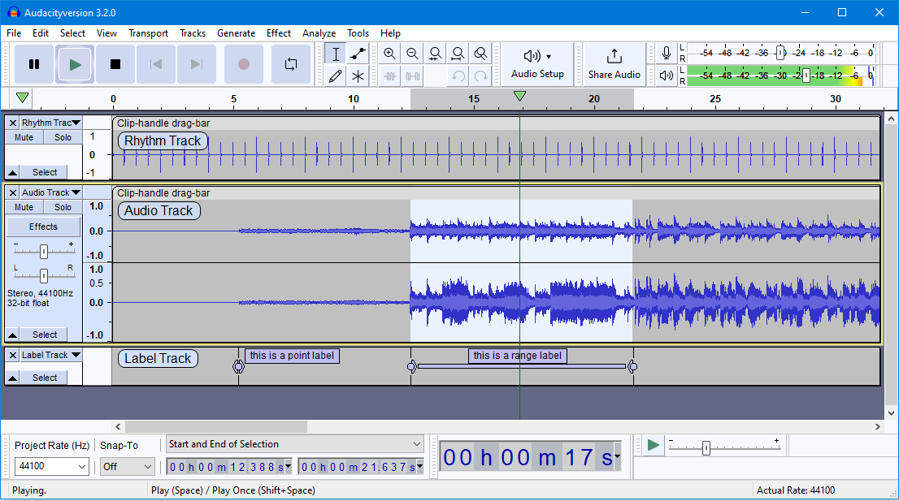
Software
Digital Audio Workstation
Examples:
Audacity
Adobe Audition
Sound Forge
Adobe Premiere
Hindenburg Audio
Notes:
When you start recording you will need some sort of software that will take your recordings from your microphone and create audio files from them. Out of the box, you can record audio as files using the built-in audio recording program in the computer. While this is ok, it is recommended you record your audio program and edit your podcast using something called a Digital Audio Workstation or DAW. This is a fancy term for a piece of audio recording software that can record, edit, clean up audio and create a final production of your audio podcast. It is a workstation where you can create a completed audio production. Many podcasters use a free piece of audio recording software called Audacity. It offers lots of audio cleanup tools and it will let you build and export your show. The interface is simple and is good for beginners. As you get more experience, paid tools, like Adobe Audition or Sound Forge, become more useful with the addition of templates and other advanced features for creating completed audio programs. Even Hindenburg has some useful tools for audio cleanup built in if you are currently using it in your studio. With the pandemic more and more of us are using online meeting software like Zoom. Zoom can be a recording platform also.

Slide 8
Recording “Booth” & Cloudware
Dedicated Quiet Space to Record
Examples:
Bedroom closet
Quiet Office
Recording Booth
Car
Cloudware to upload the podcast to:
Anchor.FM
PodBean
BuzzSprout
SoundCloud
RSS.com
Resonate
Notes:
One additional piece of “hardware” separate from your computer would be where you record your podcast. This is the area known as your recording “booth”. This can be something as simple as a bedroom closet filled with hanging clothes to deaden the sound to a fully soundproof narration booth. The main purpose is to have a quiet noise free place to record just your voice or any audio using your microphone.
Podcasting cloudware can allow you to edit and make changes to your uploaded audio within the cloudware itself.

Slide 9
Accessibility
Create transcripts for DeafBlind:
Script dialog
YouTube
HappyScribe
Adobe Premiere Pro
Otter.AI
Notes:
Captioning is an advanced step for accessibility because by captioning your show it will allow your show to be played live by someone who is deaf or hearing impaired, coordinating the spoken audio with written text in real time.Online programs like Happy Scribe or paid programs like Adobe Premier Pro, can take the transcript you’ve created and convert it to what’s called an SRT file (SubRip Subtitle file). This SRT file will then be uploaded to you podcasting platform for use as captions for your episode. One advantage of a paid software program like Premier Pro, which are often also designed for video, is they usually have a way to create captions if needed or wanted.

Slide 10
Get Recording!

Slide 11
Finding Your Idea
Start Small: programs/events
Invite guests
What story can you tell?
Notes:
So now you know you want to create a podcast, but before you can create the podcast you need to figure out what you want to record. What story will you tell? What helpful information will this bring to an audience? Is there a gap in offerings that you could provide as a recorded program? - ceh
The best ideas come from all around you. Whether you are already producing something, like a library newsletter or maybe a monthly book list, that could be a good starting point. Beyond this, is there some sort of inspiration around you? Look around. Listen. Something will probably spark an idea. - ceh
Your podcast is a reflection of you and your library. What are you known for? Do you have a large patron-base or a small one? Size matters not, but content is king. Do you have original content? - ceh
You may want to start small and record programs and events, using the same concepts presented. This would become a kind of event and program podcast. One advantage can be, if you regularly have events and programs, you are constantly recording and adding content

Slide 12
Creating the Show
Time Investment
Weekly/Monthly/Quarterly
Finding guests/scheduling
Artwork
Canva
Adobe
Building your script
Intro
Outro
Dialog
Notes:
What is your time investment?
The time needed will be up to how detailed and long each episode will be. It’s suggested to write a script to keep things organized and so that you have a plan in place once you are ready to record your audio. - ceh
You also may want to plan for some artwork for your podcast and time to put it online. This is a marathon. Put things in place well and you won’t have to redo things. Although, a podcast is an evolving creature. Over time you may find other artwork and music from other podcasts that inspire you to go in a different direction. - ceh
When building your script, depending on the theme or content of the show, How long will it take to gather the information you need related to what you cover? How long will it take to read all of the book reviews you have? What are your sources? How often does information update? How long will it take to read lists? Do you solicit questions from patrons as part of your show? These are some things to think about. For this you may want to anticipate that the first episode will take longer to develop because this is your entry point. - ceh
A regular-recurring time commitment comes down to how long it takes to write a show script (or improvisation in the booth). If what you offer is timely, when do you decide you have what you need to write your script? You may want to keep the show short to start and then expand. The focus when starting out should be to create something that your user/listeners like. This will build a base of listeners. - ceh

Slide 13
Marketing

Slide 14
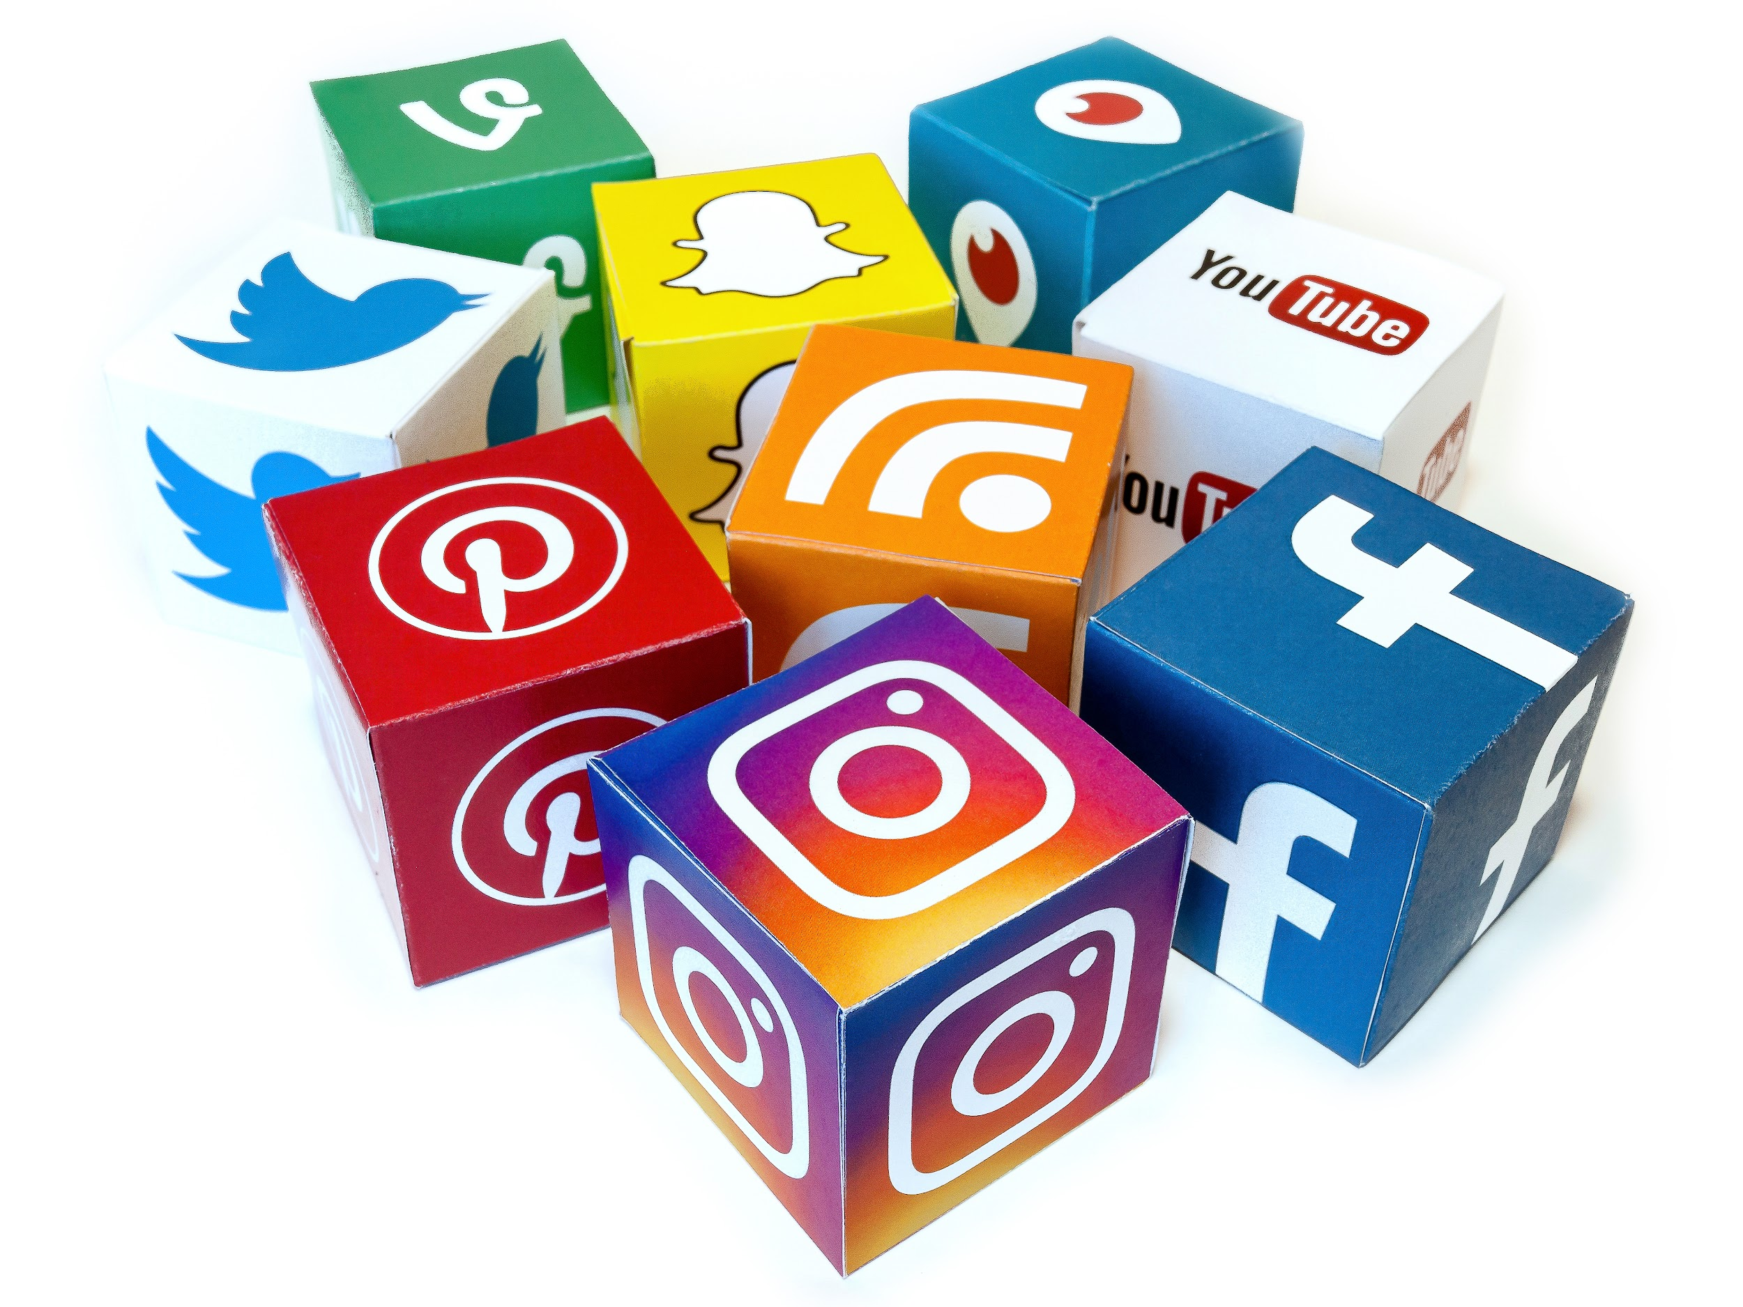
Marketing the Show
Social Media
Newsletters
Phone messages
Flyers
Book Cartridges
Newsline

Slide 15
Contact Us
Craig Hayward, MLIS
Systems and Digital Services Librarian
State Library of North Carolina
Accessible Books and Library Services
984-236-1100 | craig.hayward@ncdcr.gov
Andrew Russell
Recording Studio Manager
Maryland State Library for the Blind and Print Disabled Maryland State Library Agency
410-230-2433 | Andrew.Russell@maryland.gov
Ashley M Biggs
Marketing & Outreach Librarian
Maryland State Library for the Blind and Print Disabled Maryland State Library Agency
410-230-2430 | Ashley.Biggs1@maryland.gov

