Slide 1
Volunteerism at Your Library
Christine Tuttle
Az1A – Arizona Talking Book Library
Outreach & Community Engagement Librarian
ctuttle@azlibrary.gov 602-926-3354

Slide 2
Gaining Volunteers
Application process
Training
Adventures with a new volunteer
Continuous training
Co-training with collaborate organizations

Slide 3
Making Volunteering Inclusive
Outreach Ambassador
Purpose
The Outreach Ambassador establishes initial contact and expands awareness of services that are available through the Talking Book Library. The Outreach Ambassador contacts organizations, either by phone or in person. They provide information about the services provided by the Talking Book Library. Outreach Ambassadors also offer the opportunity for organizations to schedule a library representative to come and speak to a group.
This position is available for any volunteer who does not wish to travel and conducts all contacts by phone or email.
Target subject of business/organizations in a specified field.

Slide 4
Having Volunteering Accessible
Outreach Presenters/Table Event Representatives
Purpose
The Outreach Presenter will be an integral part of our speakers’ bureau. The volunteer is the library’s representative at events such as health expos, community clubs, support groups, workshops, assisted-living homes, nursing homes, fraternal organizations and other venues where healthcare professionals and the community meet. The volunteer informs healthcare professionals and the community about our services, answers questions and distributes library literature.
Lives, works, and participates in their local community. Access to transportation – for Arizona, at least, is a must.

Slide 5
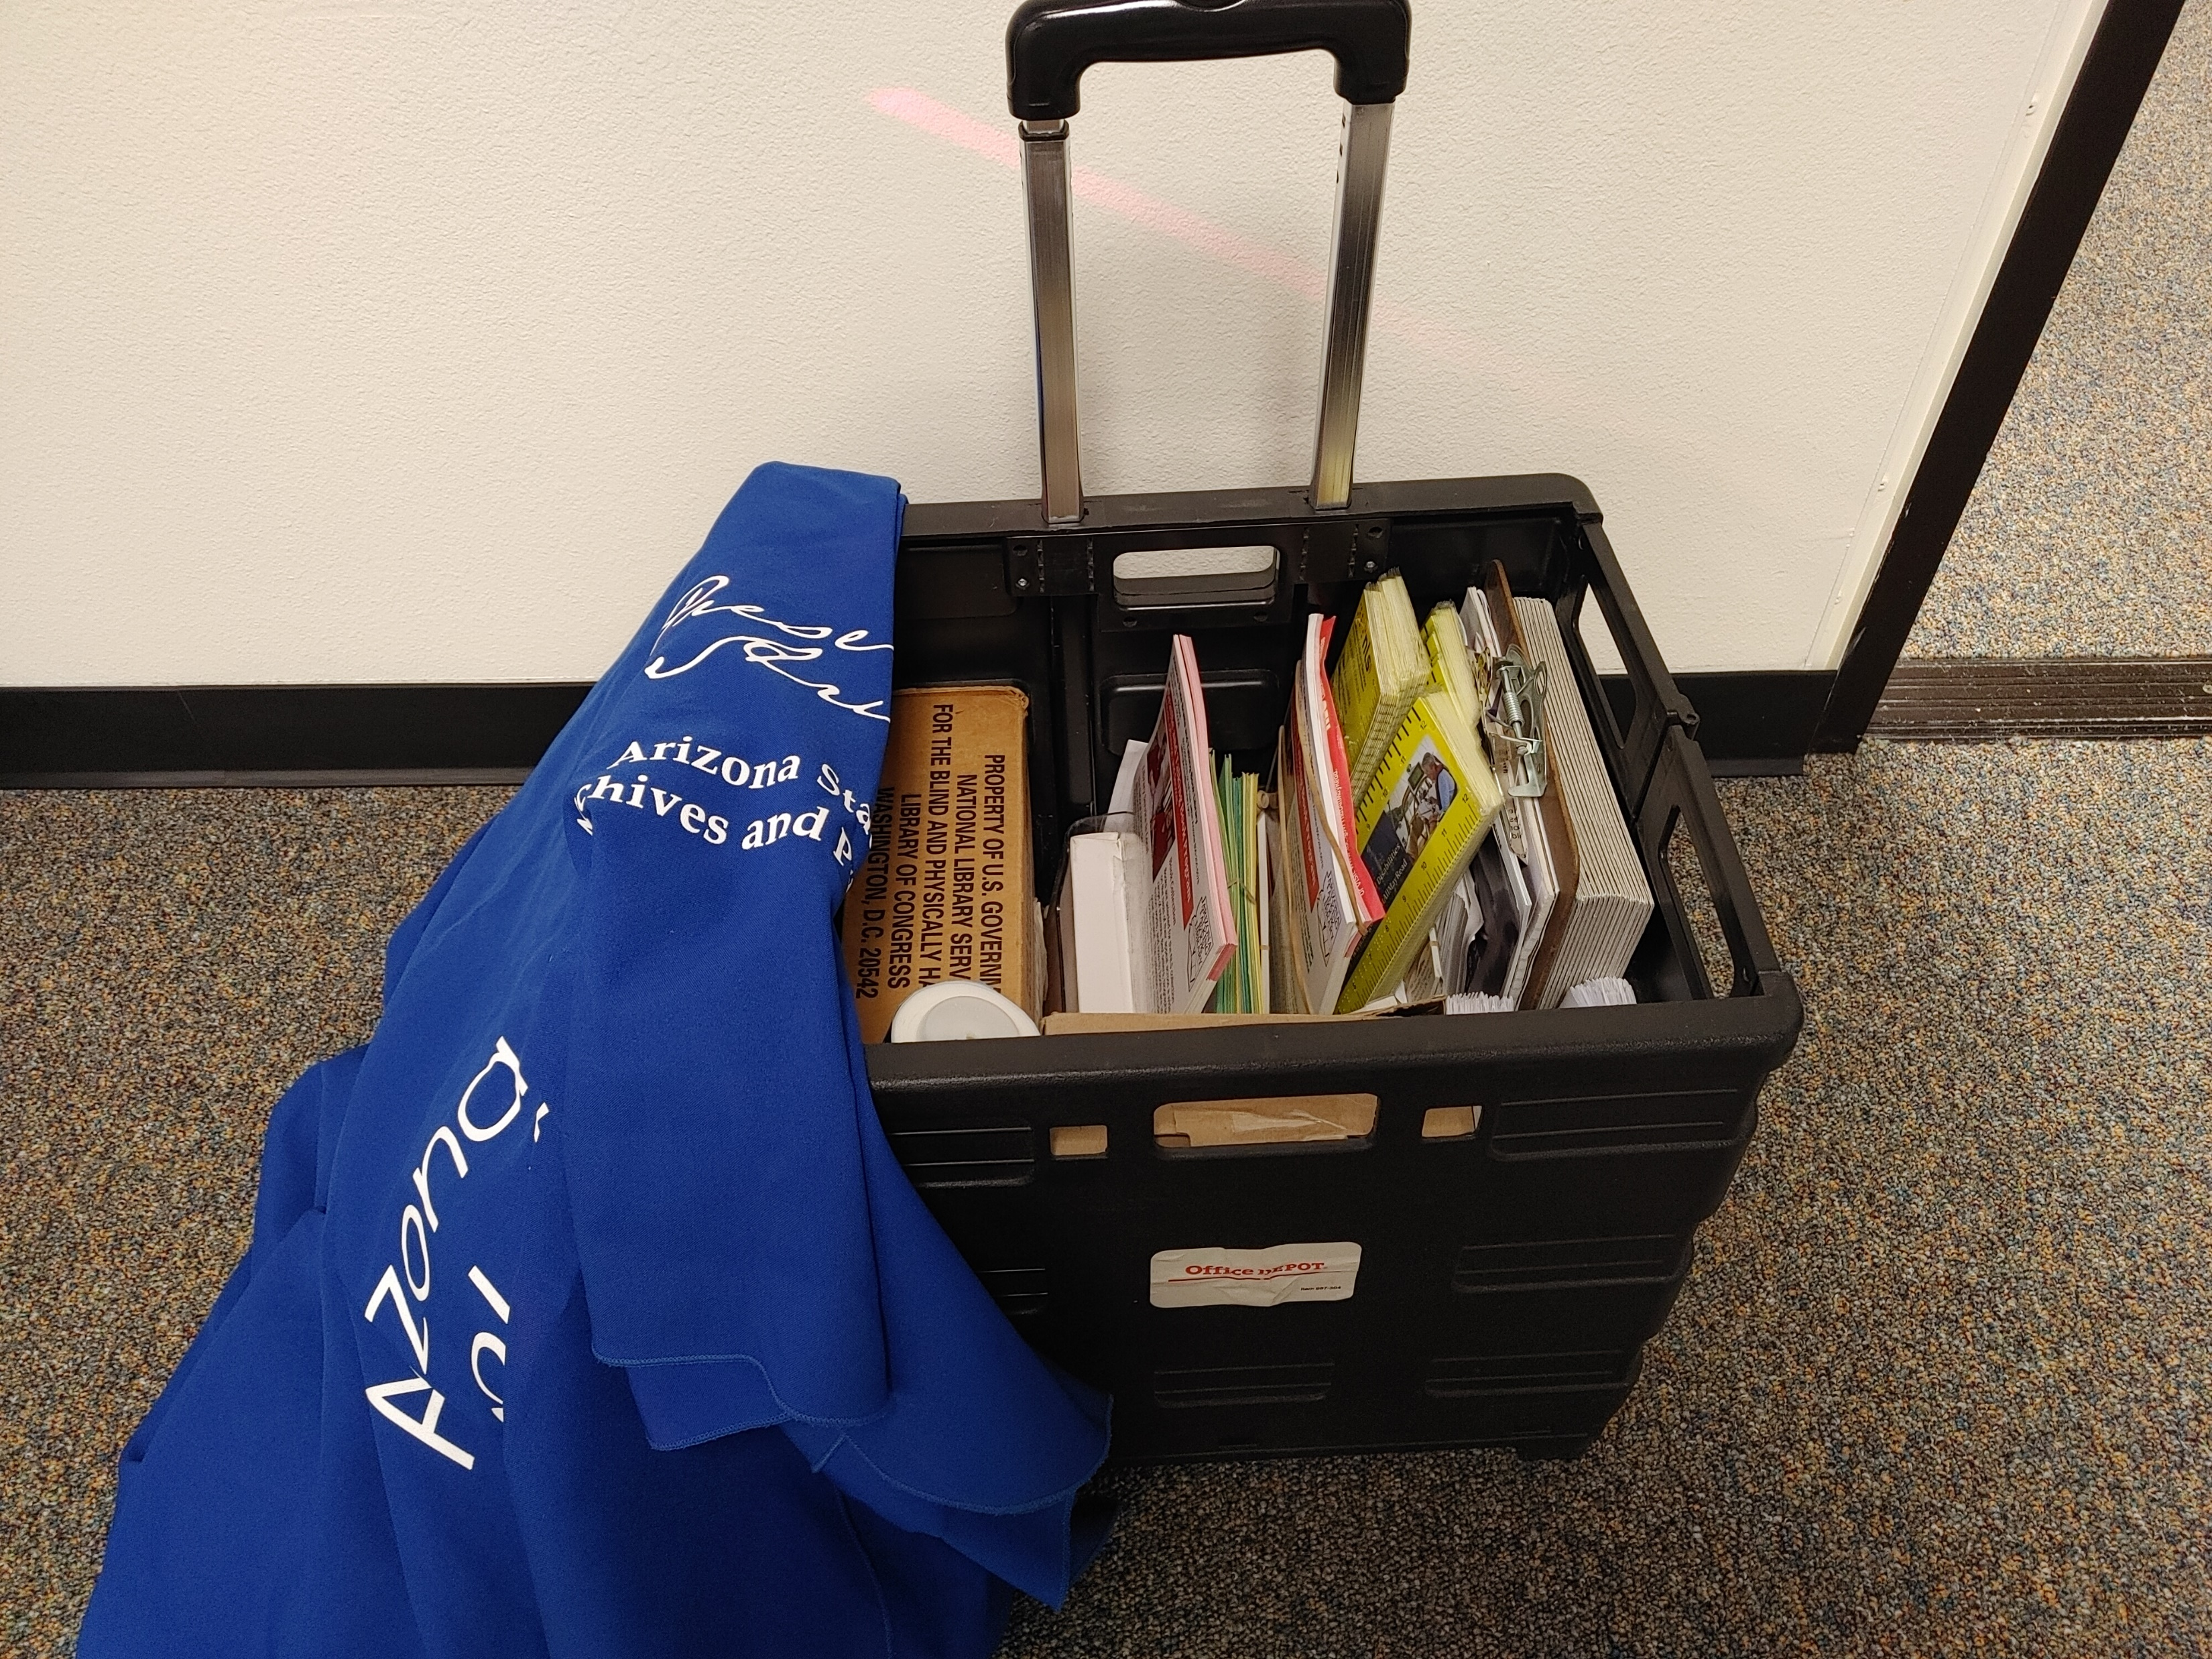
Making the Volunteer Active and Independent
Outreach kit
Online training
USPS materials

Slide 6
Volunteer Reporting
Direct reporting link
https://azsos.libwizard.com/f/atbl_outreach
VicNet/Volgistics reporting software for volunteer including traveling time:

Slide 7
Documentation
Communication with volunteers at least 2x annually outside of trainings – based on last name.
Report back to a volunteer when an ambassador’s efforts come to fruition.
Work with volunteer to provide feedback if an event doesn’t have a good outcome.
Thanking volunteers for taking the time and dedication when volunteering on behalf of the library. Thank you notes in print and braille!

Slide 8
Final Thoughts
Start Local
Start with library members
Advertise in newsletter/social media
Borrow manuals/documentation from colleagues
Have fun and ask volunteers on how to improve the program
Accept failures – you learn so much from them
And my favorite question from the public…Who are you again?
I’m Christine Tuttle – Outreach Librarian – from the Arizona Talking Book Library and it was my pleasure meeting with all of you today.

Slide 9
Hello Friends!
Christine Tuttle
Arizona Talking Book Library – Az1A
ctuttle@azlibrary.gov
602-926-3354 Direct
602-255-5578 Main
Please stop by for a tour!

