Slide 1
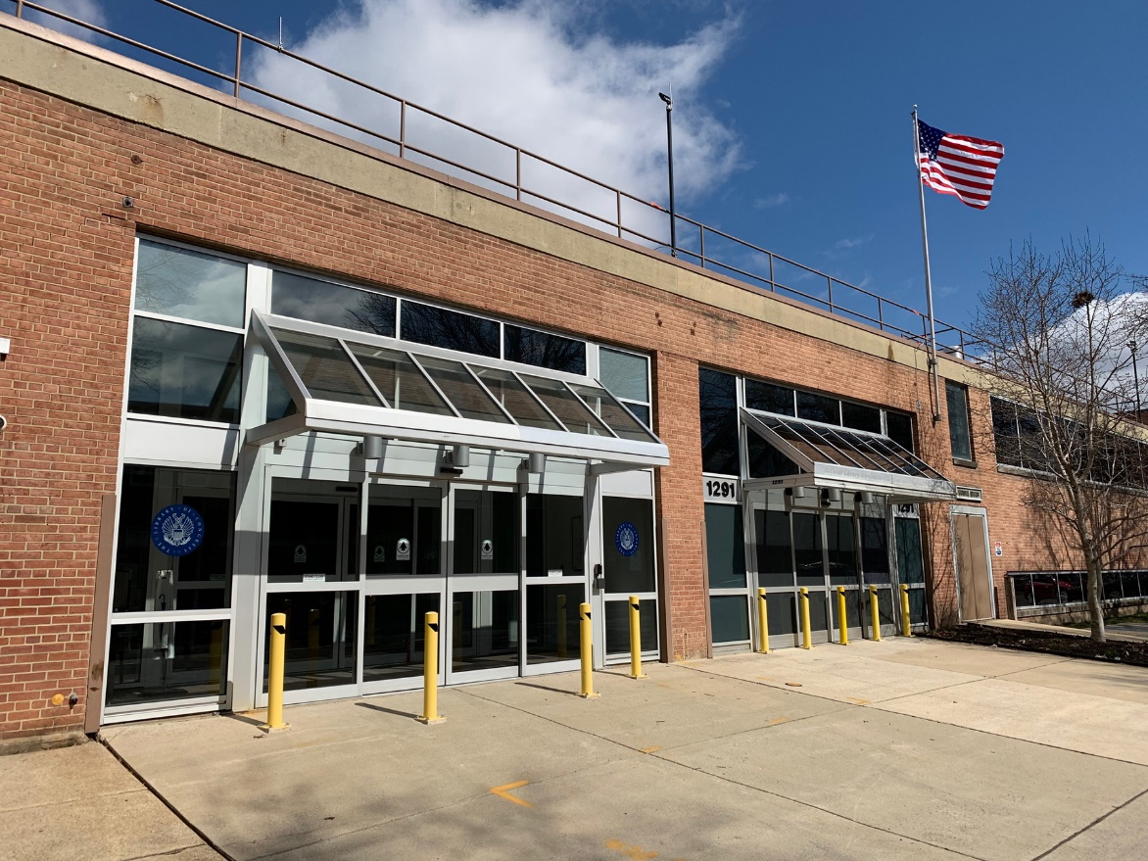
NLS 2019

Slide 2
Future Access Reimagined (FAR)
Connected digital devices
Voice User Interface
Digital delivery direct to connected devices
Digital braille program
Patron base doubled with inclusion of people with print disabilities

Slide 3
Marrakesh Treaty Implementation Act
Signed into law October 9, 2018
Goes live for U.S. May 8, 2019
Amends Chafee Amendment 17 USC 121 and 17 USC 121a
Impacts on NLS program
Music and dramatic works no longer need copyright clearance
Changes “specialized format” to “accessible format”
Defines “accessible format” as “alternative manner or form that gives a … person access to the work … as feasibly and comfortably as a person without such disability …”

Slide 4
Marrakesh Treaty Implementation Act, cont.
Defines “eligible person” as someone who
(A) is blind;
(B) has a visual impairment or perceptual or reading disability that cannot be improved to give visual function substantially equivalent to that of a person who has no such impairment or disability and so is unable to read printed works to substantially the same degree as a person without an impairment or disability;
(C) is otherwise unable, through physical disability, to hold or manipulate a book or to focus or move the eyes to the extent that would be normally acceptable for reading

Slide 5
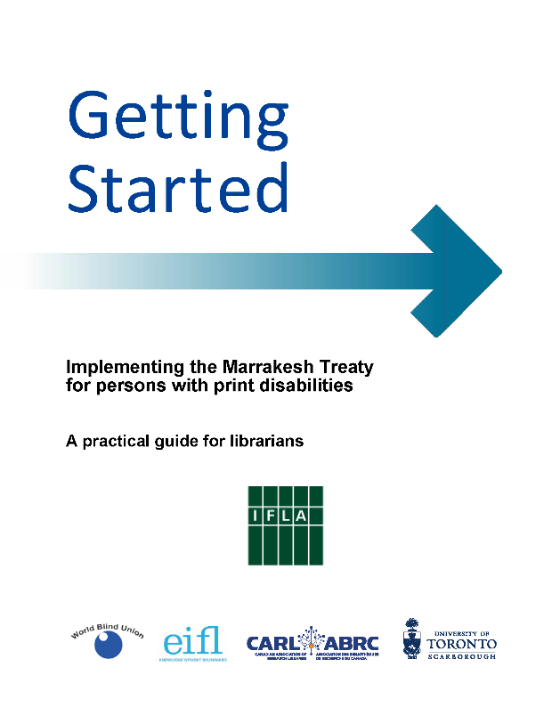
Marrakesh Treaty Implementation Act, cont.
Defines authorized entities
Permits import and export across borders within Marrakesh community
Notes:
Cover of “Getting Started: Implementing the Marrakesh Treaty … A Practical Guide for Librarians”

Slide 6
Legislative initiatives
Have been requested—are not yet implemented
Consolidate NLS funding legislation to make it more coherent
Conform funding legislation to match MTIA definitions
Authorize import and export of titles in digital formats
Authorize access to Universal Service Funds to support digital delivery

Slide 7
Eligibility certification
Defined in regulations
Plan to expand when NLS is able to increase capacity

Slide 8
NLS funding requests
BARD infrastructure build-out to support increased use
Braille eReaders

Slide 9
NLS name change
Consultation with LoC leadership

Slide 10
Braille eReaders
Contracts for two vendors
One year for development
Begin field pilot spring of 2020

Slide 11
FY19-20 proof of concept projects
Machine inventory
Smart devices
Voice User Interface
Gallup survey

Slide 12
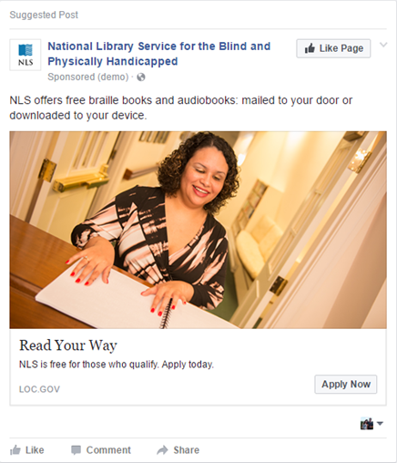
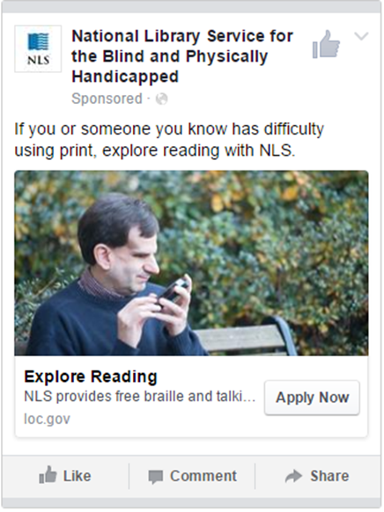
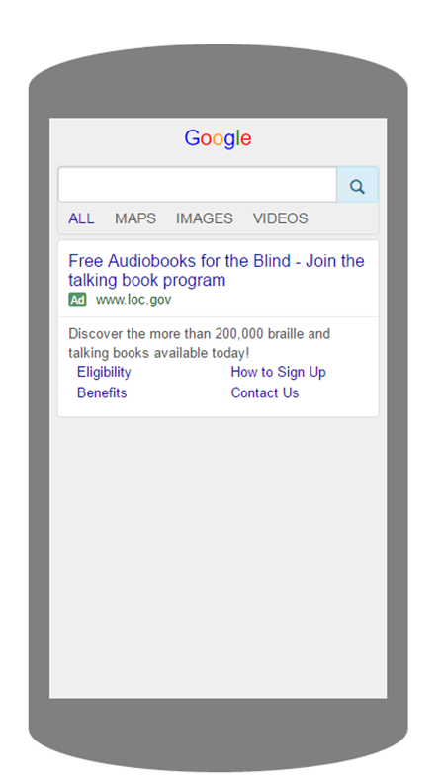
Outreach campaign
Notes:
Examples of two Facebook ads and a keyword search ad on a mobile device

Slide 13
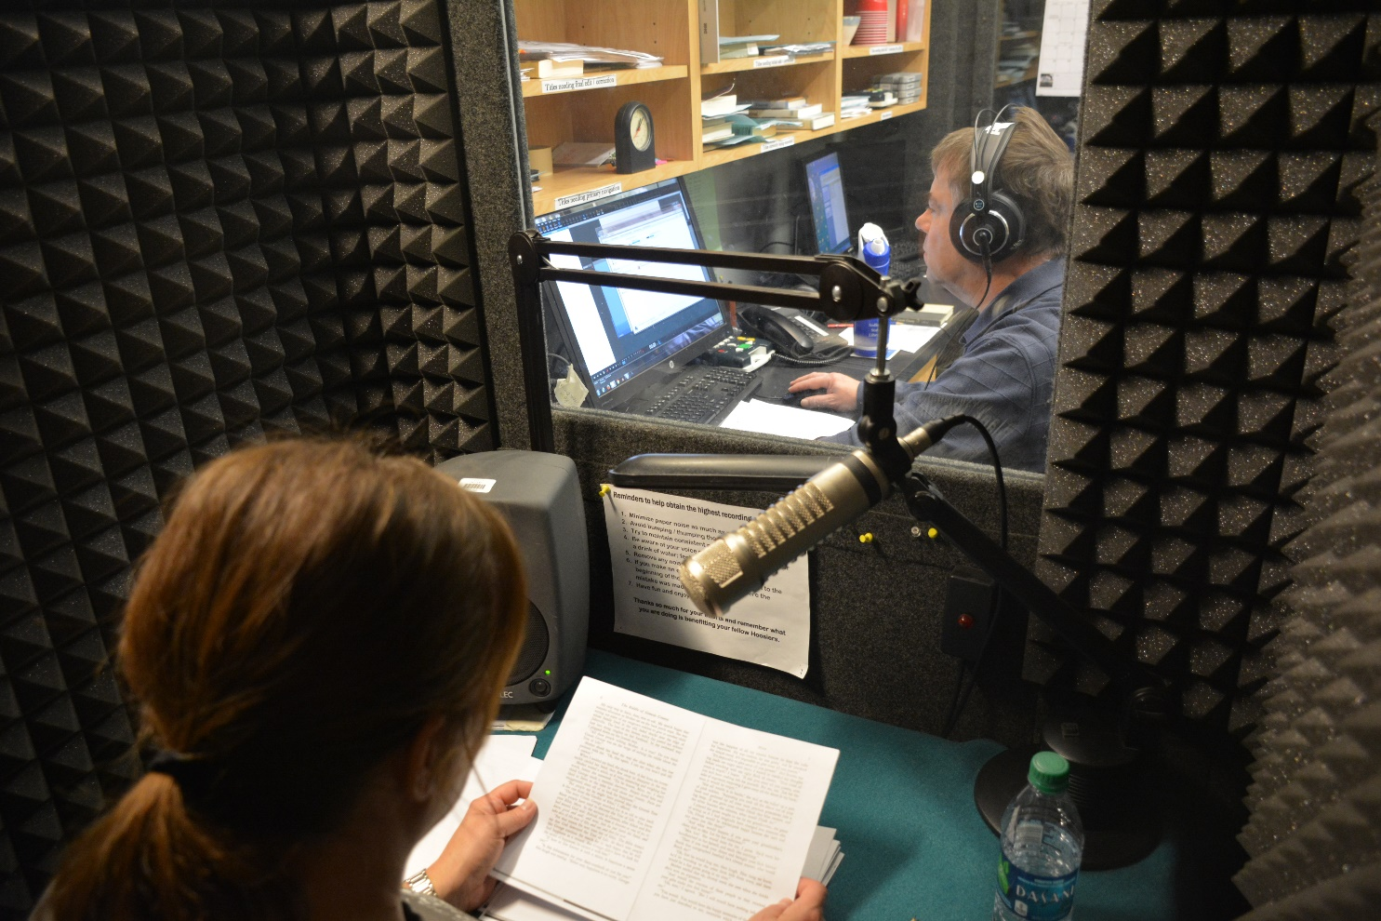
Local books on BARD
Notes:
Volunteers for Indiana Voices, part of the Indiana Braille and Talking Book Library, work on a talking-book recording of “The Riddle of Genesis County.”

