Slide 1
Notes:
Hello/Welcome/This is us

Slide 2
Educational Technology for Accessibility NYCDOE Staff Training Overview
Universal Design for Learning, Instructional Technology, and Accessible Educational Materials
UDL as the framework for high-quality Tier 1 instruction
Federal, state and local policies around AEM
Determine AEM eligibility by exploring resources to support school teams in the decision-making process
Proficiency with AEM resources that provide AEM
IEP documentation
AT as it relates to AEM
Educational technology tools to support strategic planning of instructional opportunities for all students
Session 1 | Session 2 | Session 3 | Session 4
Accessible Educational Materials (AEM) | AEM and Instructional Technology (IT) | AEM and Assistive Technology (AT) | Providing Universal Access to Print
Special Education Office
Literacy & Access
Notes:
This is the course we developed for NYCDOE educators around Educational Technology for Accessibility
This course is based on Universal Design for Learning (UDL), Instructional Technology (IT), and Accessible Educational Materials (AEM). It is designed to build upon participants understanding of UDL as the framework for high-quality Tier 1 instruction, while developing knowledge of AEM, which is the conversion of print instructional materials into specialized formats (braille, enlarged print, audio or digital texts) for eligible students. Participants will develop an understanding of federal, state and local policies around AEM. Participants will identify who requires AEM, utilize tools and resources to support school teams in decision-making, develop proficiency with resources that provide AEM, practice documentation on the IEP, and understand AT as it relates to AEM. Additionally, participants will become familiar with educational technology they can leverage to support strategic planning of instructional opportunities that will foster accessibility for all students.

Slide 3
Educational Technology for Accessibility Successes
Cross departmental partnership
Literacy & Access and Center for Assistive Technology
Increase in educator:
awareness and proficiency with educational technology
ability to critique technological tools
Bookshare accounts
Talking Books/BARD accounts
knowledge of reading intervention programs
level of involvement in AEM and AT decision-making process
Collaboration with Bookshare
Collaboration with NYPL
Trainings model best practices utilizing UDL framework
Educational Technology for Accessibility 201 coming soon!
Notes:
Crystal
Cross departmental partnership between Literacy & Access and Center for Assistive Technology to provide a training that focused on best practices instructionally with the integration of technology as additional points of access to curriculum
Increase in:
educator awareness and proficiency with educational technology (IT, AEM, AT) to support all learners
educator proficiency to critique technological tools and determine the appropriateness based on individual student needs
educators with a Bookshare account
educator awareness of reading intervention programs
educator level of involvement in AT decision-making process
Collaboration with Bookshare to generate NYC specific requests
Core Curriculum, Lexile Leveled Lists, LLI kits, videos, quick reference resources
Collaboration with NYPL to train teachers in free digital resources
Trainings were designed to model best practices with UDL integration
Based on this year’s success and participants feedback we will continue to support our educators with additional PLO
AEM Training 201 is currently in development and will continue to support our educators. This course will be based on participant understandings gained in 101 and will provide opportunities to continue developing knowledge of educational technology to support all learners in the classroom. Additionally, participants will be provided with direct coaching support for planning and implementation of IT, AEM and AT.
1.5 hour Case Study around AEM, 1.5 hour collaborative problem solving for IT tools, 1.5 hour AT presentation and hands on exploration
Add site visits for coaching, develop potential lab sites to foster intervisitation

Slide 4
NYCDOE and NYPL Collaboration
What made this partnership work?
We were lucky that we were put in contact through Bookshare
We were directly aligned in our mission of getting accessible materials to our students and families of NYC
We frequently communicated to collaborate on the development of this training
specifically how to include Talking Books/BARD and other public library resources
Andrew Heiskell Library offered space to host trainings so that our educators became familiar with the space, resources and staff
...it also made it easy for staff to pop in regularly to give talks and answer school-specific questions
Attending trainings at the library also allowed participants to easily sign up for Talking Books/BARD and library cards (this was a required part of the training - and incentivized!)
Offering participants a tour gave them a fuller understanding of the Talking Books library and gave them ideas for future class field trips
We UNDERSTOOD each other’s mission and spent time learning about what each others teams do, and that led to more ideas of how to connect as well.
Notes:
Crystal...Jill
Sooooo you might be wondering how we made this partnership work!
This is how we worked together

Slide 5
NYCDOE and NYPL Collaboration
Continued benefits...
All the places we have highlighted resources at NYPL and Talking Books:
Educational Technology for Accessibility, 2018-19 school year
Everyone Reading Conference, March 2019
Center for Assistive Technology AEM Training, April 2019
Supervisors of Psychologists Training, April 2019
Future collaborations:
Educational Technology for Accessibility, 2019-20 school year
NYCDOE AT Expo
Potential to offer continuing education credits in the future
Notes:
Maricris
This is how we worked together
Educational Technology for Accessibility Citywide PLO-4 session training for 150 educators across all boroughs
Center for Assistive Technology-70 CAT evaluators
Inclusive Schools Learning Collaborative (ISLC)-29 supervisors of psychologists citywide
We are exploring the potential to have NYPL as a continuing education partner to increase awareness of the resources and services that can be provided to students and families along with potential school-library collaborations opportunities

Slide 6
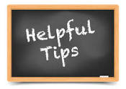
Tips for YOU
1. Contact your local school district and inquire about teacher training opportunities
Assistive Technology Department
Special Education Department
Professional Development Department
School buildings
weekly/monthly professional development meetings
Individual teachers or administrators
2. Spend time talking with your potential collaborators about how your missions align and what you can offer each other
teacher training, demos, space, field trips, etc.
Notes:
Jill
You may want to consider the following departments as an initial point of contact...
- mandated professional development hours

Slide 7
Quotes from NYCDOE Educators
“Thank you for providing us with the information about NYPL resources!”
“The Talking Books presentation was great!”
“I didn’t even realize that there is free coaching for AT users at the library!”
“It was really cool to see the evolution of Talking Books to become digital as BARD!”
“The most valuable part of this professional learning was that we were given tools and supplemental apps that can be used in the classroom for students who are in need of them. I also think that these are great resources to share with my colleagues and administration.”
“I really liked being able to access different technologies and learning about what the library provides.”
Notes:
Maricris (if we have time)
Here are some direct quotes from participants pulled up from the presentation evaluations.

Slide 8
Thank you!
Crystal Stewart cstewart10@schools.nyc.gov
Maricris Formoso-Santos mformoso@schools.nyc.gov
Jill Rothstein jillrothstein@nypl.org
Notes:
If push back around AEM then collect names for Sarah for a follow up

Slide 9
Engaging Youth in Accessible Tech Experiences
Chancey Fleet, Assistive Tech Coordinator at Andrew Heiskell
Himelda Medina Mendez, Tech Volunteer and Visions Summer Transition Counselor

Slide 10
Building relationships
One of our challenges is getting the word out to individual families, so:
We work with community partners!
We attend the DOE’s annual Braille challenge,
We work closely with Visions Services for the Blind, Lighthouse Guild, and other city and national nonprofits.

Slide 11
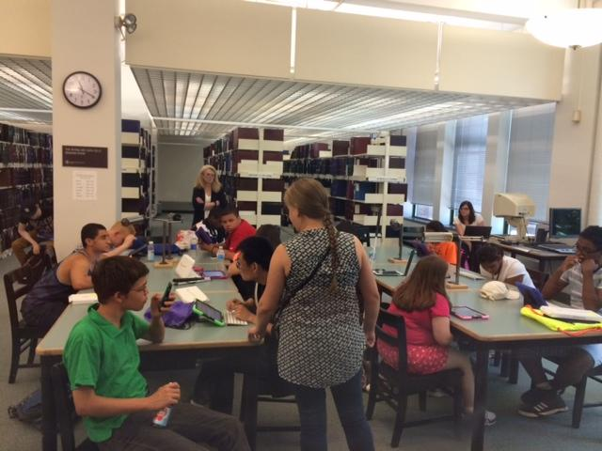
Visions Programs for Youth in Transition
Each summer, we work with 20 to 25 high school students, at the library and at Queens College where they’re based.
We offer intensive instruction in how to use the BARD and Bookshare collections;
An intro to apps for getting around the city, featuring a GPS/computer vision scavenger hunt;
And a gentle introduction to electronics and coding with Arduino.

Slide 12
Meeting our challenges
Youth participants have varying degrees of vision, tech experience and ways of being motivated.
We differentiate instruction by providing detailed outlines for everyone, and working closely with summer counselors to facilitate multiple small working groups.
We’ve learned that 60-minute activities are a great length, and that teaching broad concepts beats hitting every point in a detailed outline.
Our job is to inspire youth to learn more throughout the year with activities that are brief, approachable and compelling.

Slide 13
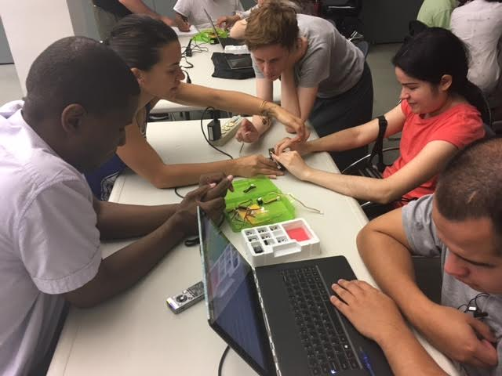
NFB Youth Slam: Contributing to a National STEM Intensive for Youth
NFB programs are open to youth from around the country and attract youth who are already highly motivated in STEM.
A weeklong intensive format allowed us to teach a detailed curriculum culminating in final projects built, soldered and coded by students.
Participating remotely or in person in national youth education helps us learn from our colleagues and broadly share our curriculum and strategies.

Slide 14
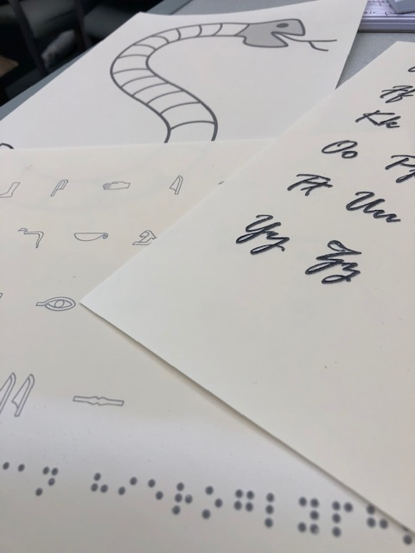
Braille Challenge: Engaging with Families and Educators
Each year we table at Braille Challenge.
We spread the word about physical accessible books, we showcase simple tech for reading (BARD and Bookshare) so that families and educators can get excited to start.
We bring friendly, simple tactile graphics (rocket ships, maps, animals), and accessible drawing supplies.
We want families and educators to remember us as a destination for accessible reading, tech and design.

Slide 15
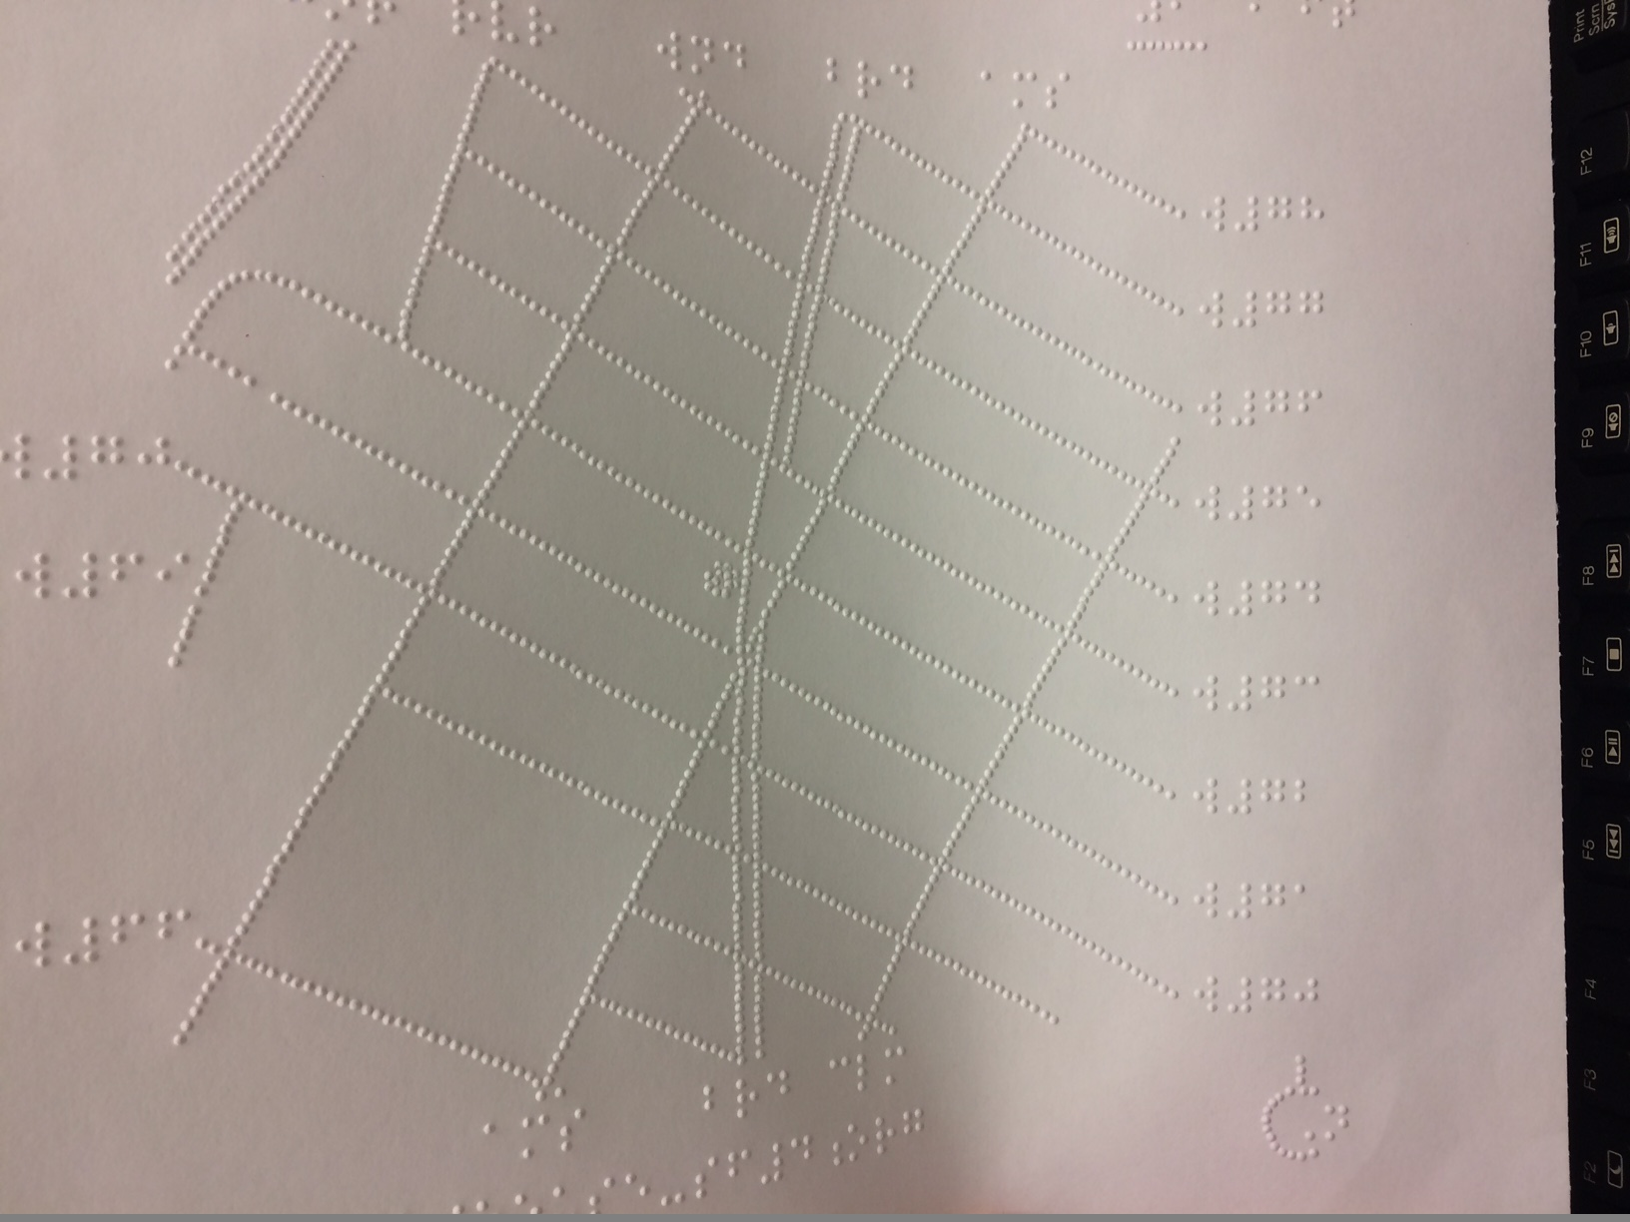
Building strong individual relationships
Offering steady support to O&M instructors, teachers of visually impaired students, students in education and everybody else in the field helps us find referrals and get to know new patrons.
Professionals can participate in tech coaching, make maps and graphics with us, and network with one another.
Once connected with us, families are welcome to participate together in group or one-on-one tech coaching.

Slide 16
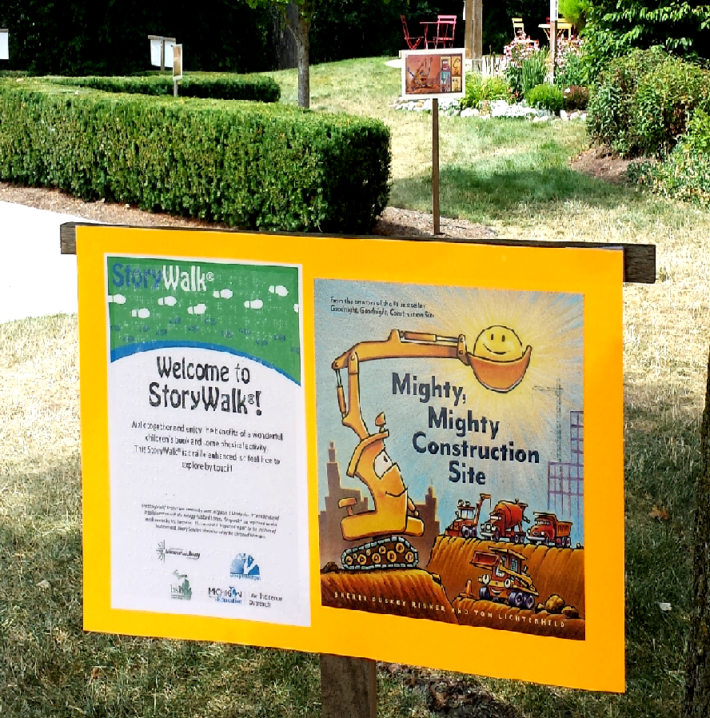
Braille Enhanced StoryWalk® in Michigan
A StoryWalk® is a fun, educational activity that places a children’s story along a popular walking route in your community. A Braille Enhanced StoryWalk® simply adds a braille overlay on the posters. By including braille, the libraries help embrace accessibility and equal access to information, and create community conversations about disability awareness.

Slide 17
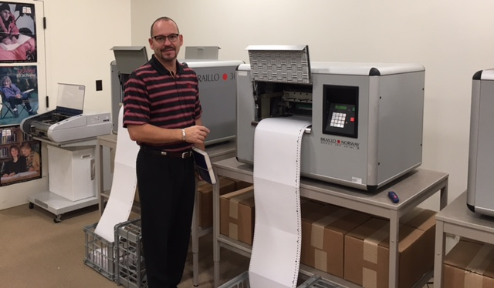
Braille Enhanced StoryWalk® in Michigan
The Team:
Library of Michigan
Department of Education— Low Incidence Outreach (MDE-LIO)
The Michigan Braille and Talking Book Library (BTBL)
Made possible with grant funding from the Institute of Museum and Library Services.
The Process: 5 easy steps!
Book Selections
Library Survey Sign-Up
Purchasing
Brailling / Laminating
Mailing
Notes:
Braill

Slide 18
Braille Enhanced StoryWalk® in Michigan
Survey and Impact Results
2017
100% said it improved their ability to provide services to the public
The combined service areas of all participating locations totals 1,793,850 people!
2018
“Customers like feeling the braille! Even the mounted police officer and her horse checked it out!” -Detroit Public Library
The combined service areas of all participating locations totals 2,636,495 people (and at least one horse)!
2019 in planning process!

