Slide 1
Accessible Technology for Everyone: Teaching Tech at the Library
Chancey Fleet, Assistive Tech Coordinator, and Nefertiti Matos, Tech Trainer, Andrew Heiskell Braille and Talking Book Library
Scott Norris, Adaptive Tech Librarian, BSBP-BTBL

Slide 2
Starting a Tech Clinic at Andrew Heiskell
Started by volunteers with logistical and space support from the library in 2010
Centered on individual goals and exploration
Reference-oriented and sales-free
Everyone is welcome: people with disabilities, family members, professionals
Volunteers work in several languages and we particularly reach out to Spanish speakers

Slide 3
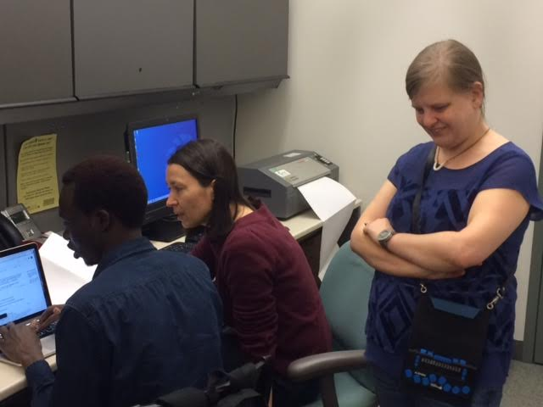
Attracting volunteers and patrons
Publicity: quarterly NewsLion, city and state mailing lists, referrals from professionals, word of mouth
It’s very common for volunteers and patrons to introduce friends and family
Volunteers participate to give back to the community, gain professional experience, meet people and learn new things
Patrons appreciate that we are free of paperwork, free of charge and free of eligibility requirements

Slide 4
Establishing a learning culture
We work with patrons to develop note-taking methods that make them feel confident and secure, from day one. These include print, Braille, typing and recording.
We connect patrons to self-study resources: Hadley Institute, AFB’s Learn NVDA, Typing Club, reference materials particular to software and hardware, and web search strategies.
We encourage patrons to set goals and develop practice habits.
We invite patrons to involve family, home care workers and other allies in their study plan, if they like.
We encourage volunteers to study and strategize together.

Slide 5
Building a community of practice
Volunteers use a shared calendar and documents through GSuite and Dropbox
Volunteers study and strategize together and are encouraged to include time to learn from and with other staff and volunteers
During a quarterly pitch meeting, volunteers propose, outline and assign new workshops
Our tech department is comprised of three former volunteers including our brand new trainer for Spanish-speaking patrons

Slide 6
Welcoming interns from the New York State Commission for the Blind and CityAccess
Interns work with us intensively for an average of twelve weeks.
During their rotation, they shadow department staff, participate in group workshops, learn the tools we use to manage information and appointments, and hone their tech research skills.
Interns can focus on tech training, logistical support and/or tactile graphics and design.
Interns also have the opportunity to work with our audiobook studio manager, office manager and community partners in their field of interest.

Slide 7
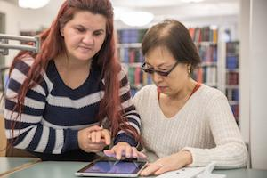
One-on-one coaching
Talking Typing Teacher and Typing Club
Operating system basics: Windows, Mac, iOS, Android, Chrome and Kindle (with screen readers or magnification)
Focus on free and affordable tech (including whatever tech a patron already has)
When purchase decisions are upcoming, we talk through what to ask and what to make note of
Supported calls to tech support, and supported web searches

Slide 8
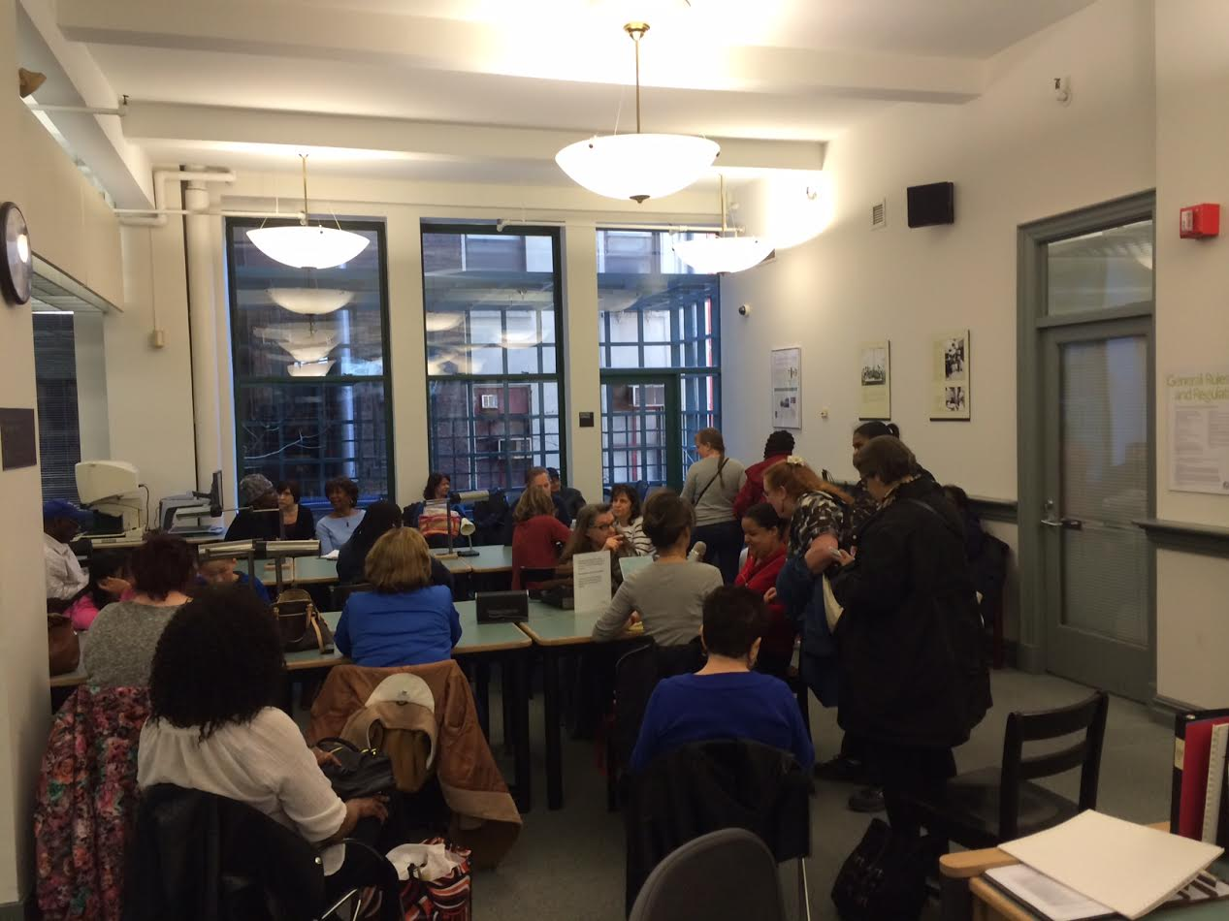
Group workshops: building knowledgeable communities
We choose workshops based on patron and volunteer interest, novelty (something new every quarter) and unmet community need.
A few standouts: Blind Photography, Intro to GarageBand, On the Move, iOS App Swap

Slide 9
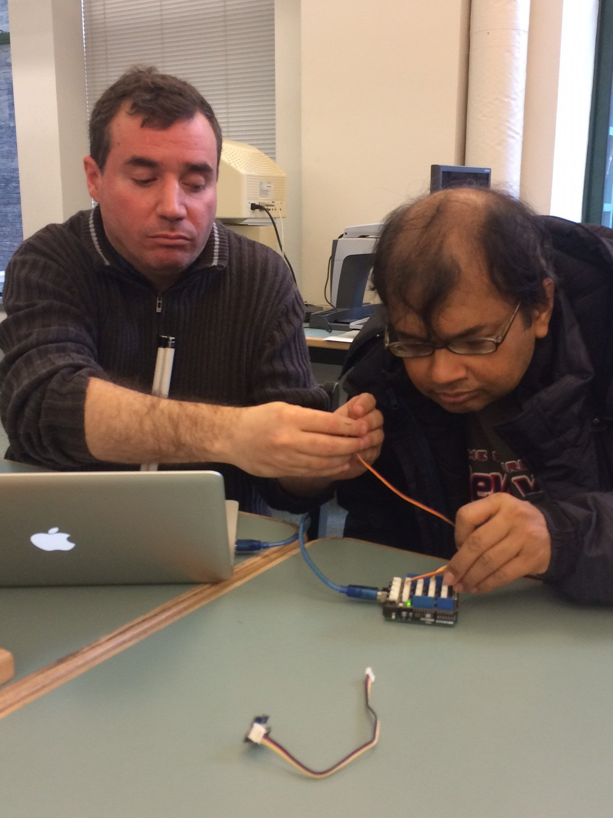
Blind Arduino Project
Teaches fundamentals of electronics (solderless wiring) and coding with Arduino
Focuses on nonvisual techniques
Participants code an audible and tactile light-level sensor
Learn more at blarbl.blogspot.com

Slide 10
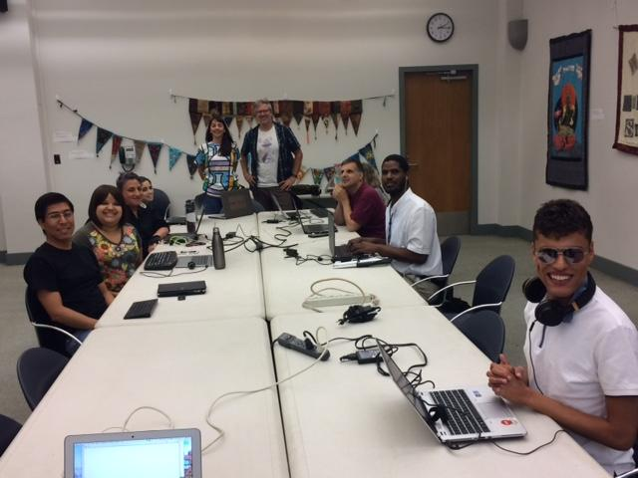
Accessible HTML, CSS and Javascript
Web design basics for novices
8-day intensive with an accessible course website
Accessible tactile screenshots to explain page layout and formatting
Accessible code editor (Notepad++)
Taught by community partners with web design expertise and native screen reader users
Focuses on getting started with web design and understanding basic principles of web accessibility

Slide 11
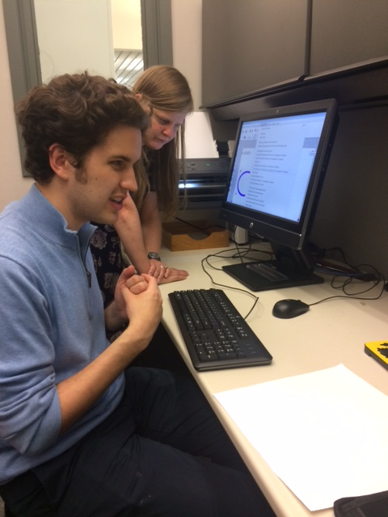
Dimensions Project
Bringing the world of accessible tactile graphics and 3d models to library patrons
Patrons with and without disabilities can produce, not just consume, graphics and models
TactileView software with Everest embosser
Swellform machine
3Doodler Start drawing pens (nontoxic, low-temp)
Lulzbot and Ultimaker 3D printers, Cura 3d printing software, and Openscad for accessible modeling
TMAP (Tactile Map Automated Production)

Slide 12
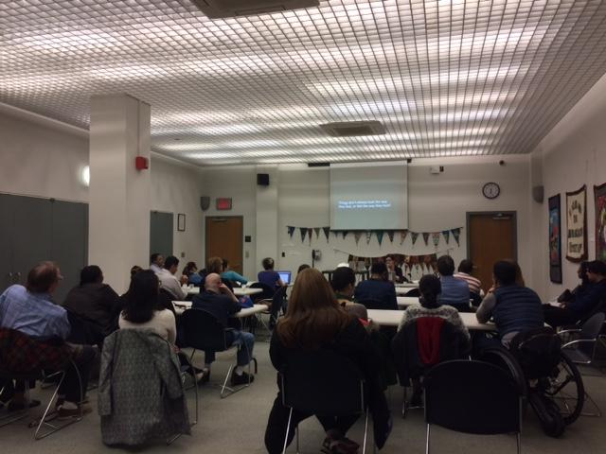
Dimensions: community impact
Individuals can Braille assignments, graphs, and images;
3d print Braille slates and learning tools;
Create original 3D designs,
Work with methods for accessible drawing (3Doodler, Sensational Blackboard, Intact tablet)
These opportunities are also available to professionals, cultural institutions and everyone else.

Slide 13
Notable community partnerships
An individual design volunteer created a 3D printable peg slate, jumbo writing slate and one-cell learning model.
The Whitney, Cooper-Hewitt, and other museums have created accessible Braille programs and images.
City agencies have created accessible parade and street fair maps and then bought their own embosser
Our HTML/CSS tactile explainers were used at a course in Uganda
Our Braille study group created dozens of Braille valentines for community members

Slide 14
Focus on library collections: supporting patrons with BARD and Bookshare
No matter what we do, we maintain a focus on core library collections and the goal of inspring readers to check out BARD, Bookshare and NFB-Newsline.
Tech volunteers support BARD with one-on-one coaching, custom written and recorded instructions, and links to online resources.
We partner with the Bookshare Outreach Coordinator, a former tech intern, to share referrals and up-to-date news about the collections.
As patrons explore topics in tech, coding, art and design we provide pathways back to books in our collections.

Slide 15
Welcoming remote participants
When workshops are discussion-oriented rather than heavily hands-on, we offer remote participation so folks who can’t be here in person can join.
Initially we used Google Hangouts.
We recently moved to Zoom, where we can control everyone’s mics, include more people, share screens and documents, and offer an accessible experience on all platforms.
Zoom even includes an option to dial in.
Locally occurring workshops with remote participants help us maintain an in-person community feel while including everyone.

Slide 16
Scott Norris
Innovative Tech Education in Michigan

Slide 17
Technology Club
How it got started
Publicizing the club
Attracting presenters
Recent notable presenters

Slide 18
Supporting our patrons
Overview of what software and hardware we support
Offering support in person, by phone and online
Meeting our challenges

Slide 19
Library without Walls
Planning a compelling 2019 event
Attracting a keynote speaker
Deciding on relevant topics
Our format: 18 one-hour sessions
Recruiting our spakers
How we advertise

