Slide 1
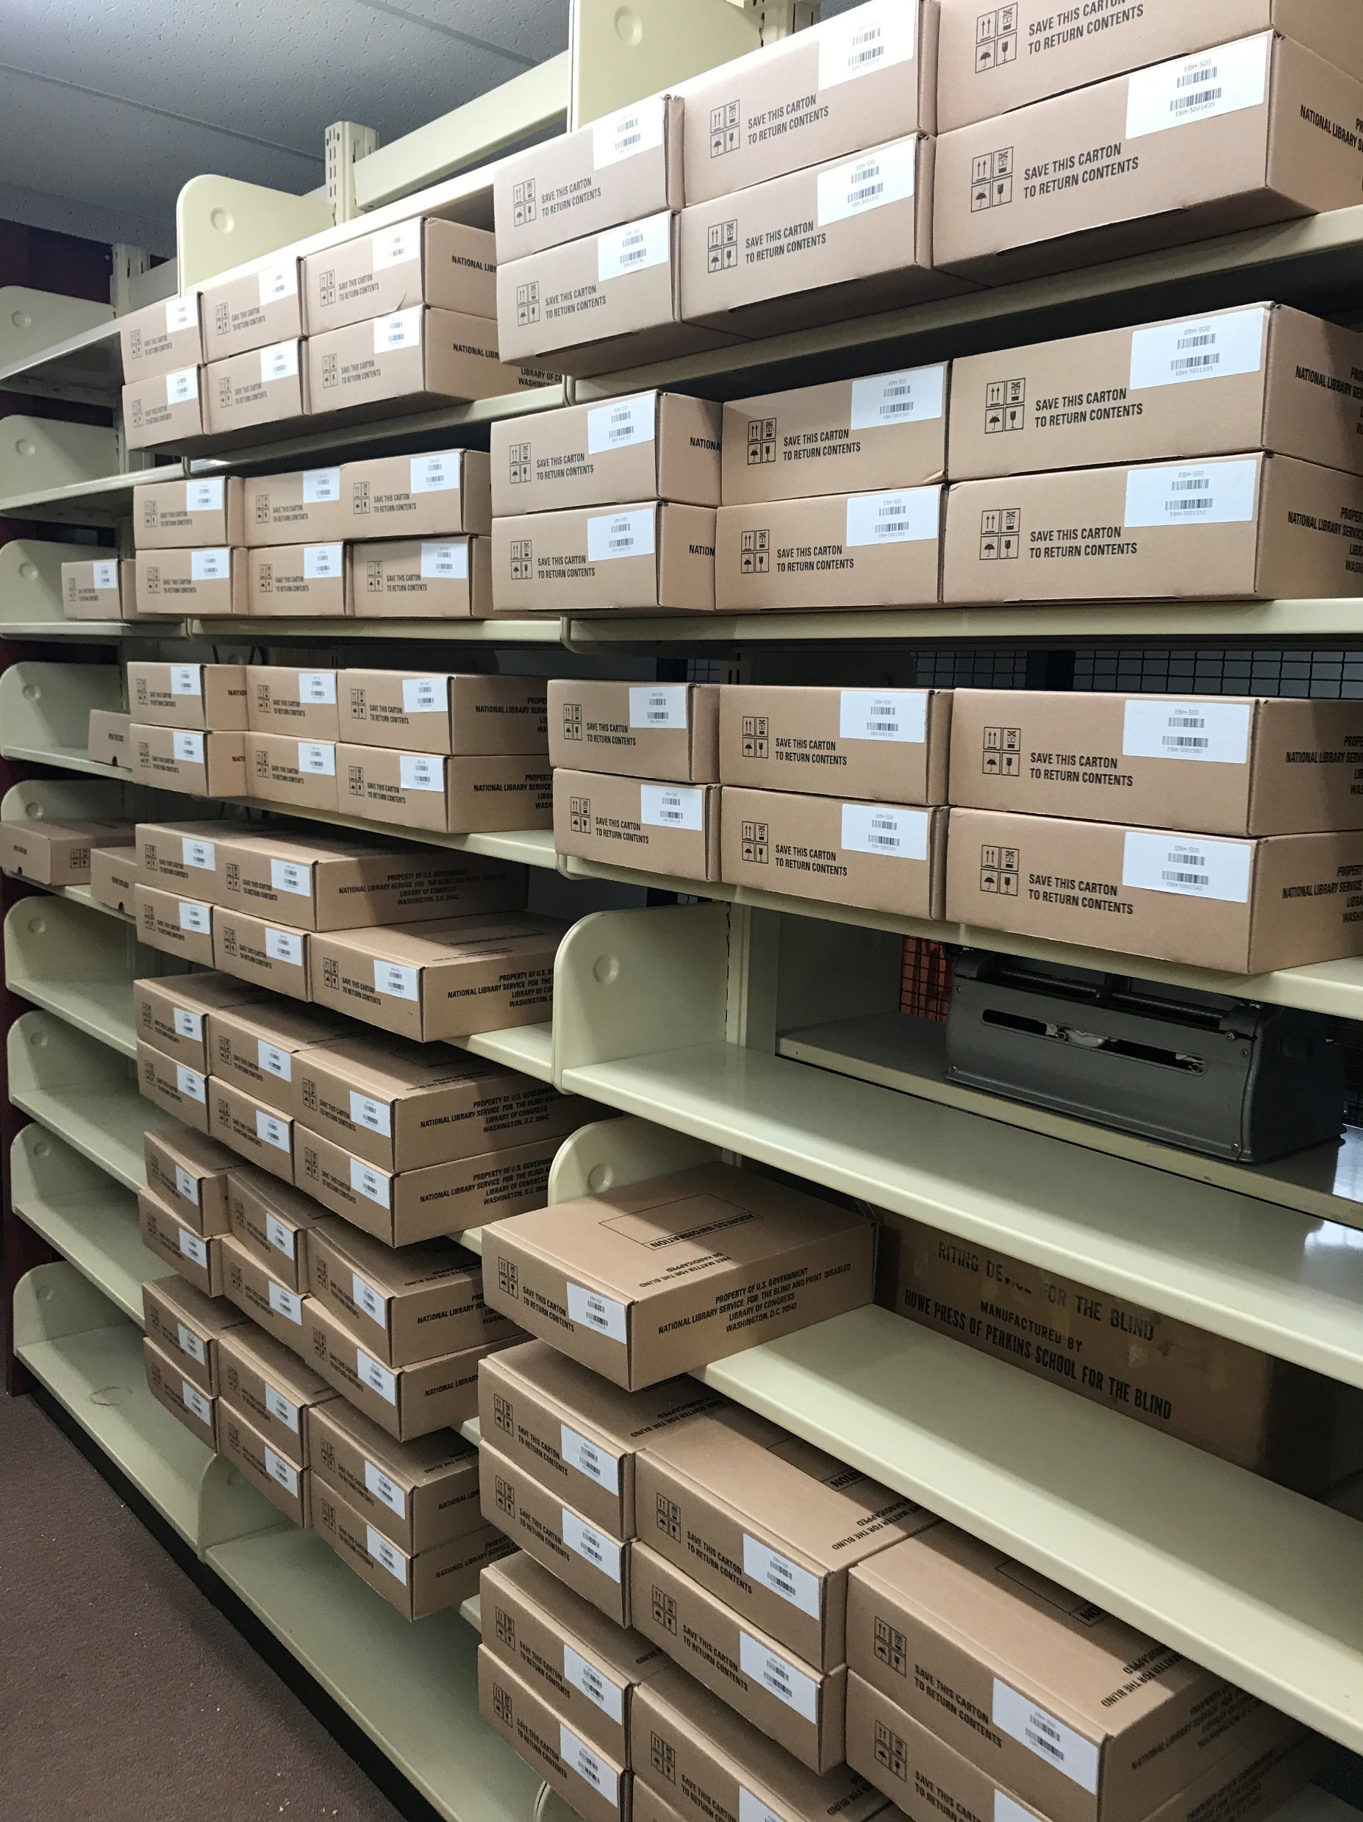
Preparing the HumanWare eReader for Circulaton
Amanda Trawick, Senior Librarian
Alabama Public Library Service
Regional Library for the Blind and Physically Handicapped
6030 Monticello Drive
Montgomery, AL 36117
334-213-3927
800-392-5671
atrawick@apls.state.al.us

Slide 2
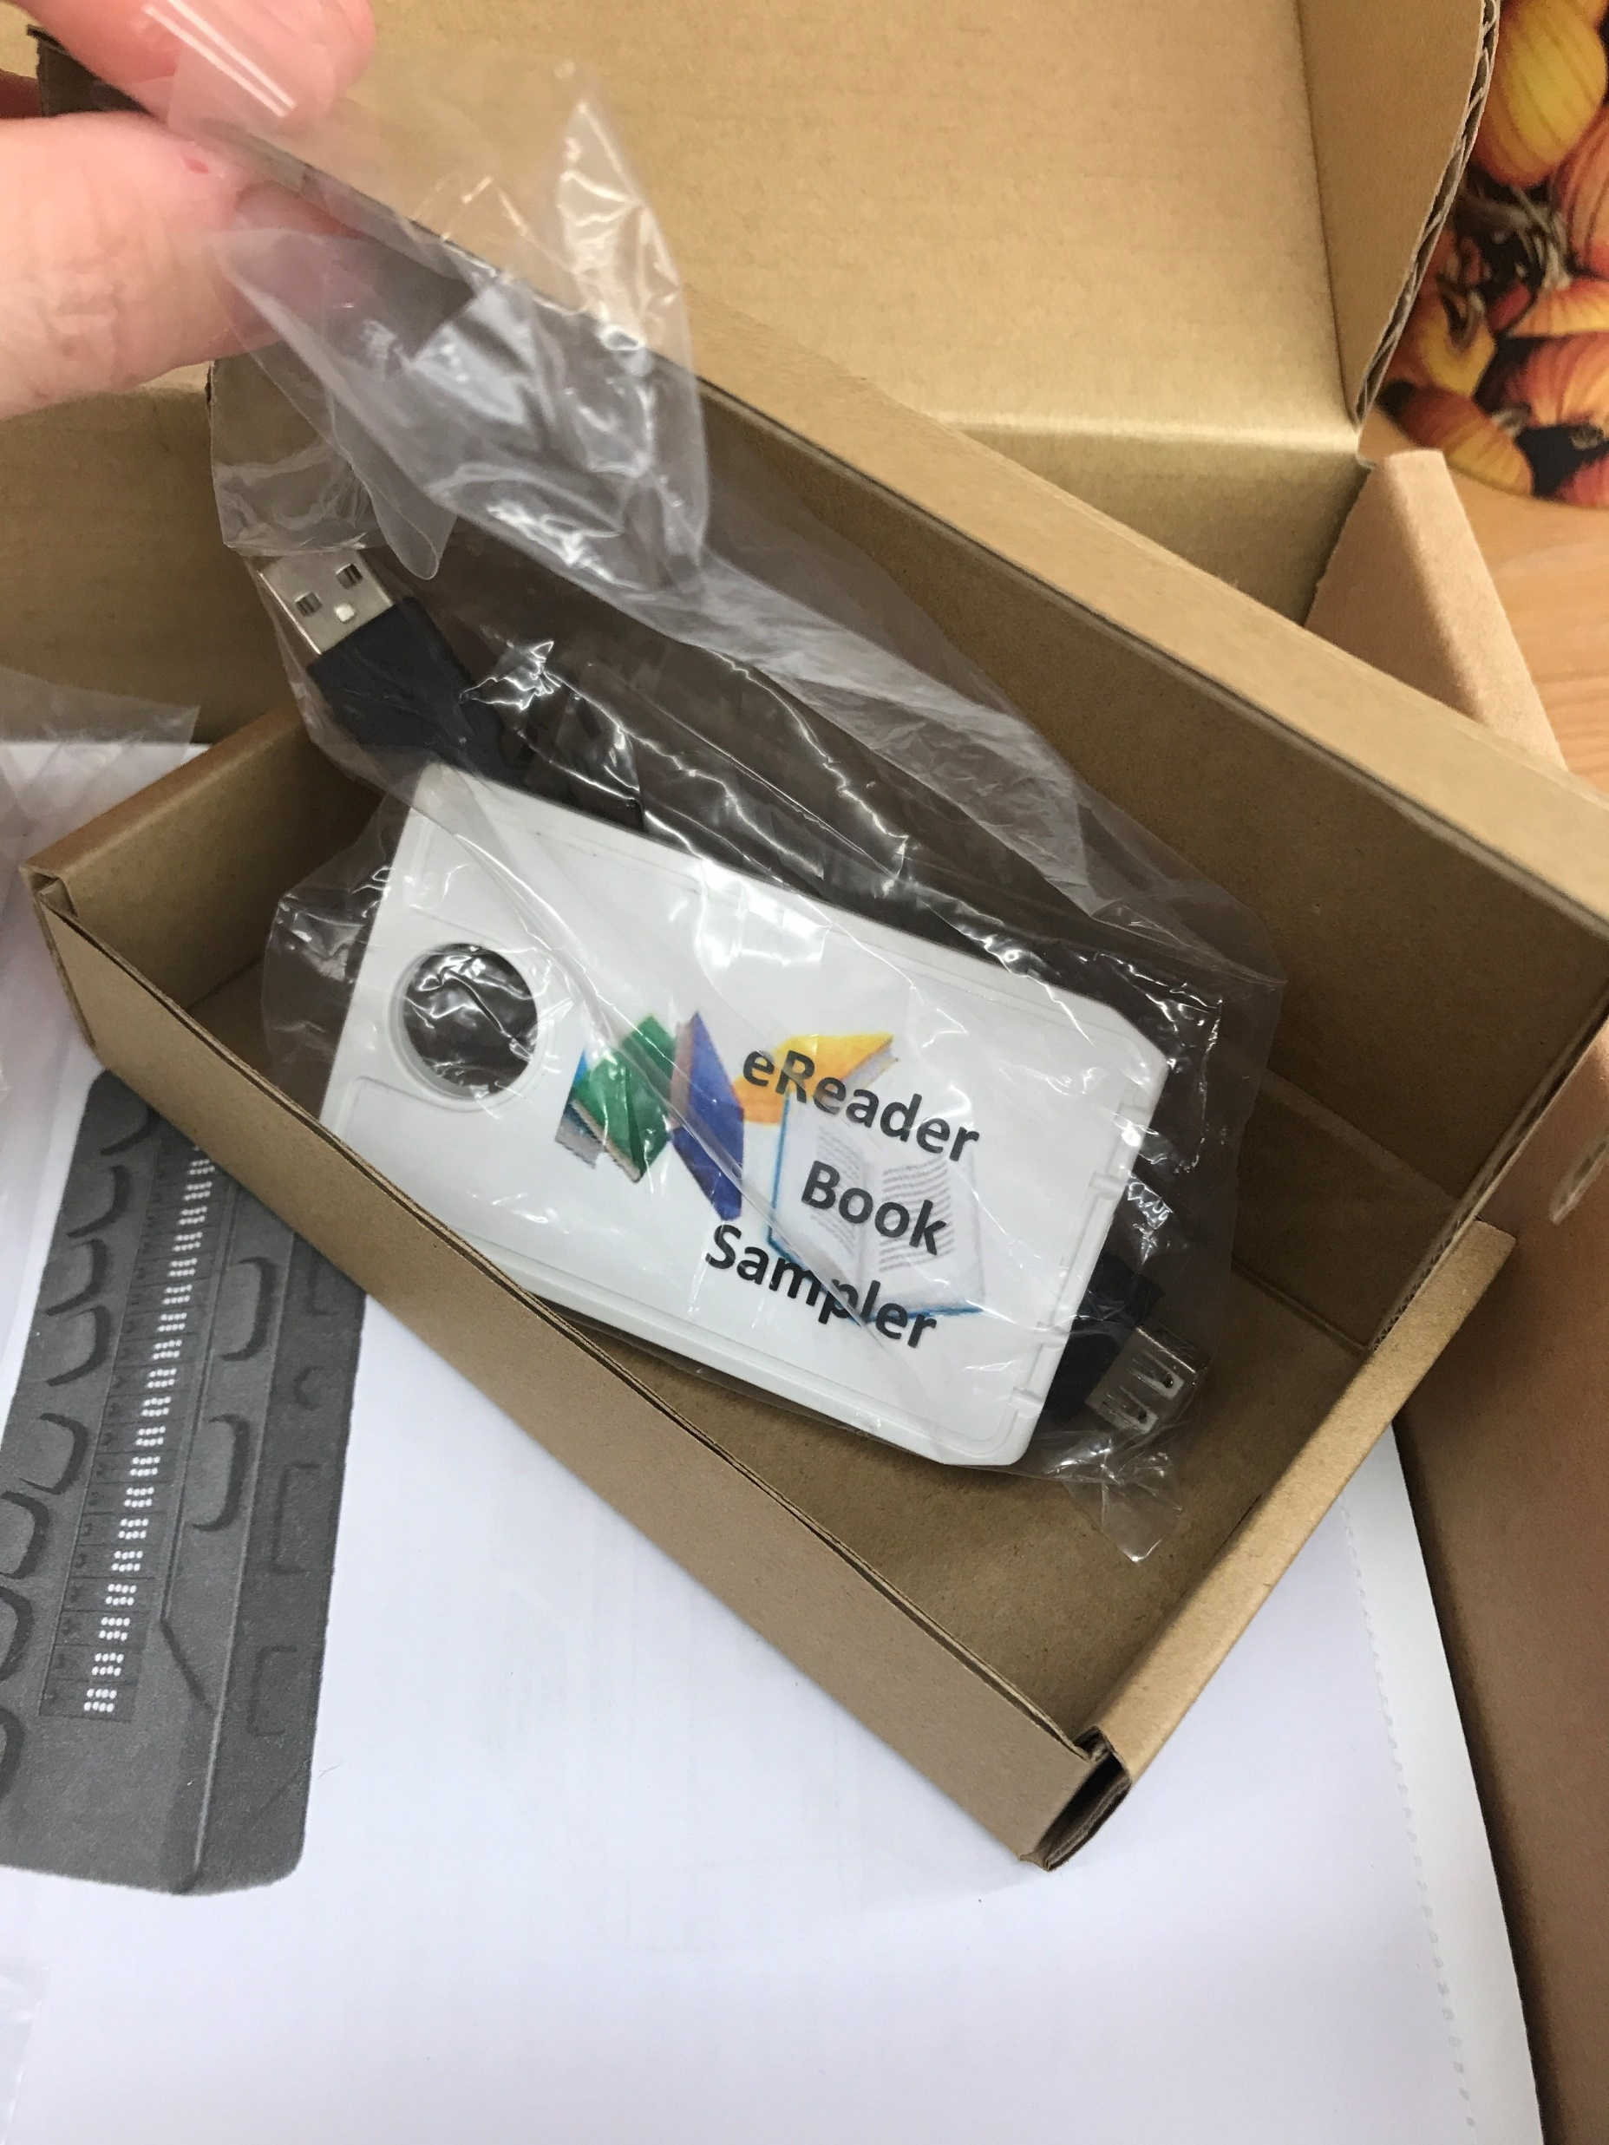
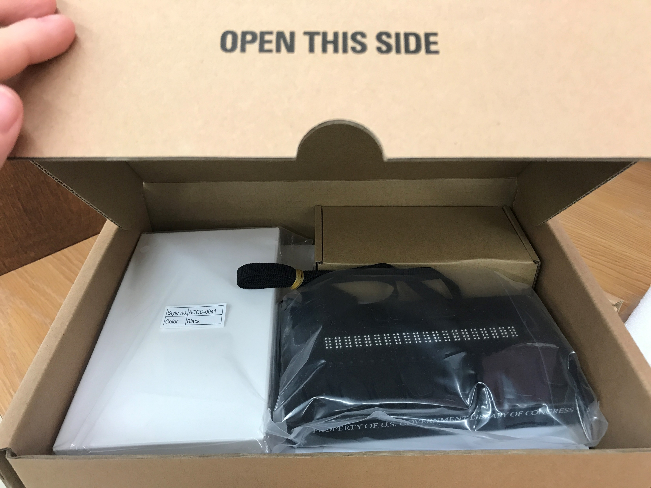
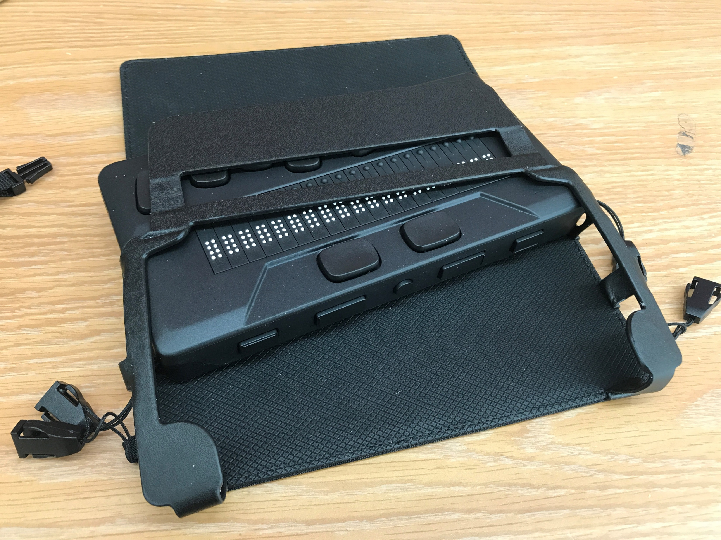
EBH
(electronic braille reader- HumanWare)

Slide 3
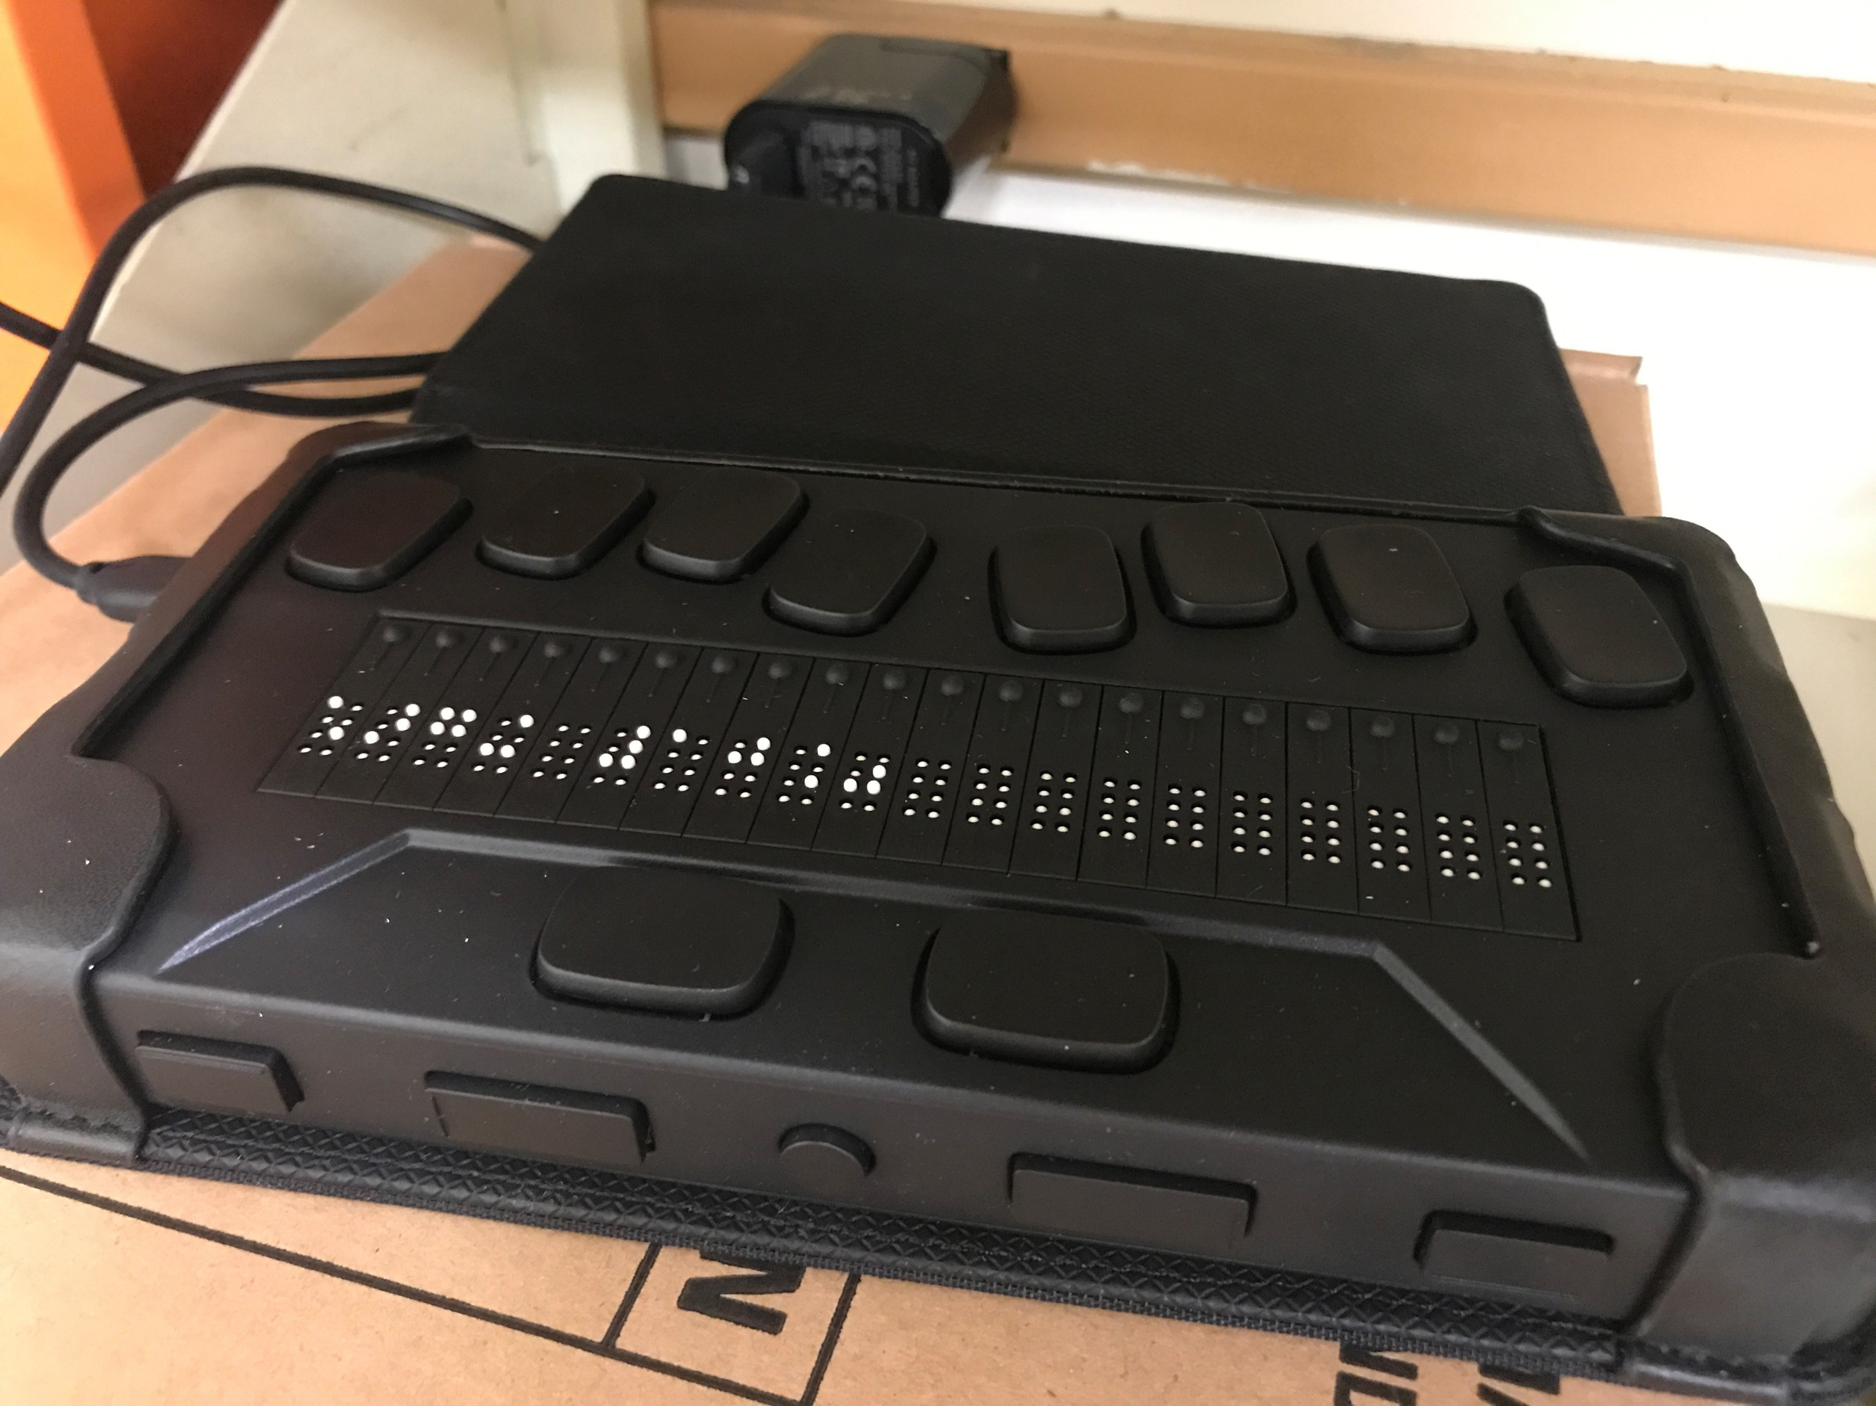
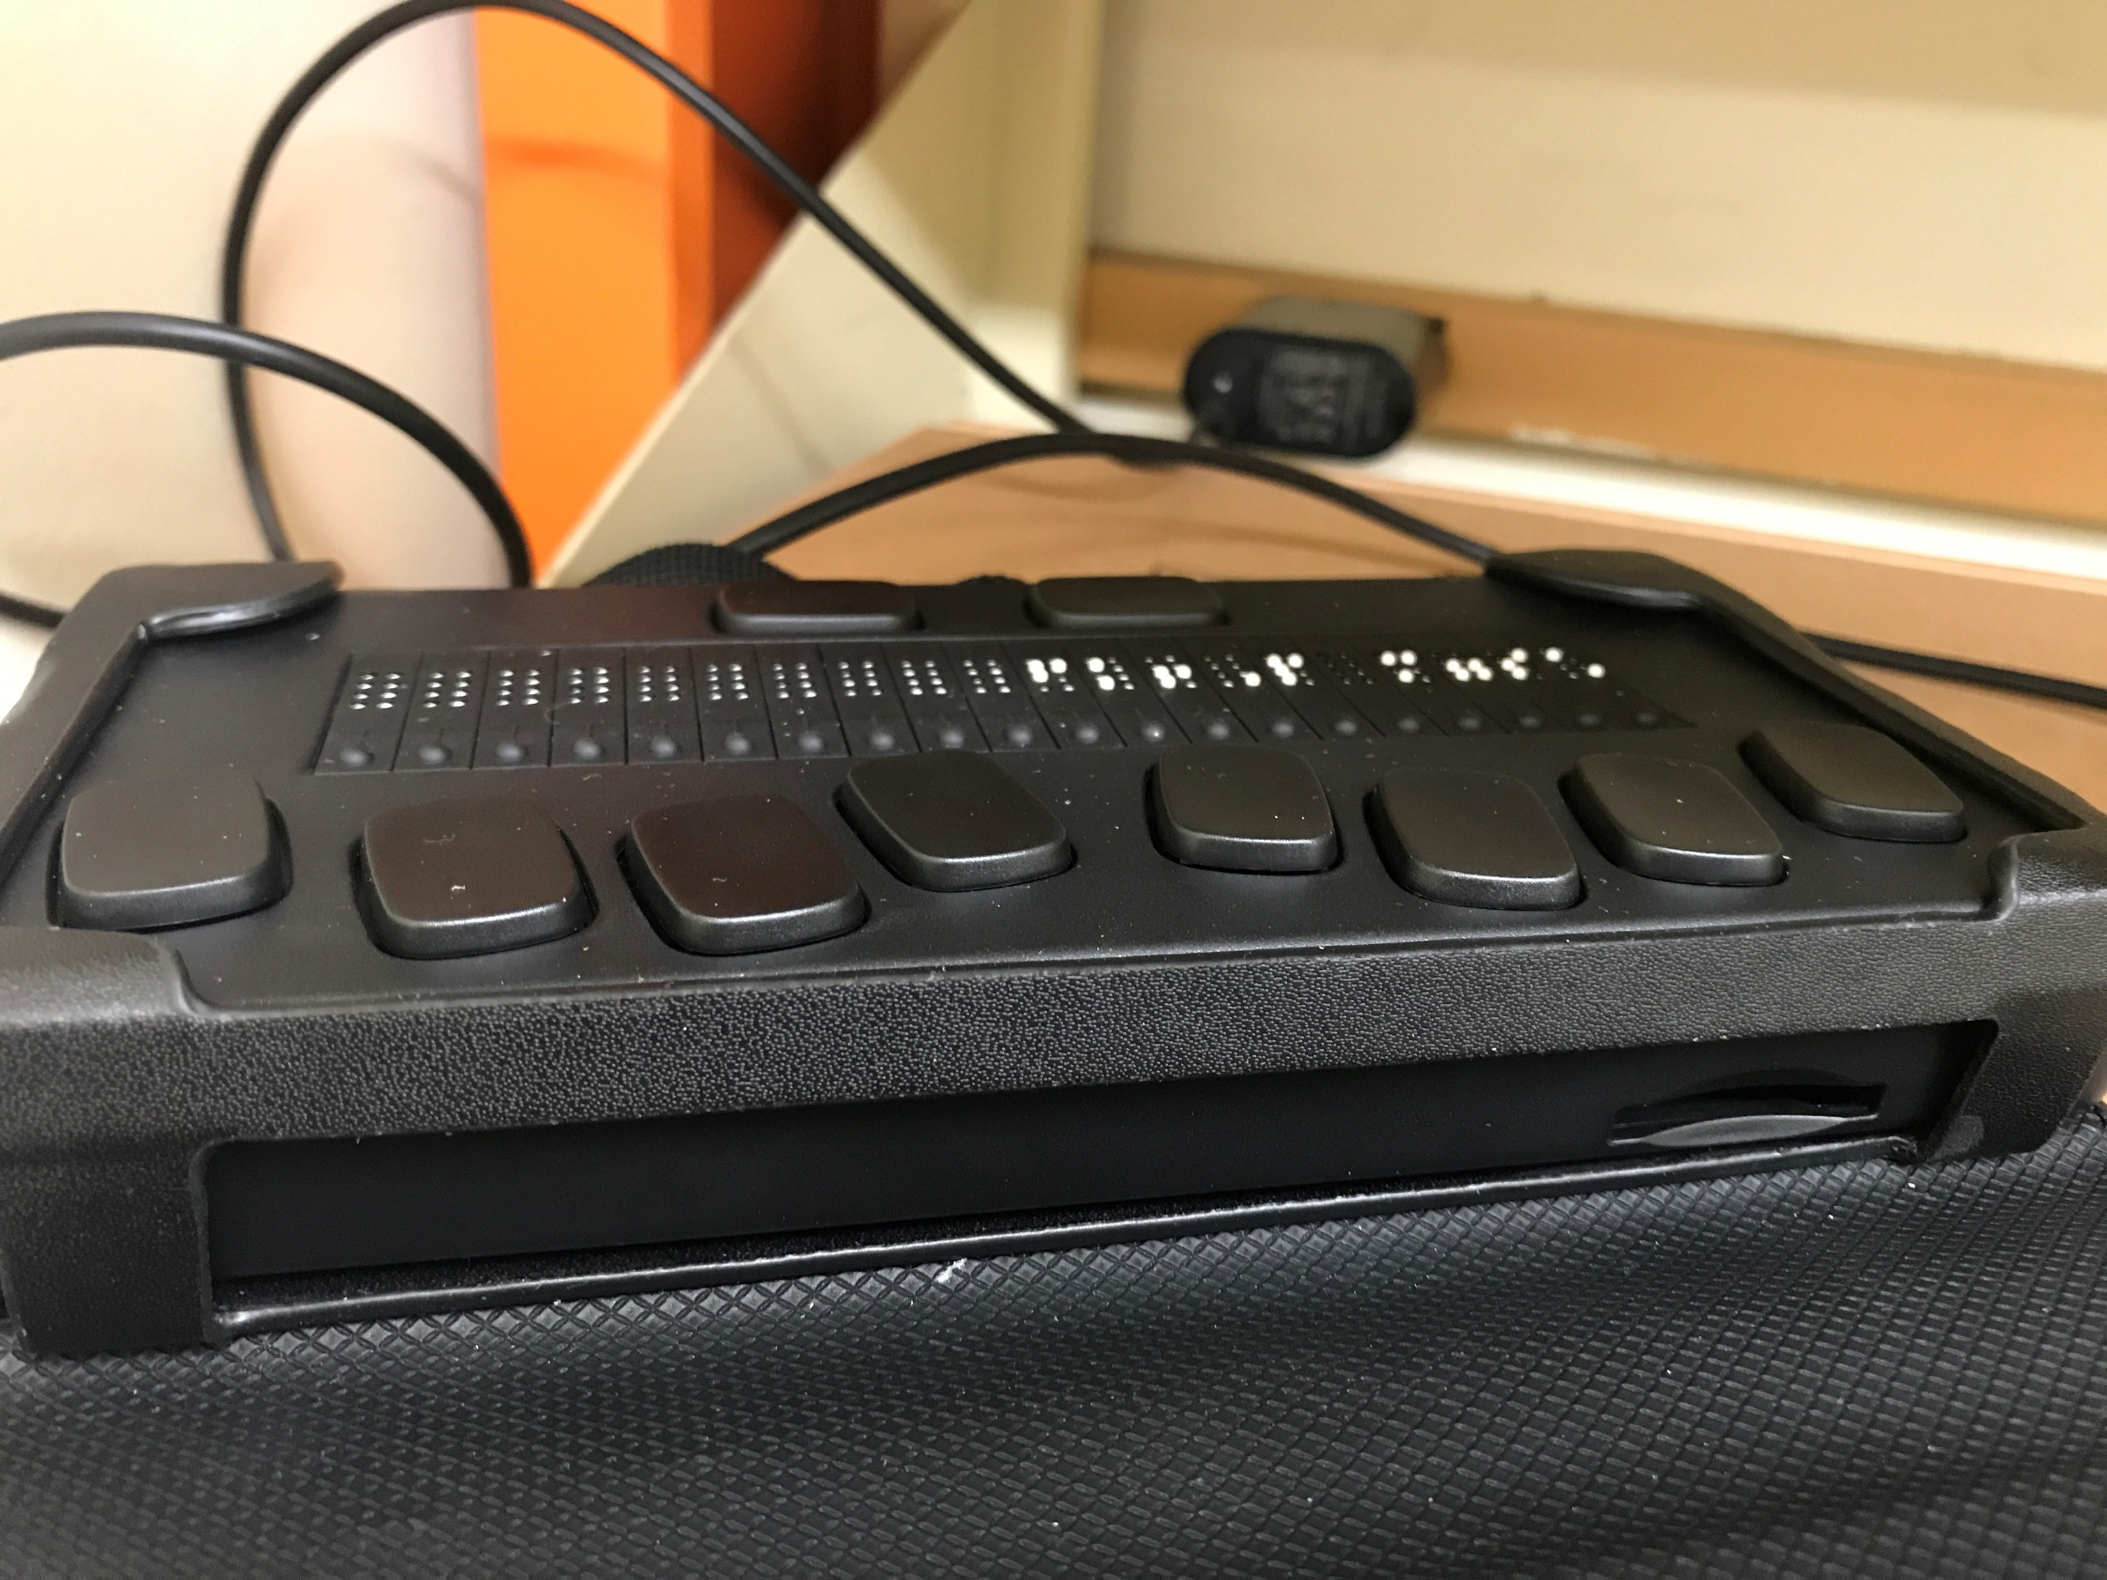
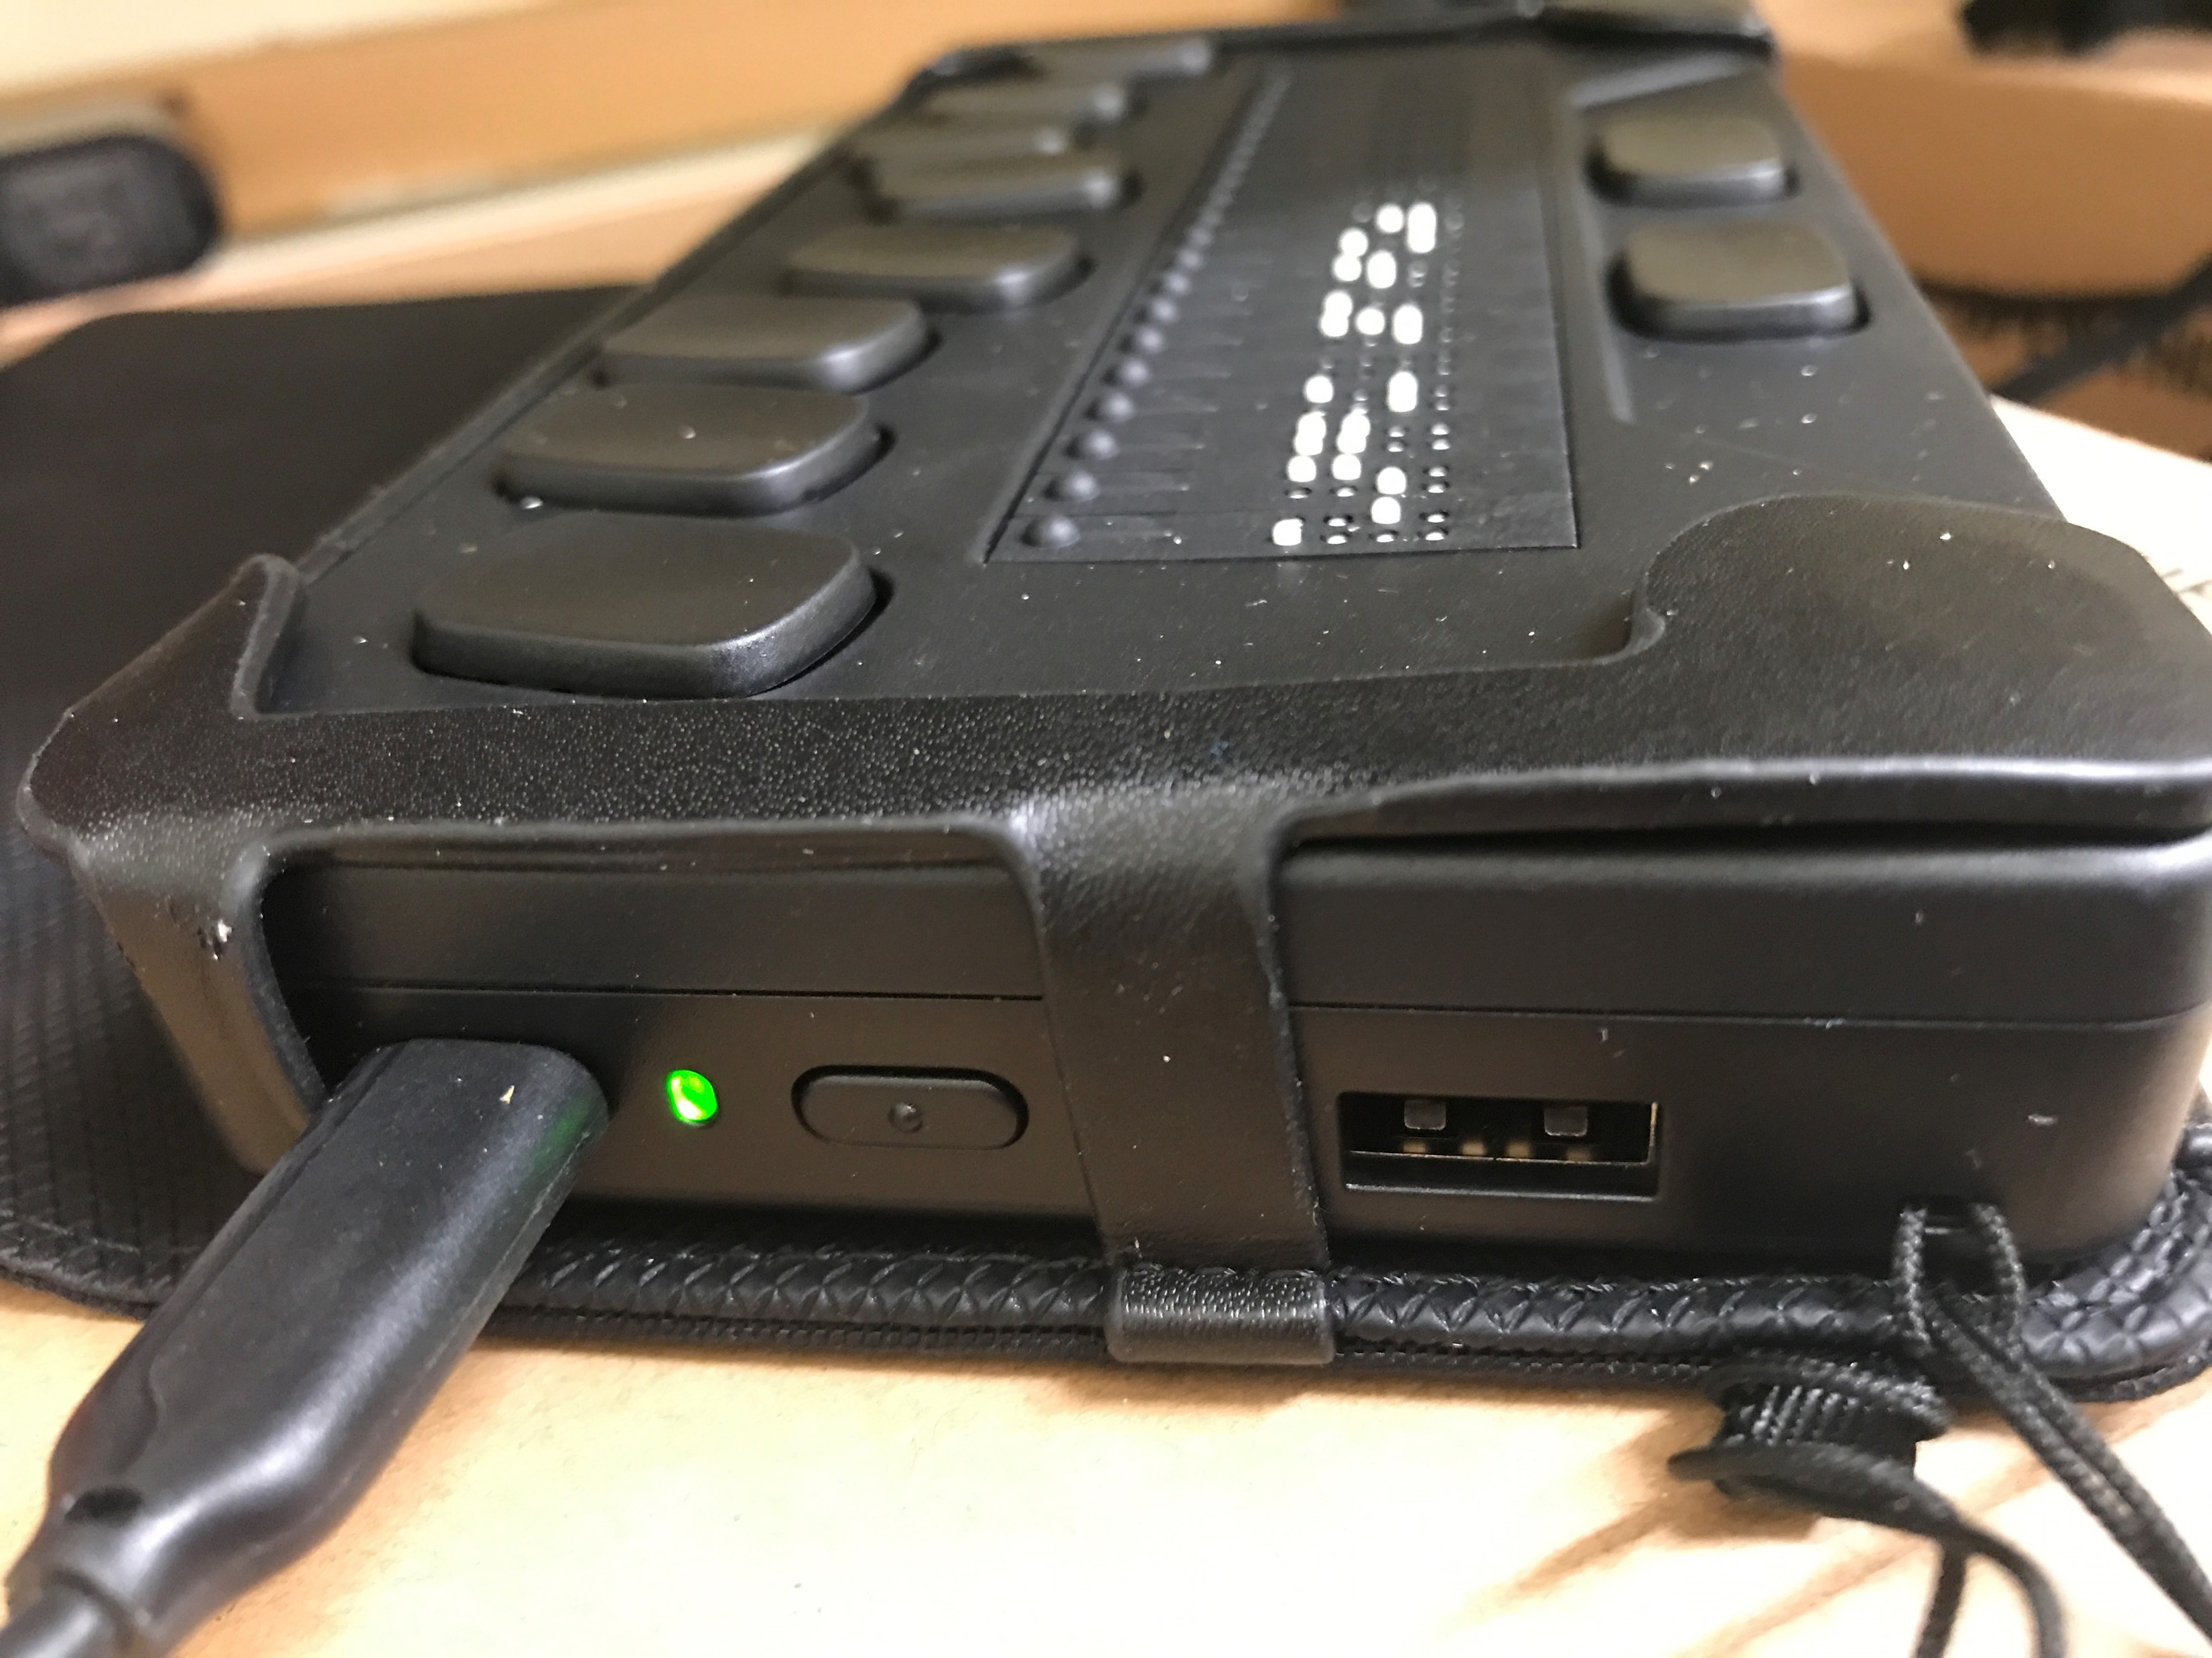
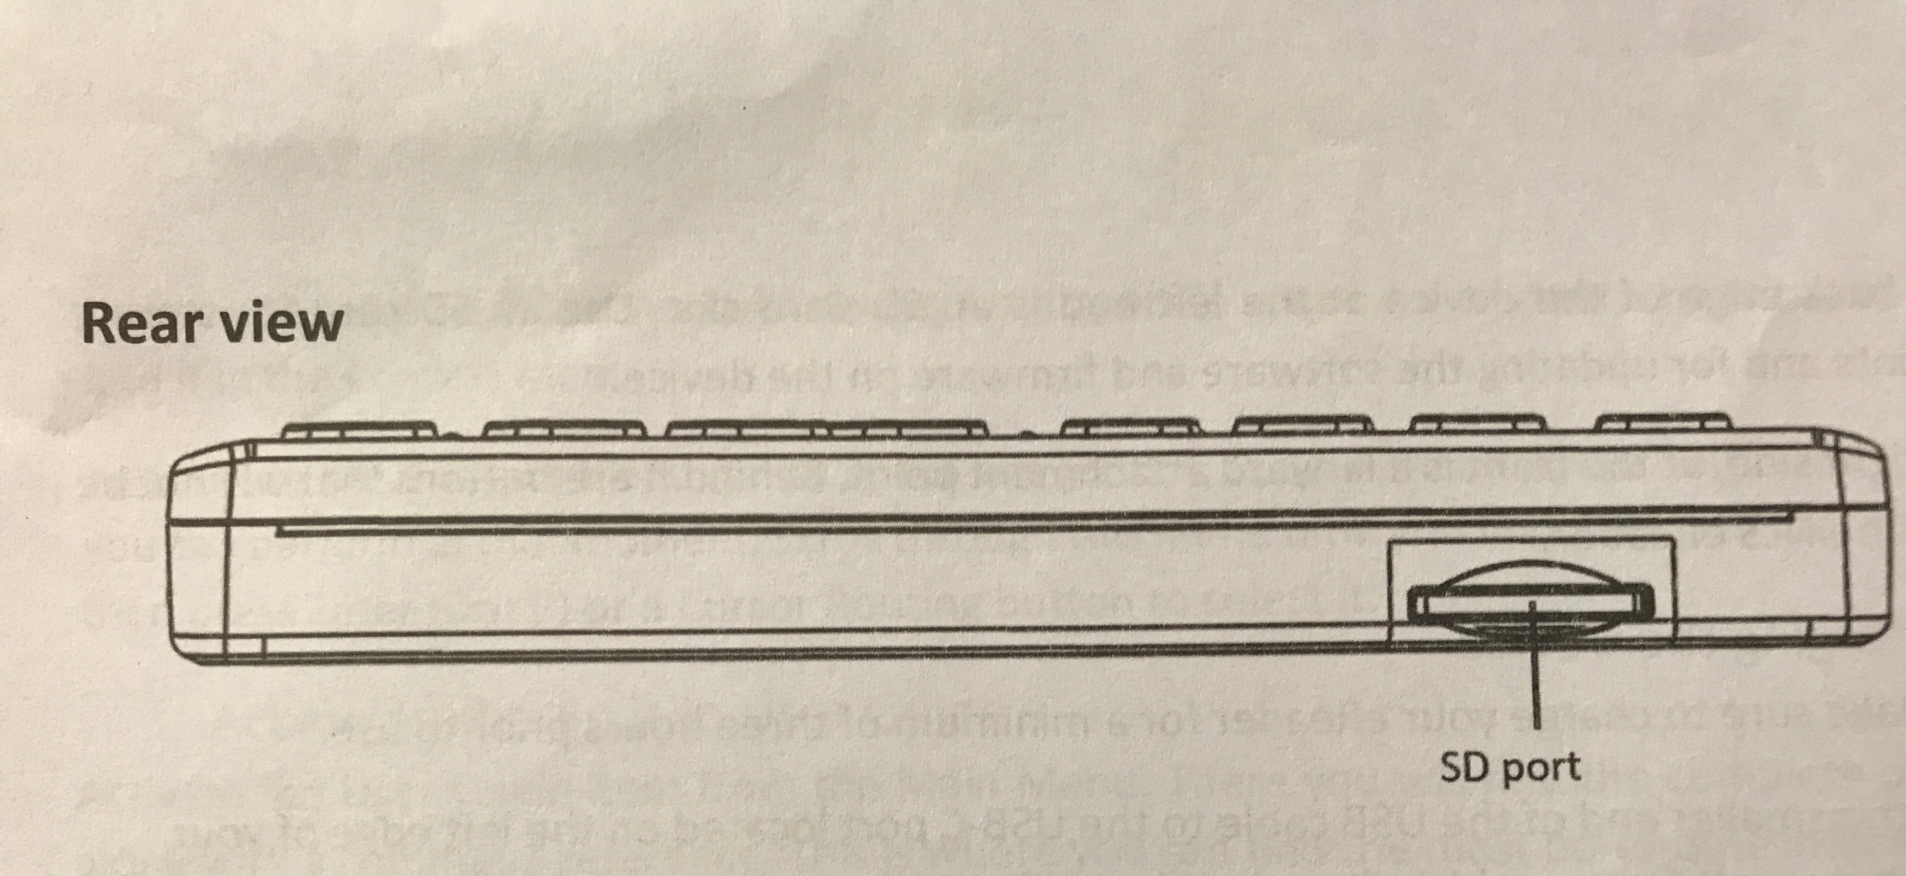
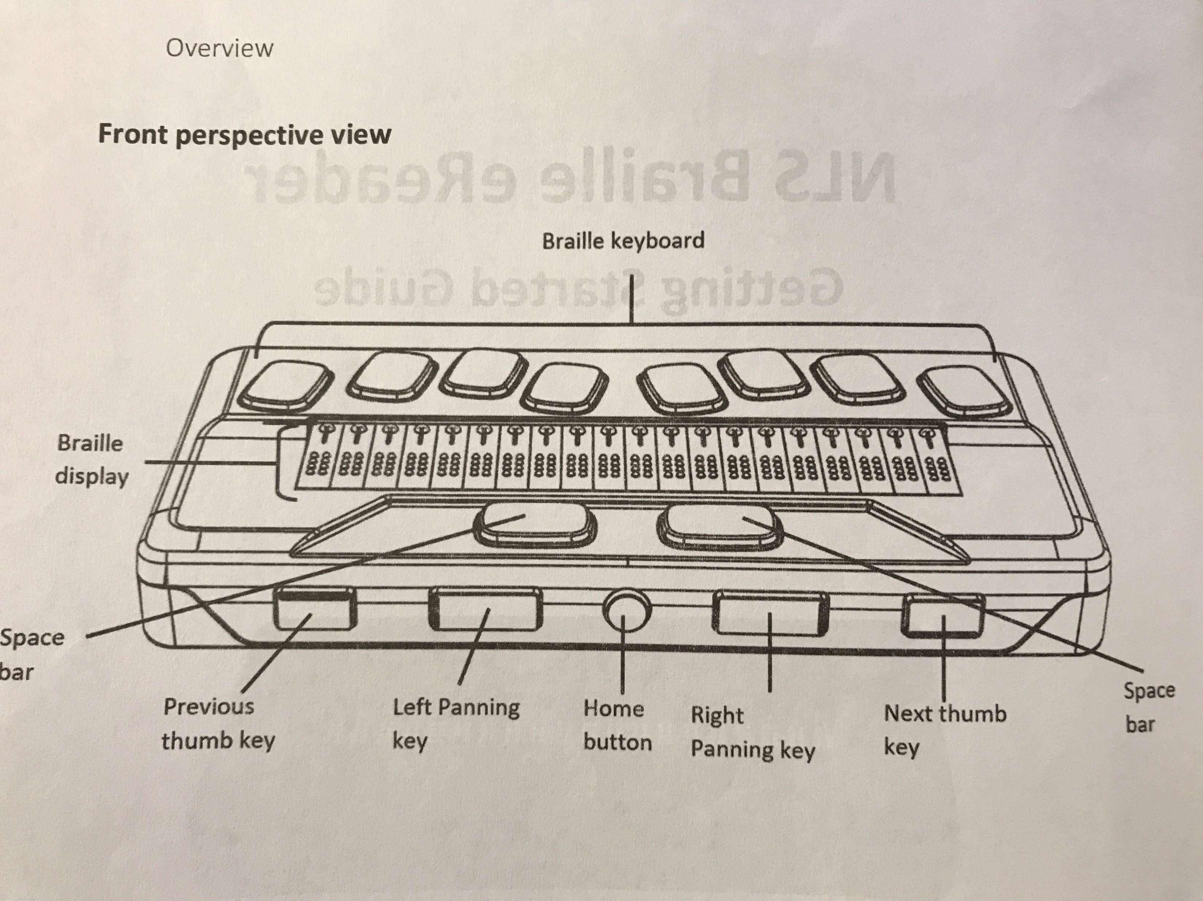
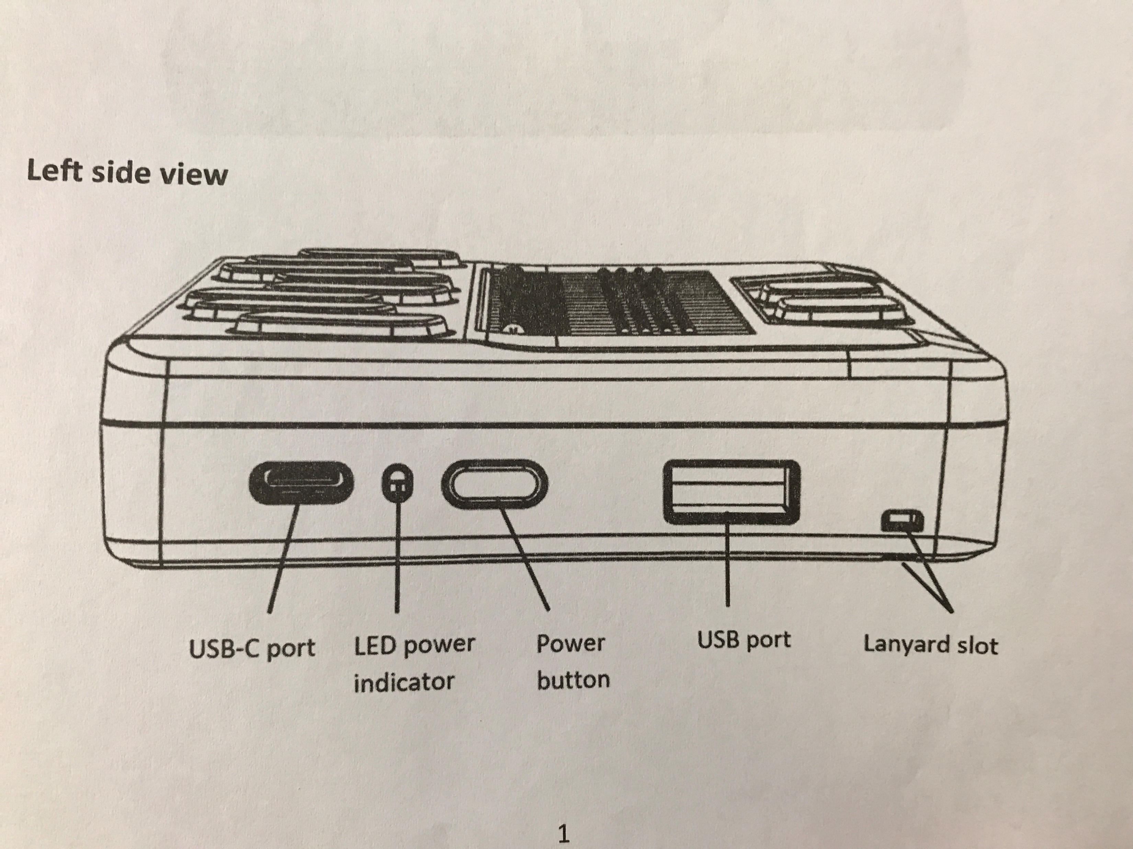
Patron questions asked:
We have you listed as braille reader. Are you still a braille reader?
Would you like to participate in a program to test a new refreshable braille display?
Do you have an email address?
Would you be able to set up an email account in order to use the braille eReader?
Can you confirm your mailing address?
Can you confirm your phone number?
Are you willing to participate in surveys about the eReader?

Slide 4
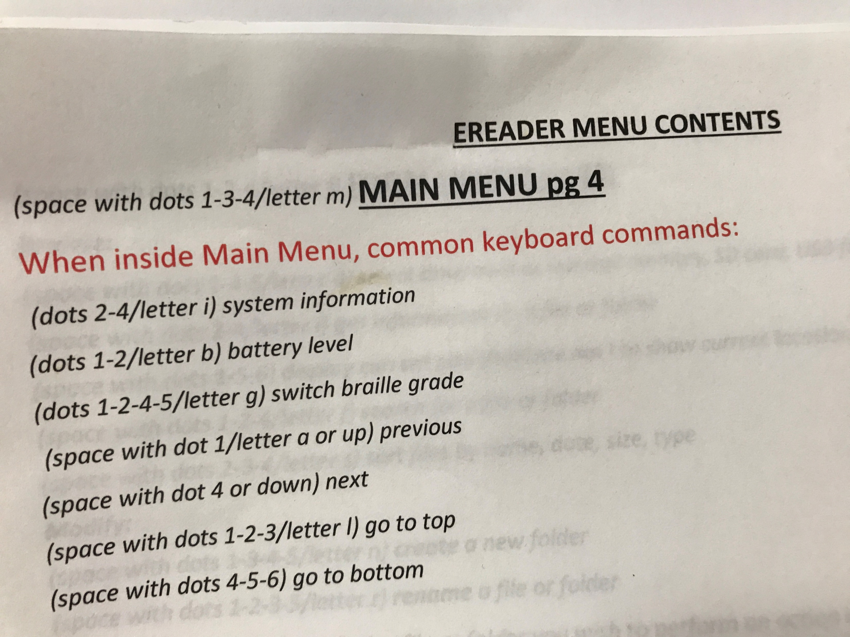
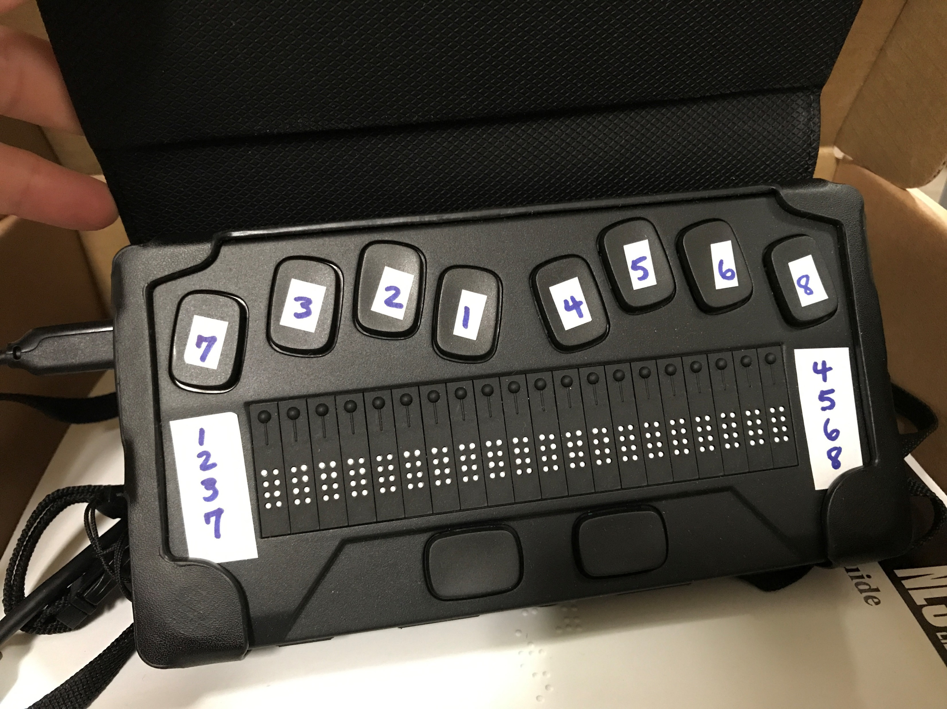
eReader basic training was provided by NLS
as well as backup tech support- NLS will contact a patron if assistance is needed

Slide 5
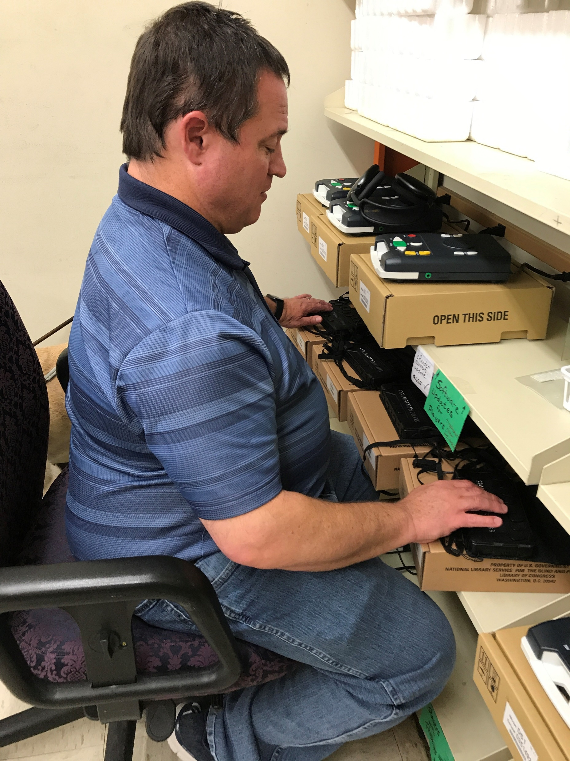
Tim Emmons connects eReaders to Wi-Fi and applies software updates before eReaders are sent to patrons.
When paired with a tablet or PC the eReader can also be used to:
Surf the internet, email, text, use social media, participate in a ZOOM meeting (with no speech interruptions from a screen reader such as JAWS)
Amanda Trawick, Senior Librarian
Alabama Public Library Service
Regional Library for the Blind and Physically Handicapped
6030 Monticello Drive
Montgomery, AL 36117
334-213-3927
800-392-5671
atrawick@apls.state.al.us

