Slide 1
Our Tactile Journey
Applied tactiles in LAMP programming
& overview of the tools used.
Library of Accessible Media for Pennsylvanians
Carnegie Library of Pittsburgh
Stephen McMillen & Mark Lee
Notes:
Hi everybody, I am Mark Lee from LAMP in Pittsburgh and I am a middle-aged tallish white man who isn't burdened with too much hair. I am here with My Colleague Steve (introduces and describes himself).
Housekeeping: today we are doing a PowerPoint Presentation and will describe each slide. This presentation is also uploaded to the wiki and contains alt text and was tested in JAWS before being uploaded. We will move through this presentation fairly quickly due to time constraints. Please save questions till the end.
Our first slide reads: Our Tactile Journey: Applied Tactiles in LAMP programming and a brief overview of some tools we use. Next to that is our name LAMP set against a blue background and a shelf of light blue books with no titles and one book with a title on the side: Read for Life-LAMP's motto.
We are here from LAMP in Pittsburgh to talk about some of the ways we use and have used tactile and touch to enhance programs at LAMP. We are not experts/Journey / Not destinations and would love to hear what you are doing at your libraries as we know many of you do a lot.

Slide 2
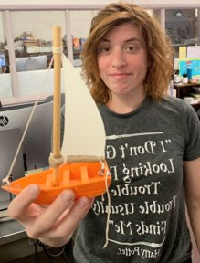
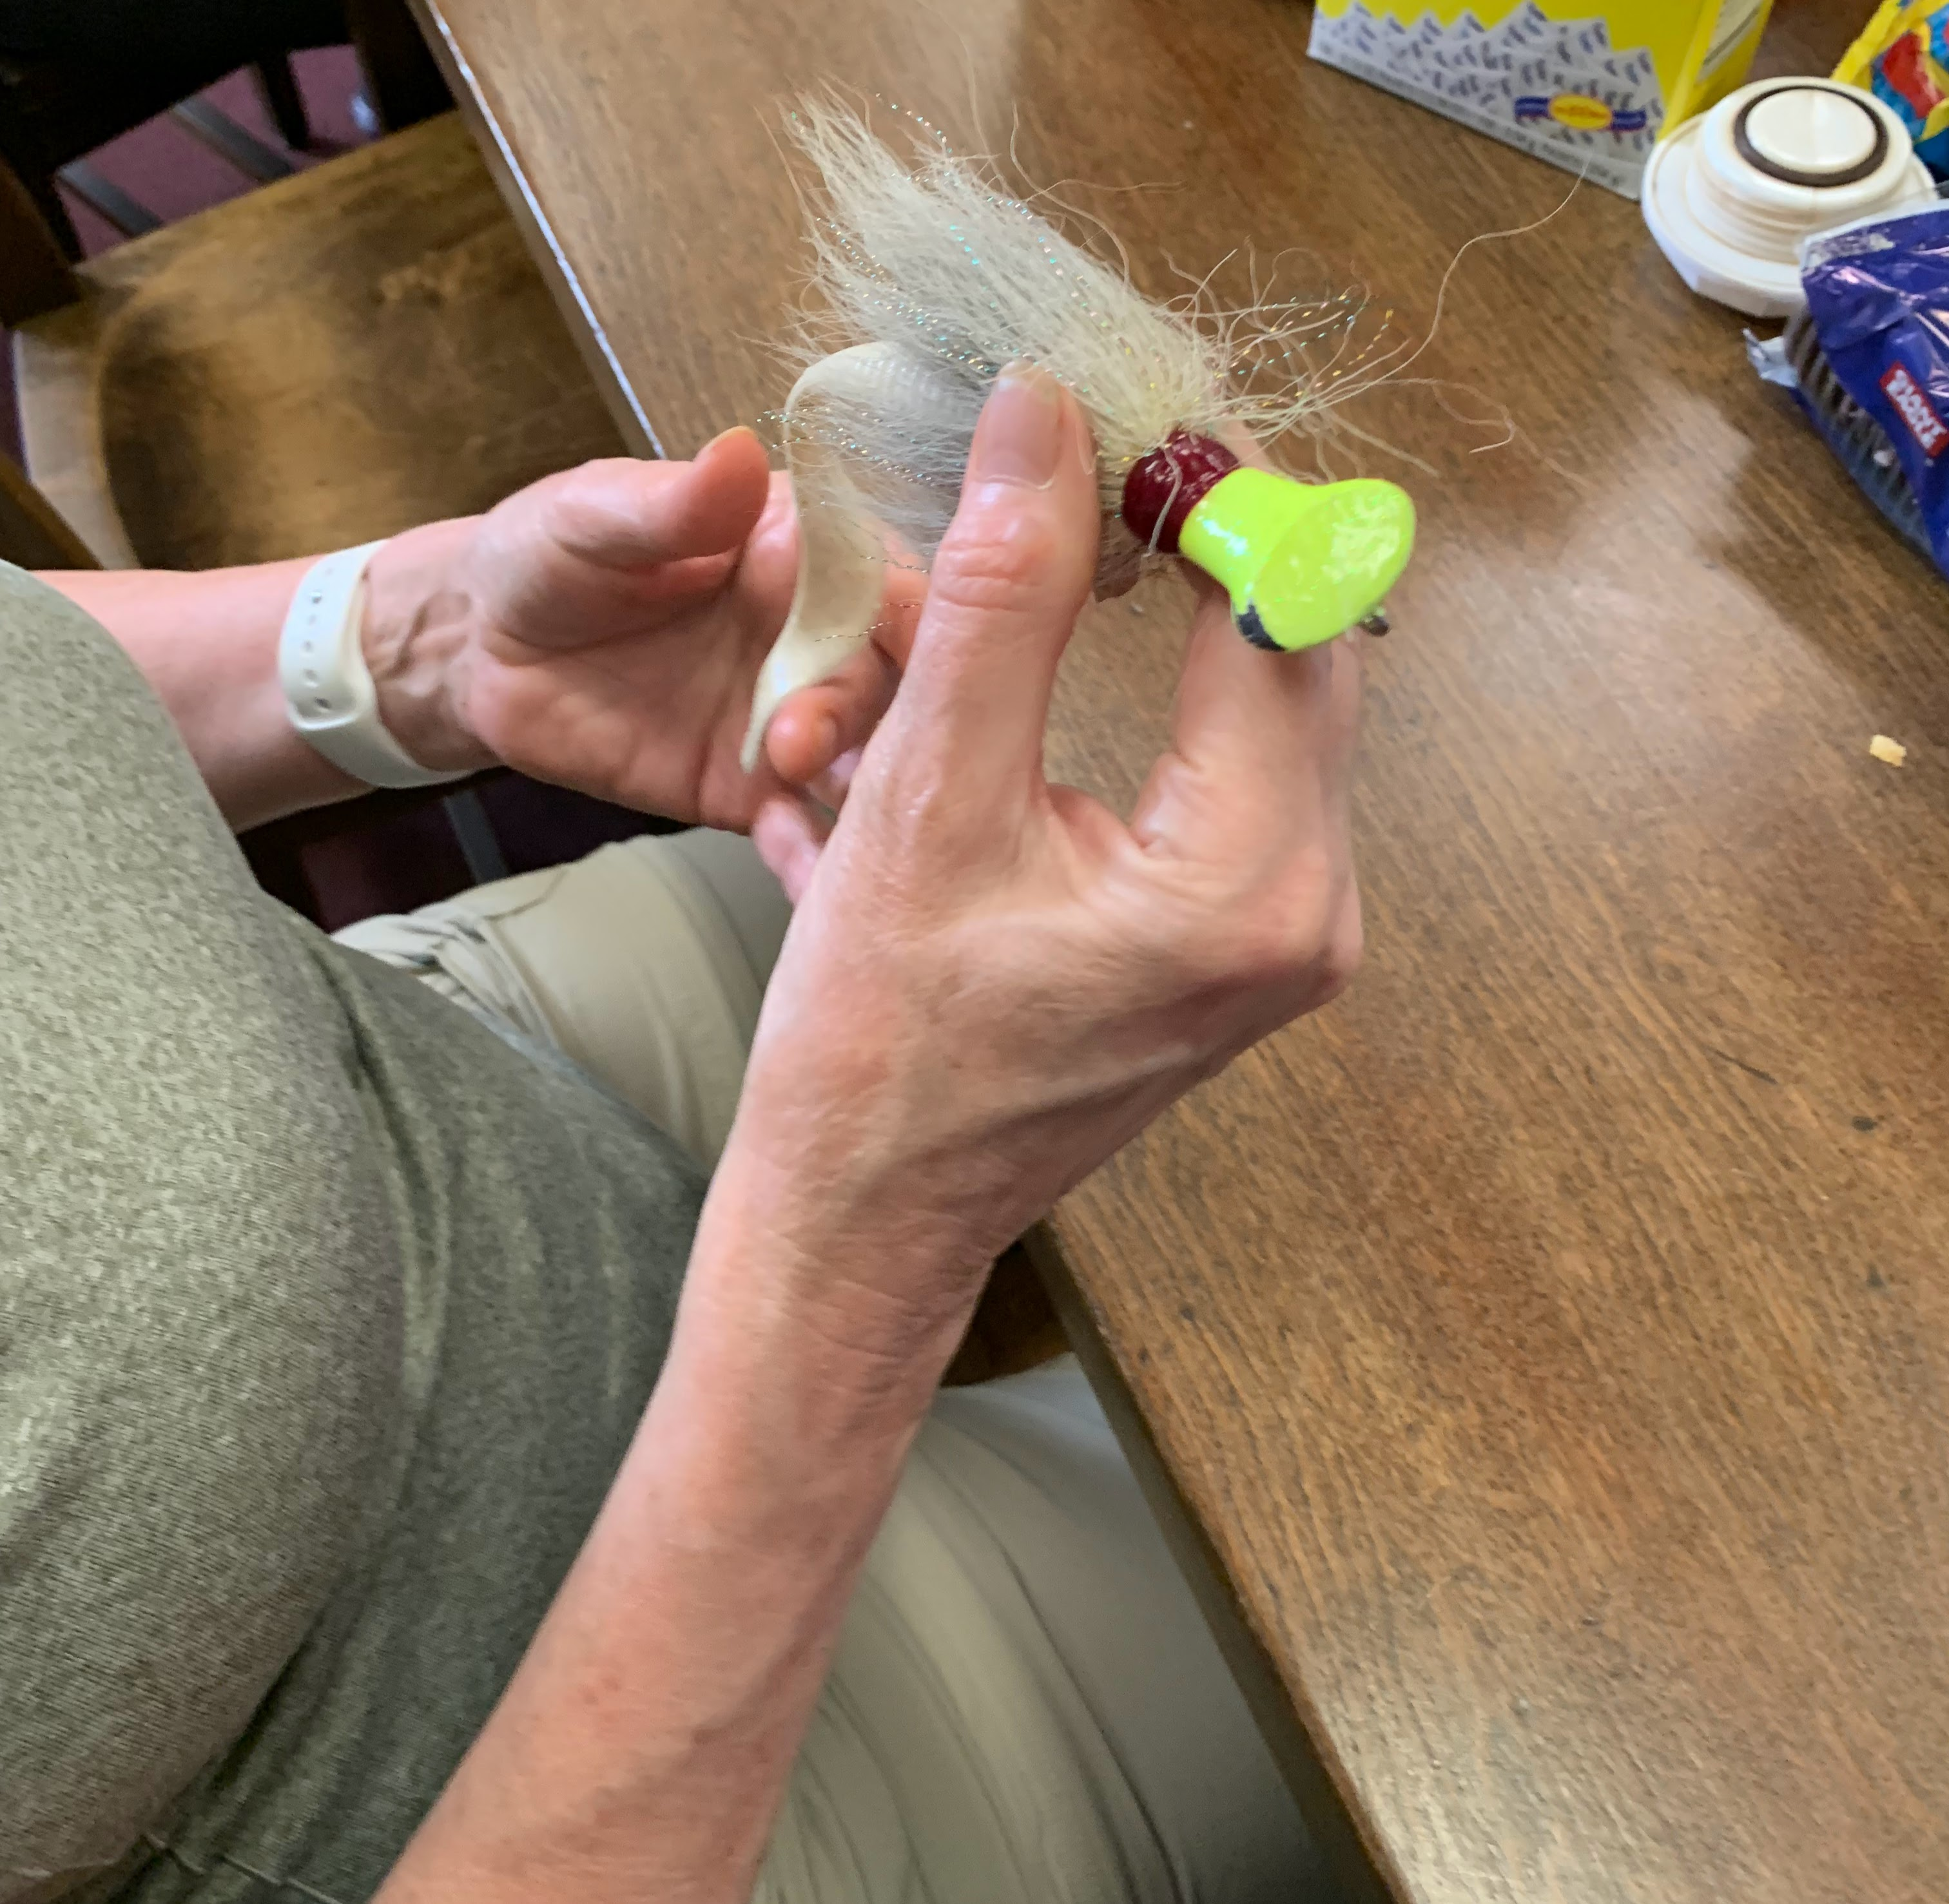
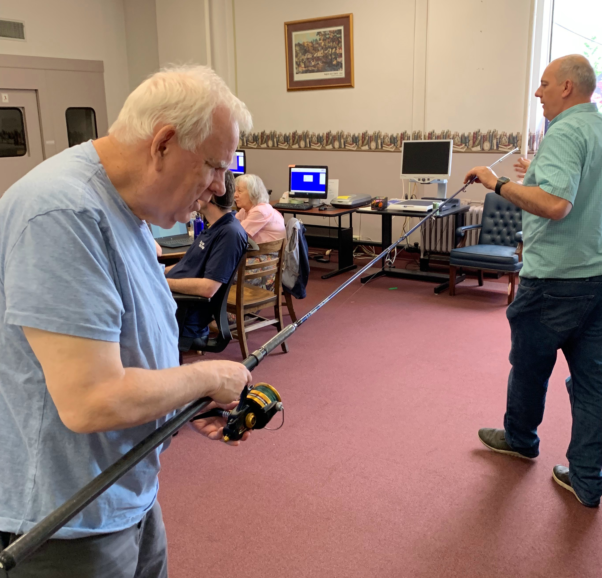
Old Man and the Sea Tactile Book Club
Notes:
Some ways we have incorporated tactile aspects into programming has been to experiment. Here we worked with patrons to pick a book and then tried to add tactile objects into the book group discussion with some surprising results. Chose Old man and the Sea .
3D print out of skiff
Person holding a lure (cork over the hook)
Someone using Deep Sea Rod while another person creates tension in the line at the other end. Real & Fabricated tactile objects.

Slide 3
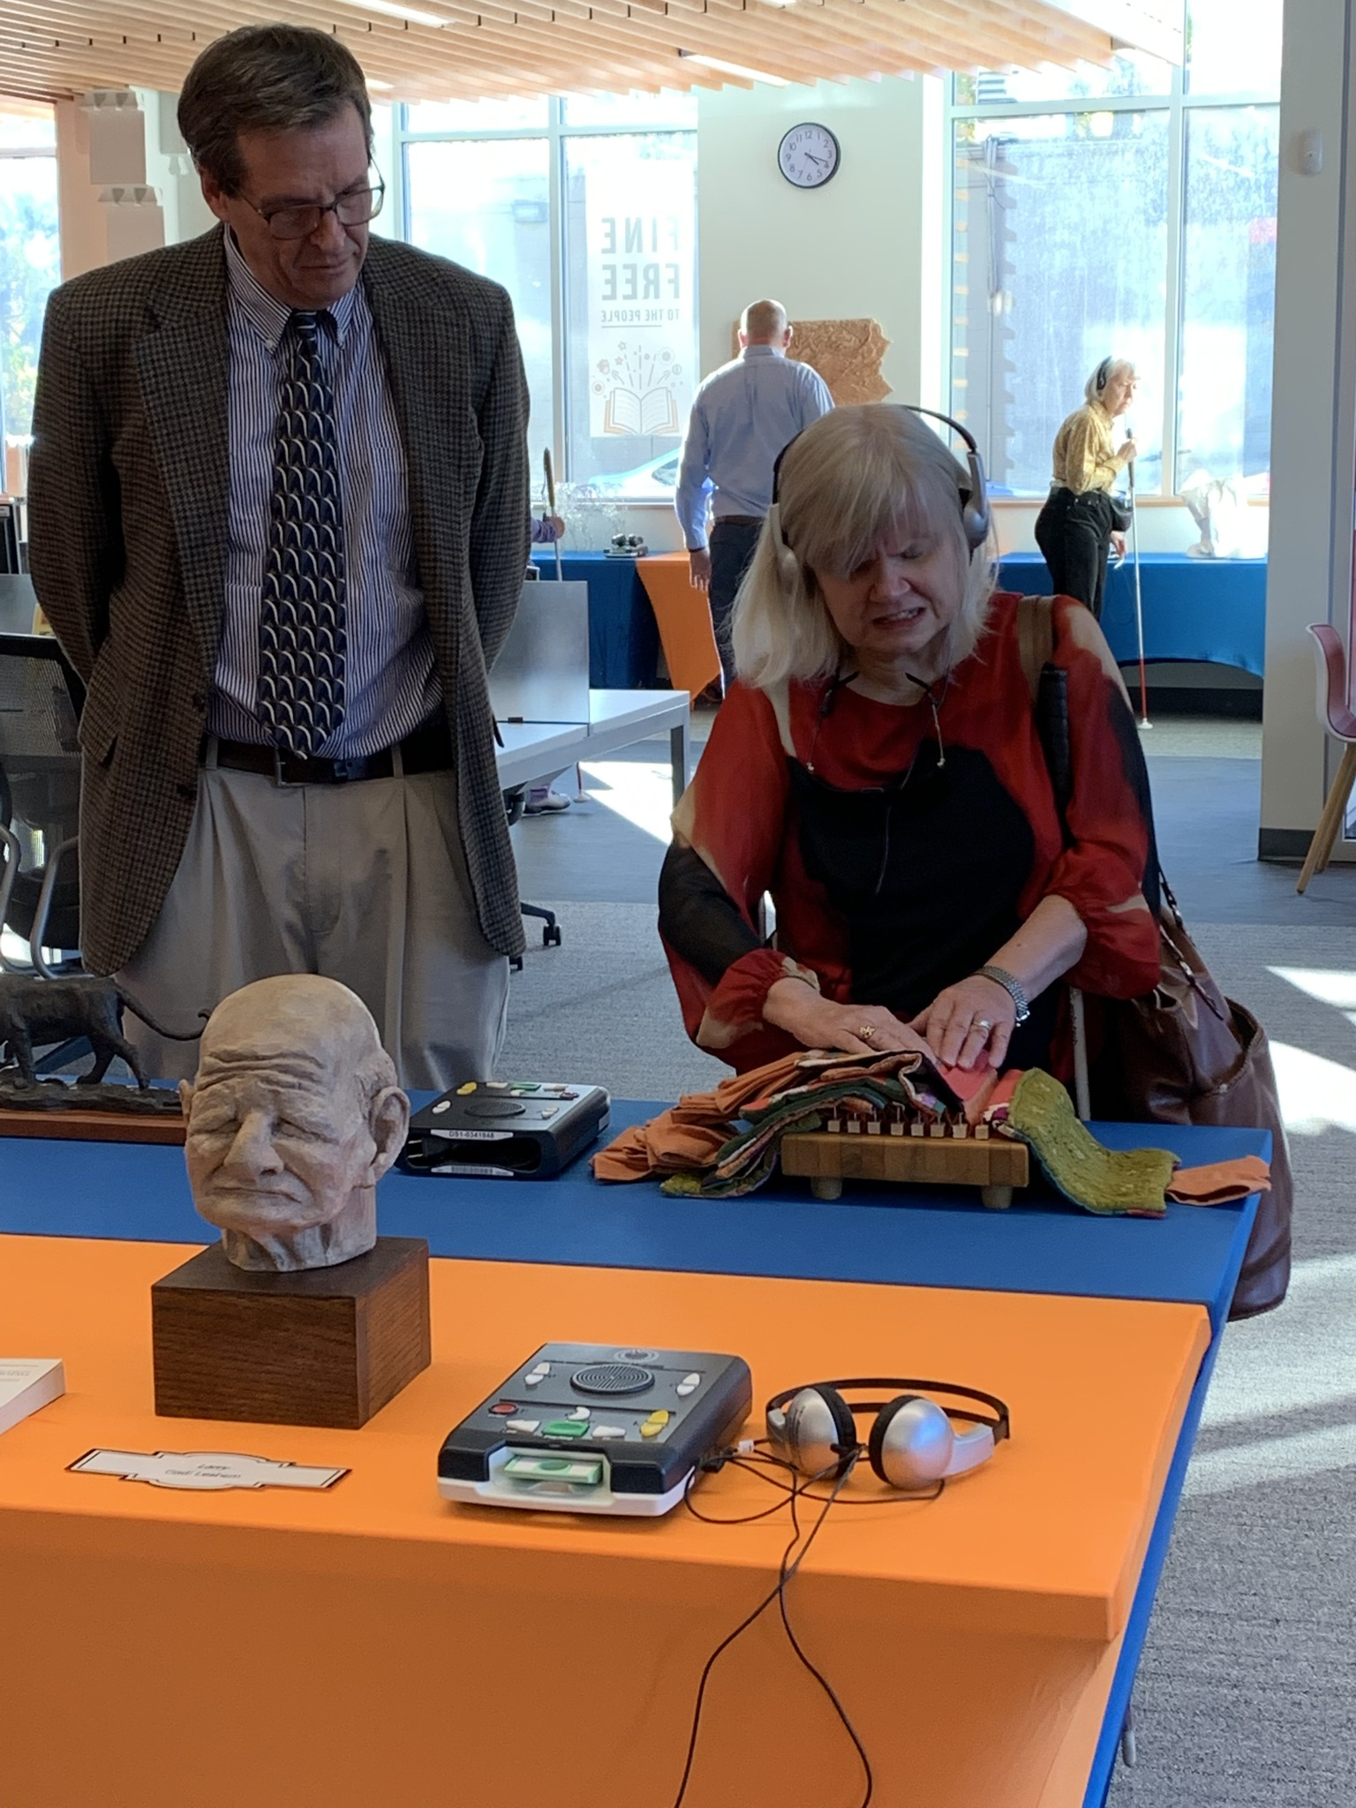
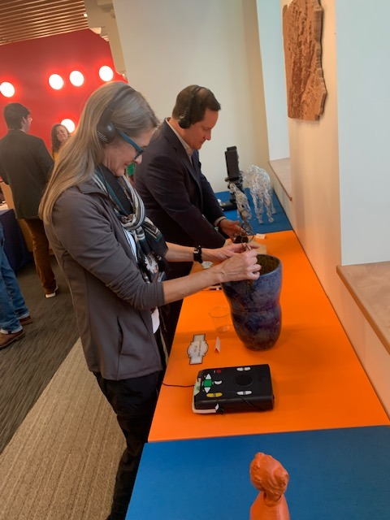
Somatosensory: Relating to the Senses
Notes:
Somatosensory: Relating to the Senses. Art show at LAMP Pittsburgh. W/ Pittsburgh Society of Sculptors
An Art exhibit in which sculptures are allowed to be touched annually done since 2017 at Pittsburgh's LAMP
This Exhibit has a universal design because you can interact with art through touch while also listening to the artist describe the materials, inspiration, and meaning of their work. Can't do that with most art.
This is a month long exhibit taking place in November each year Coordinated by Mary Beth Parks – Please visit this year.

Slide 4
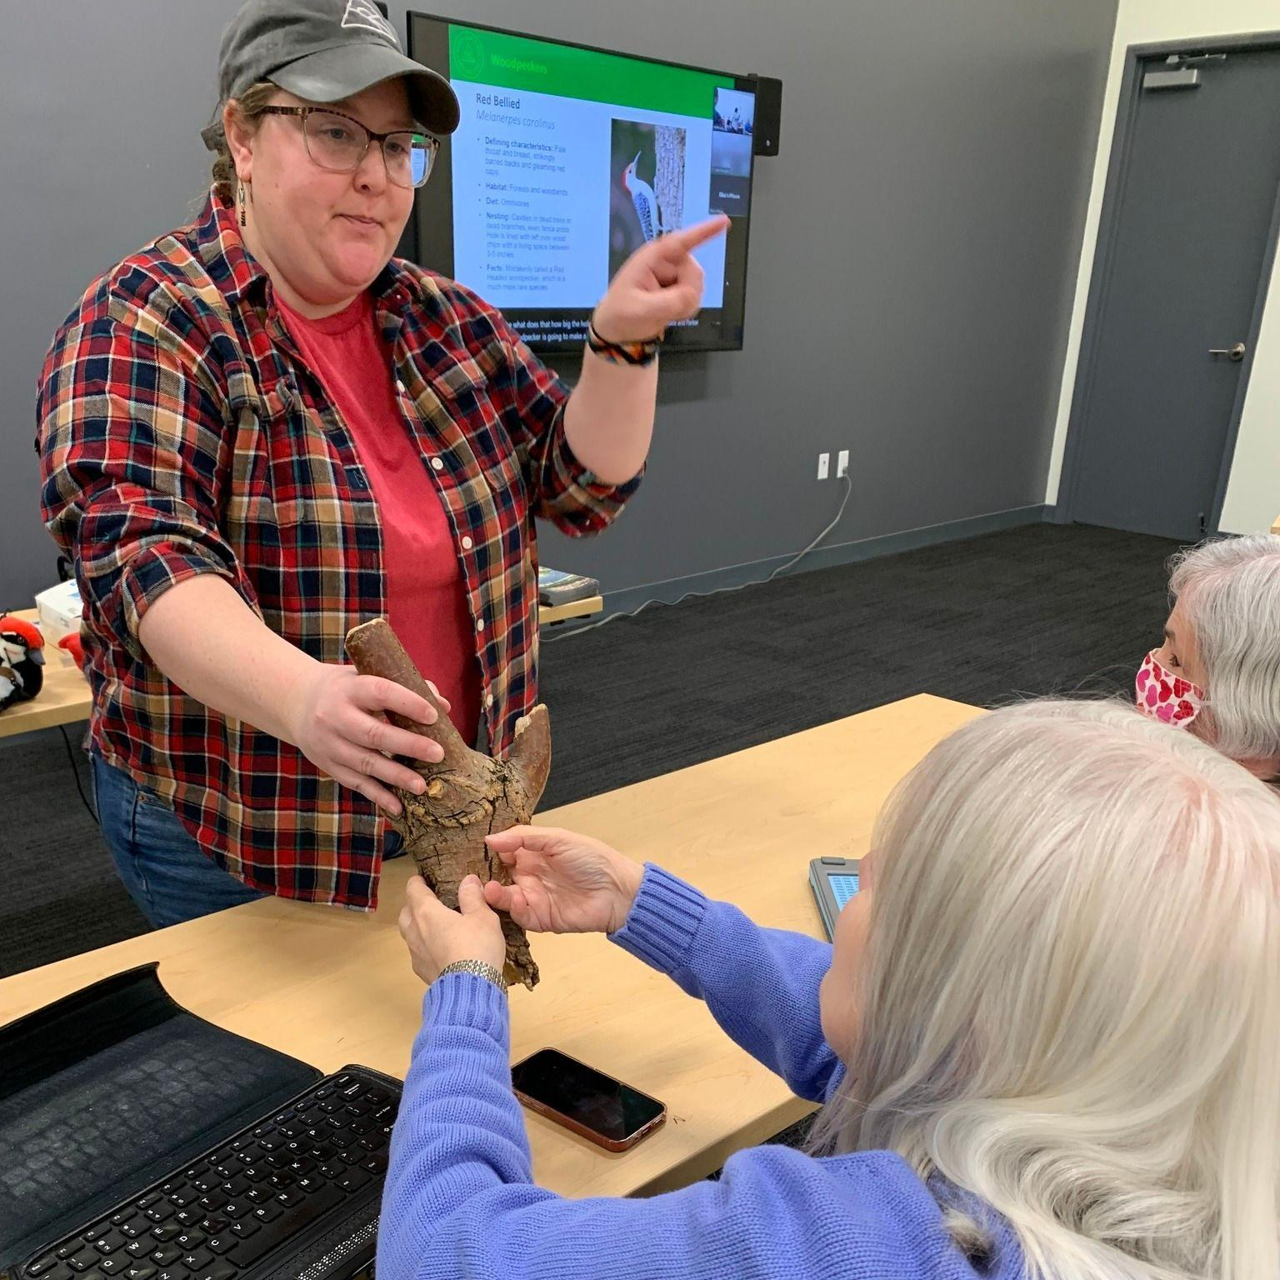
Birding in Your Backyard / Skins & Skulls
Notes:
Other ways we are deliberate about including tactile aspects in Library programs.
We get a menu of programs to choose from and select those that have tactile elements
Contact presenters to let them know that presentations are enhanced if there are items included that people can touch.
Mary Beth is good at having this communication with presenters well in advance of the program date. Gives presenters time to prepare for tactile interactions.

Slide 5
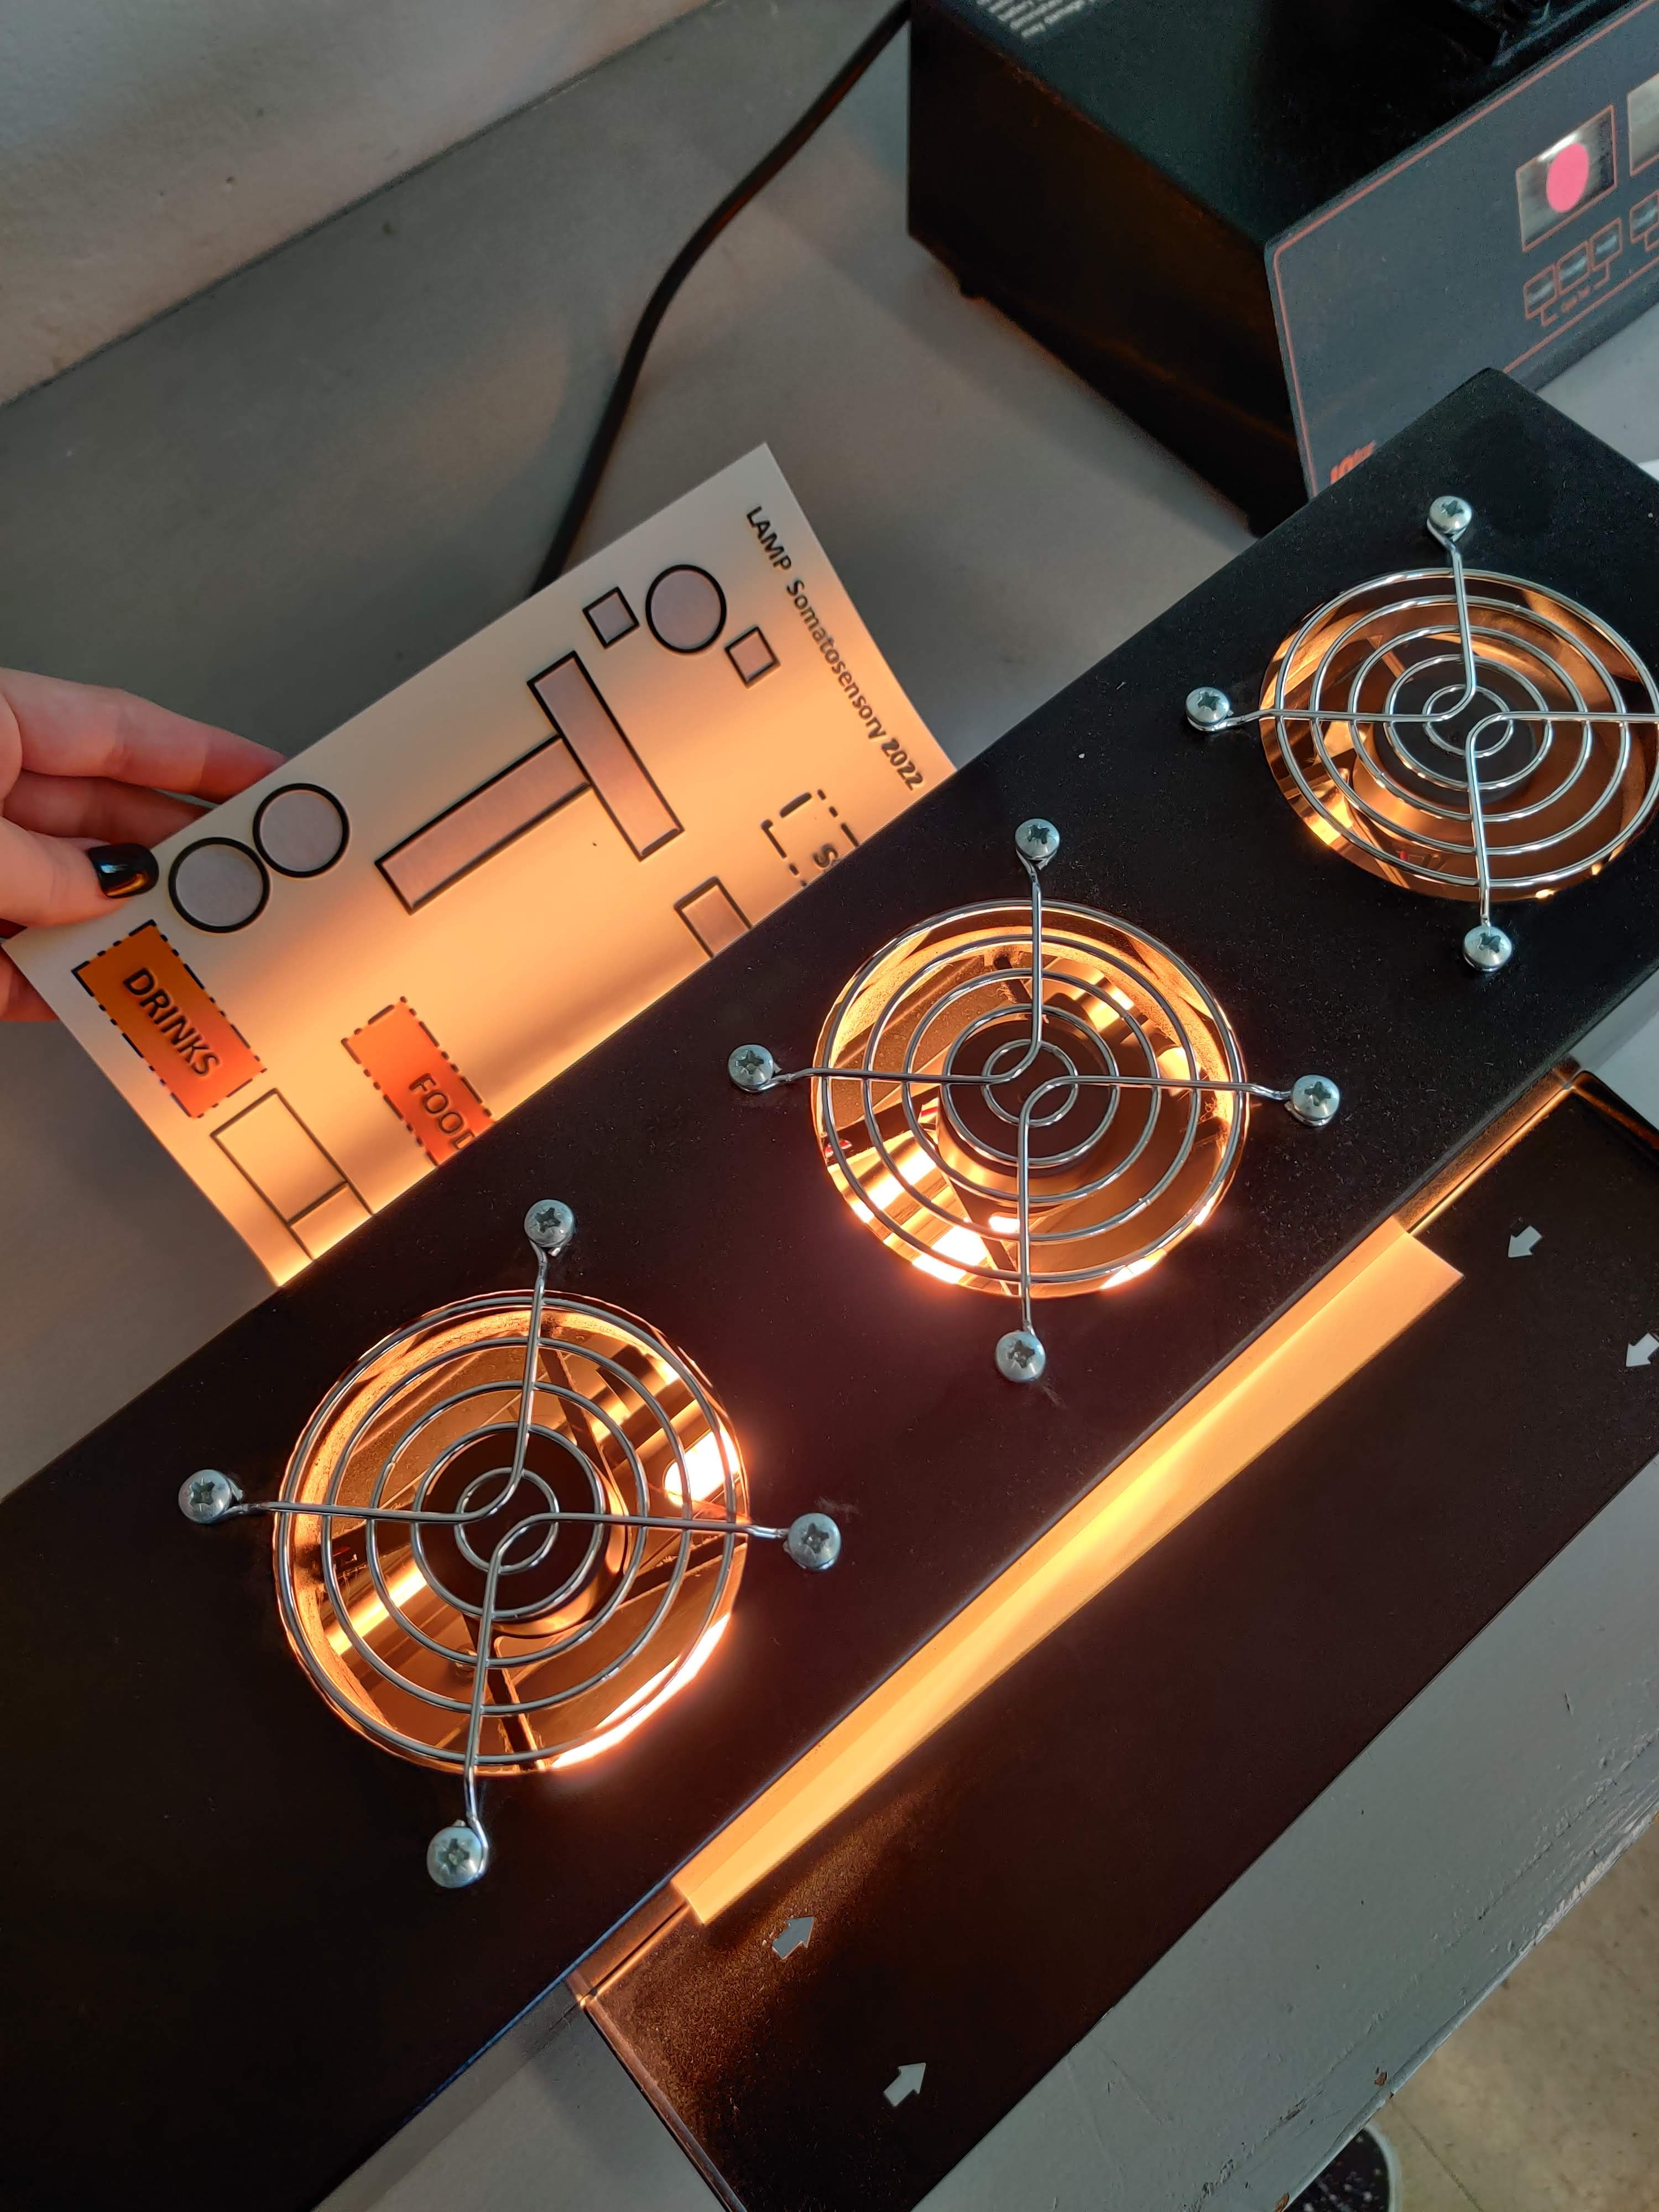
Swell Form production
Notes:
Zyfuse Swell Form Tactile Graphics Machine from American Thermoform. H6” W20” D5”. $1,400. +
As many of you know swell form raises the carbon in black ink and when combined with swell paper and heated in the printer creates a raised tactile image.

Slide 6
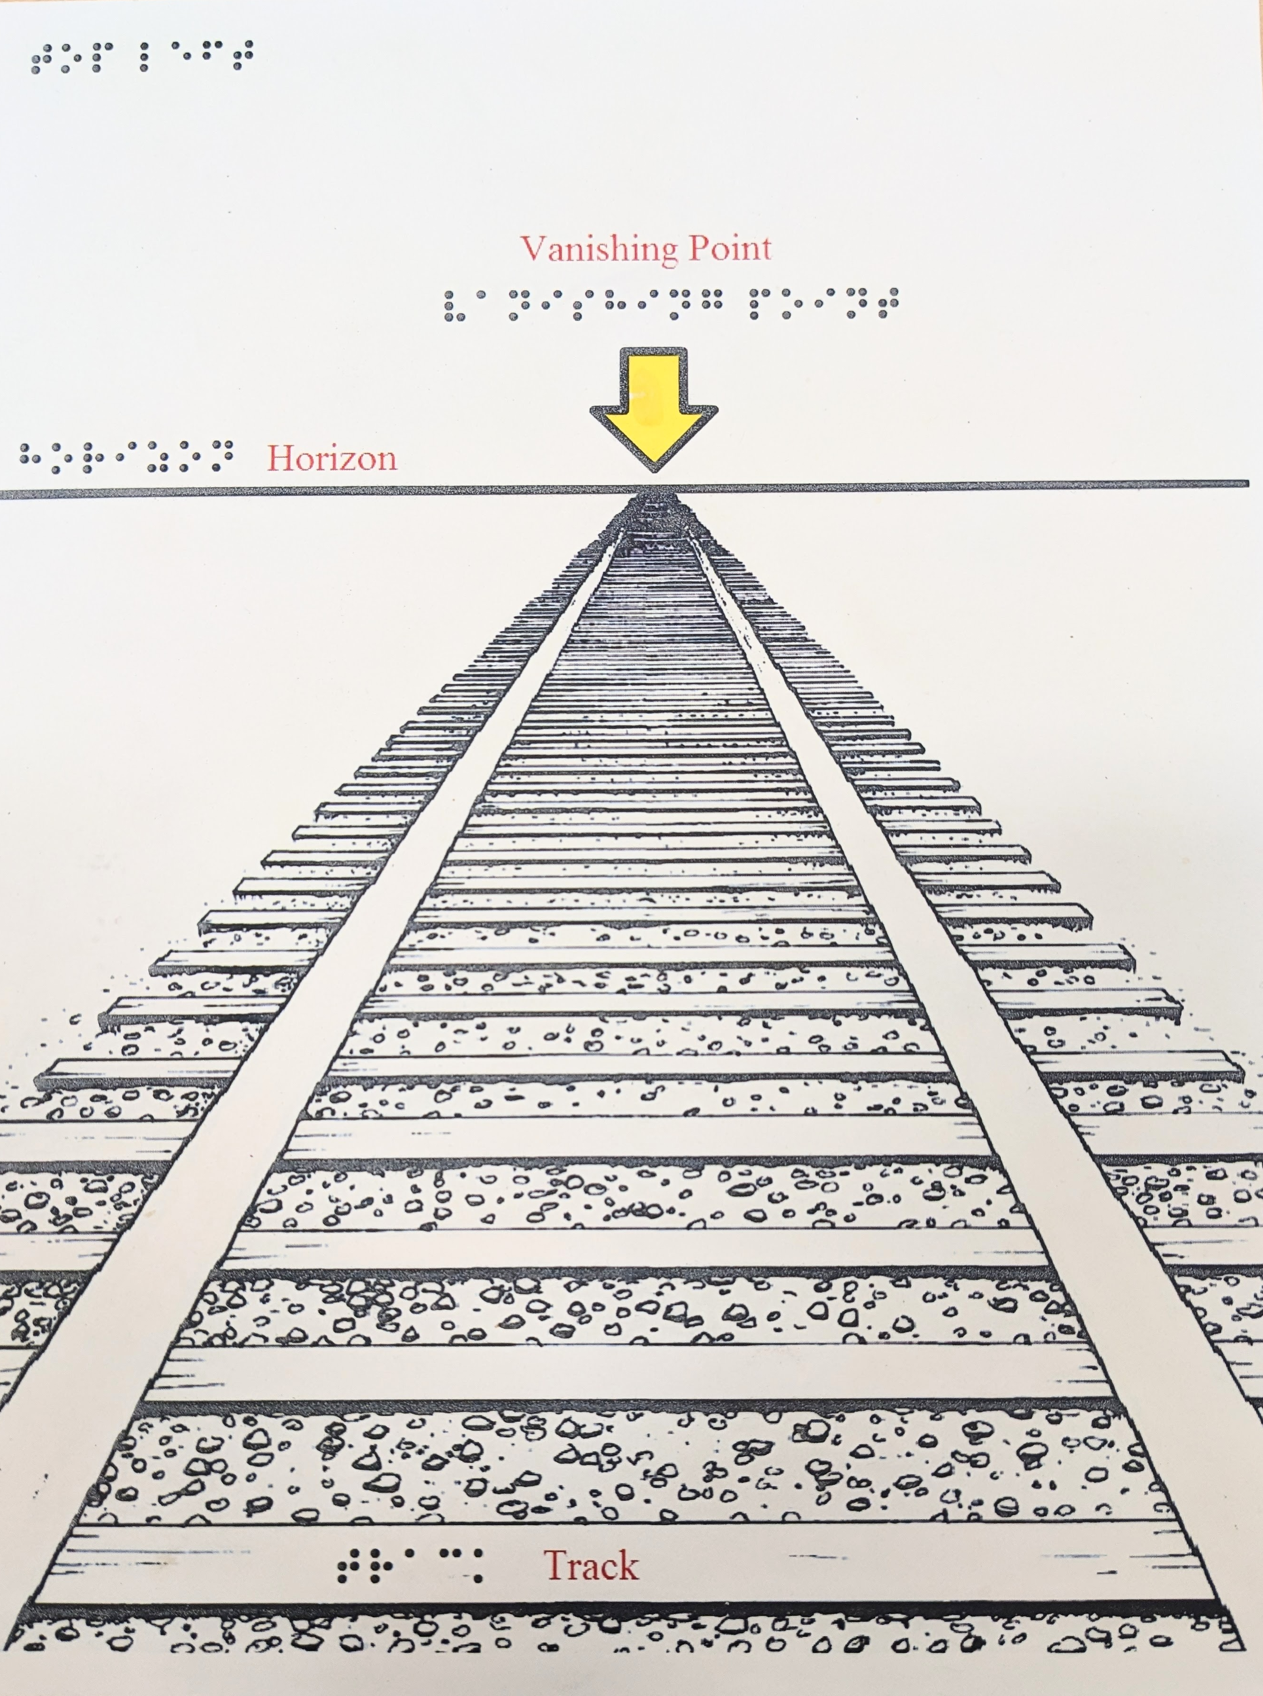
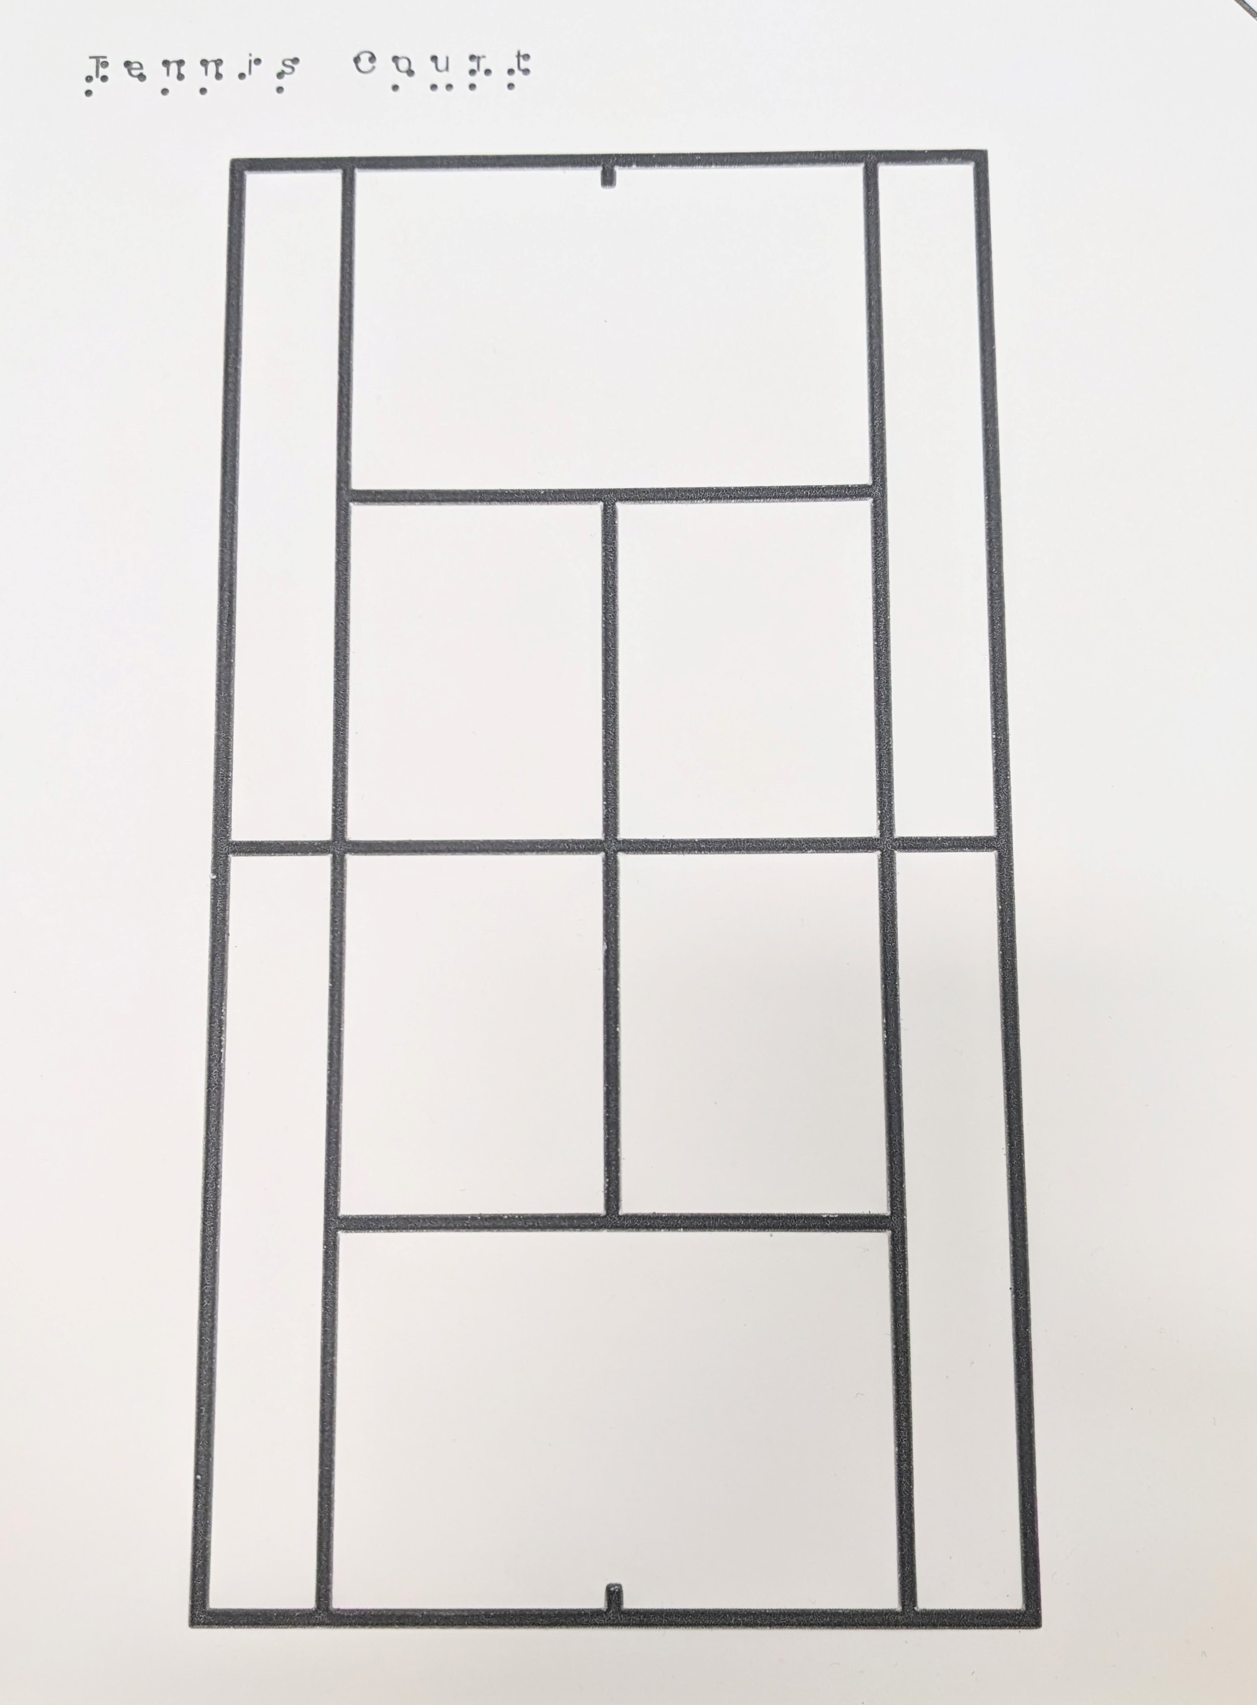
Swell Form Technical Drawings
Notes:
In this slide we have three examples of Swell Form technical drawings. The Left hand image is a Swell Form drawing of railroad track approaching the horizon to explain the concept of the visual vanishing point. The image in the middle is a Swell Form Patent drawing of a Fender Telecaster Guitar. The image on the far right is a Swell Form Tennis Court.

Slide 7
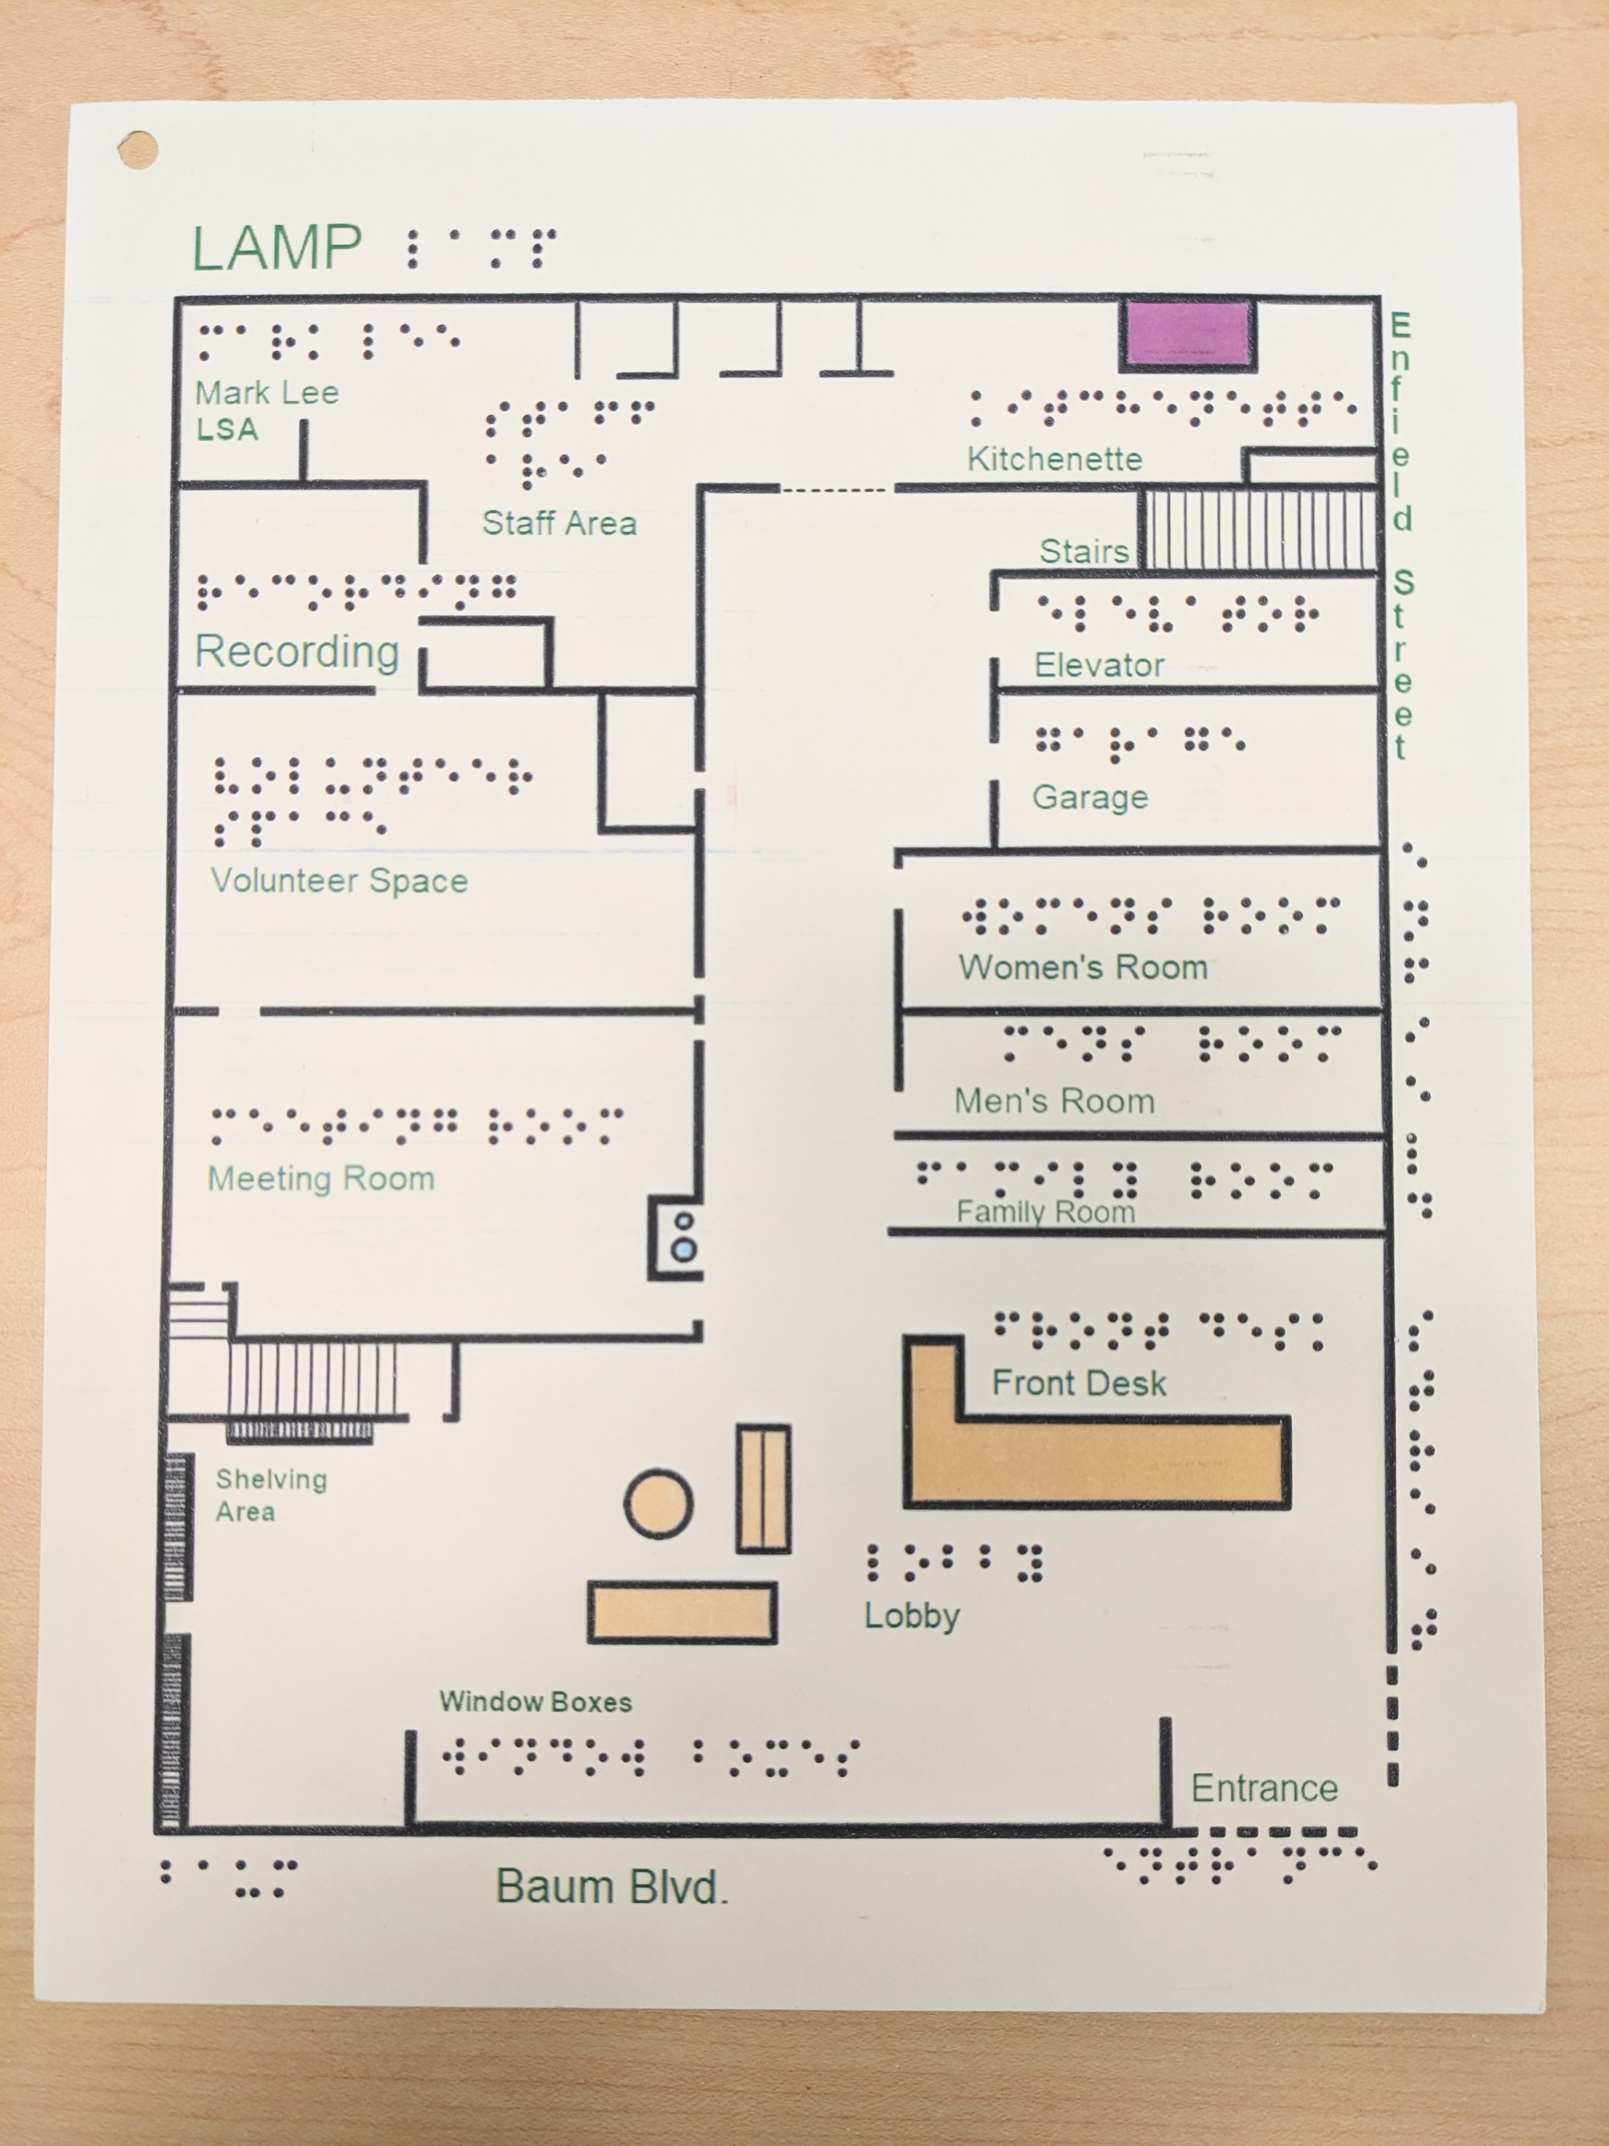
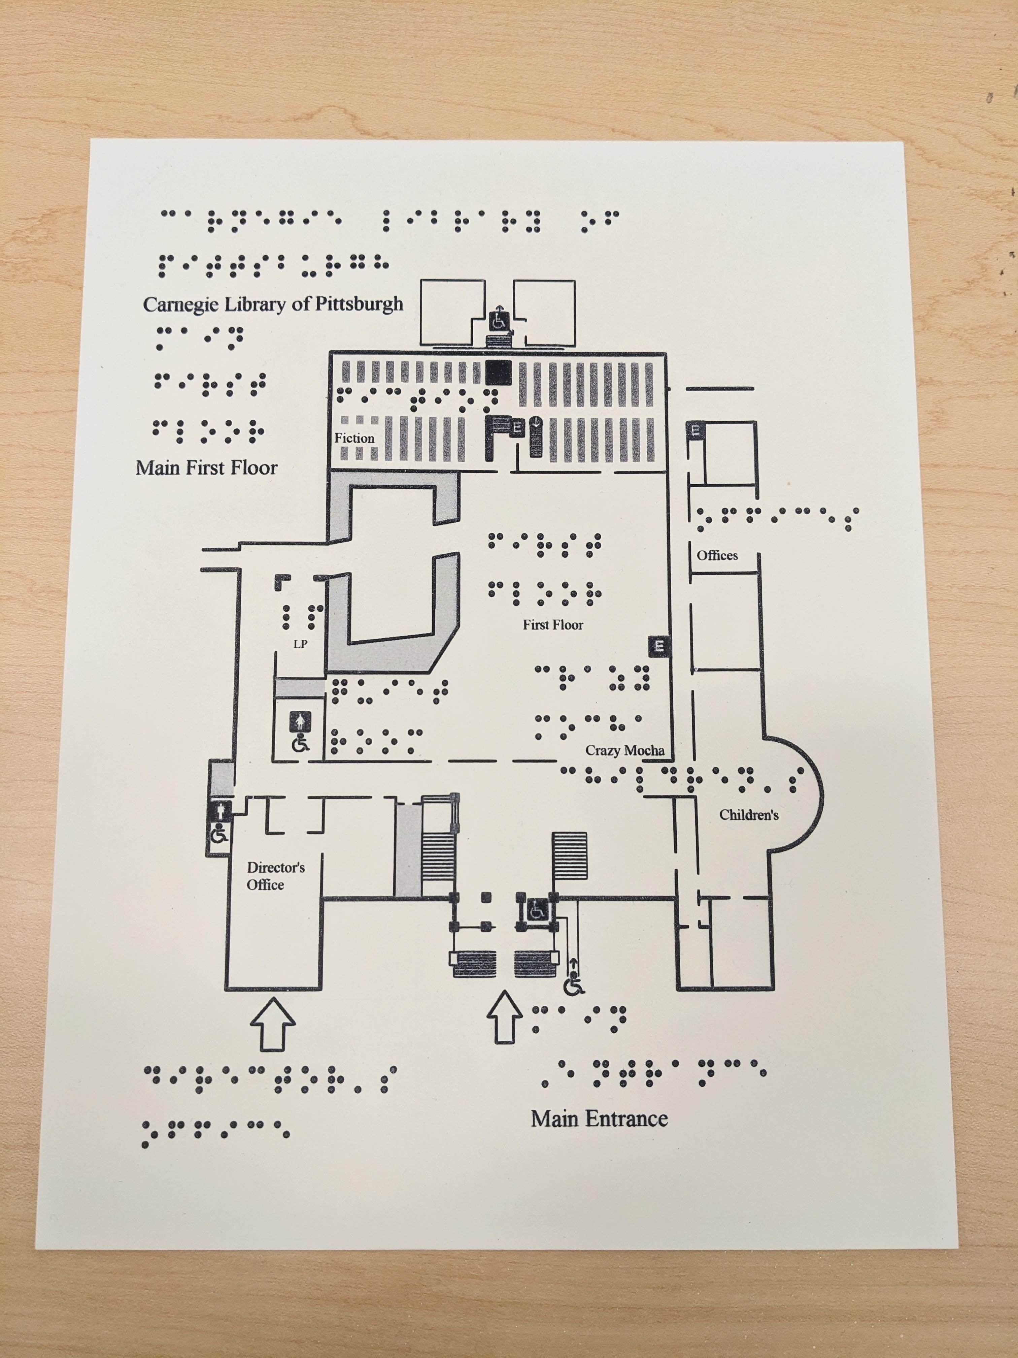
Swell Form Maps
Notes:
The image on the left is a Swell Form map of the first floor of the LAMP Pittsburgh. The image on the right is a Swell Form map of the first floor of the Carnegie Library of Pittsburgh, Oakland branch. Both maps contain print and Braille labeling and are good examples of a practical use of Swell Form technology.

Slide 8
Book Club Cover to Tactile Image
Notes:
In the LAMP book club program we have added these tactile book covers to help precipitate further discussion about the book.
Three images of the cover for the book "The Butterfly Effect: Insects and the Making of the Modern World" by Edward D. Melillo. The image includes drawings of five butterflies of varying sizes in color on a peach background. The first image on the left is the original cover for the book. The second image, in the middle, has been manipulated and edited to create a black and white version that will work well for a Swell Form document. The third image, on the far right, is the final document with a tactile Swell Form representation of the book cover, the title and author in Braille, and tactile orientation mark in the upper right hand corner.

Slide 9
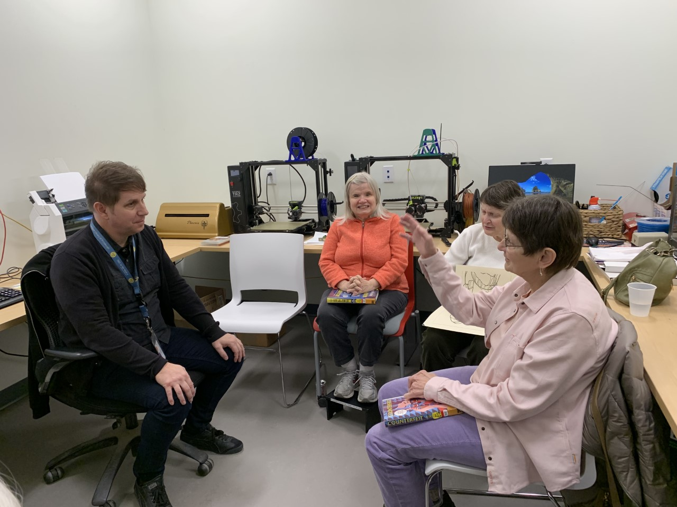
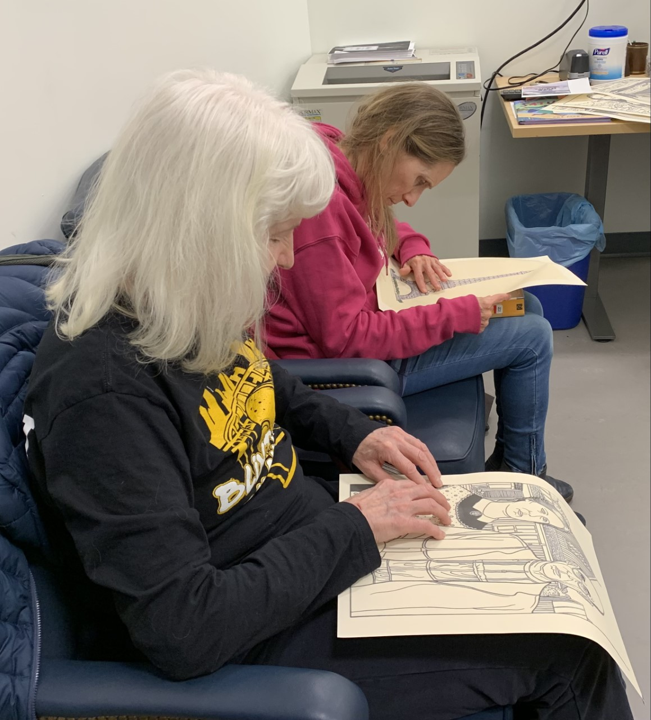
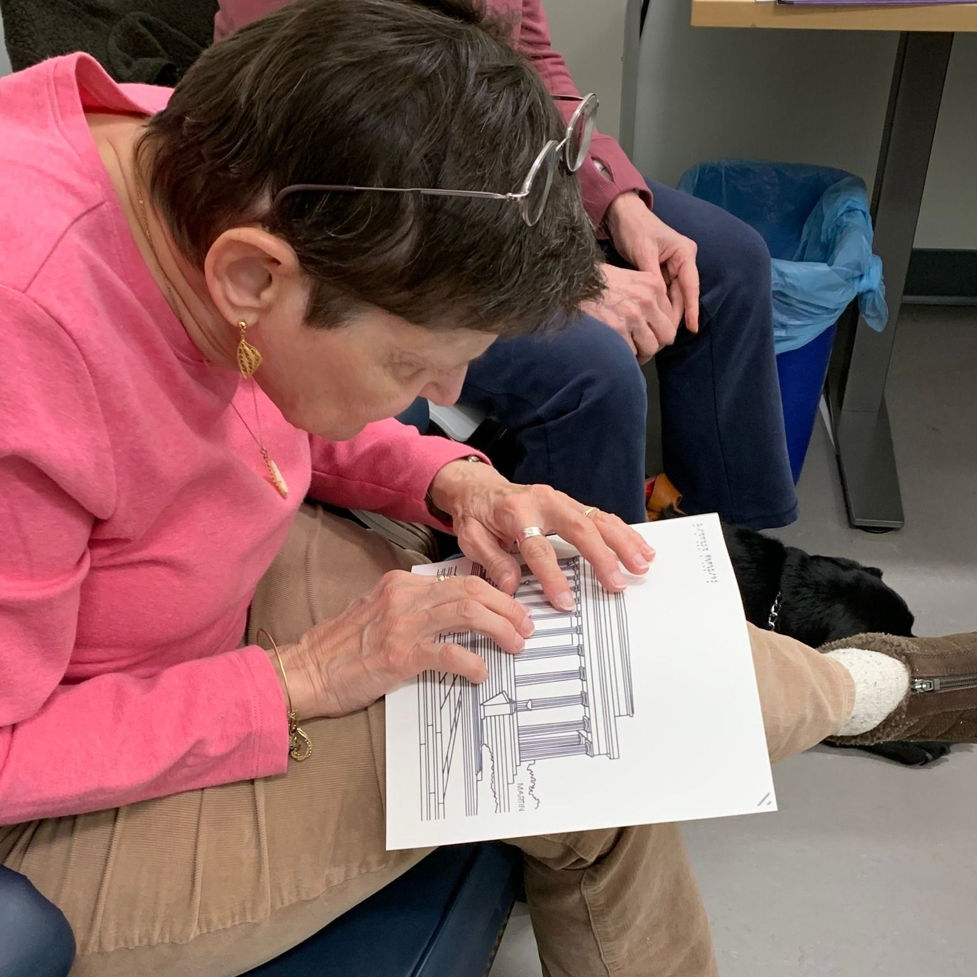
Tactile Tuesday Discussion Group
Notes:
At LAMP Pittsburgh we have a monthly program called Tactile Tuesday. In this group we explore and discuss patron interests in tactile images; and the tools, technology, hardware, and software to create them. Patrons are encouraged to use the hardware and software tools. There is much learned from the participants feedback and their interests drive the direction of the group and is evolving the ways that we include tactile into our programs and service.
There are three images on this slide. The images on the out most left and right are of Tactile Tuesday participants examining Swell Form graphics with their hands. The center image is of the discussion group conversing and sharing their opinions and interests.

Slide 10
Index Everest-D V5 Braille Embosser from Humanware: $4,300 500 sheets of Braille paper from American Thermaform: $30
Notes:
In this slide we have a picture of the Index Everest-D V5 Braille Embosser. H18” W22” D7”. Features Braille and text labeled control. Has synthetic speech to help guide the user. WiFi. Bluetooth. The paper feeds from the top. $4,300 from Humanware. 500 sheets of Braille paper from American Thermaform $30. We use this tool to create Braille documents and embossed images.

Slide 11
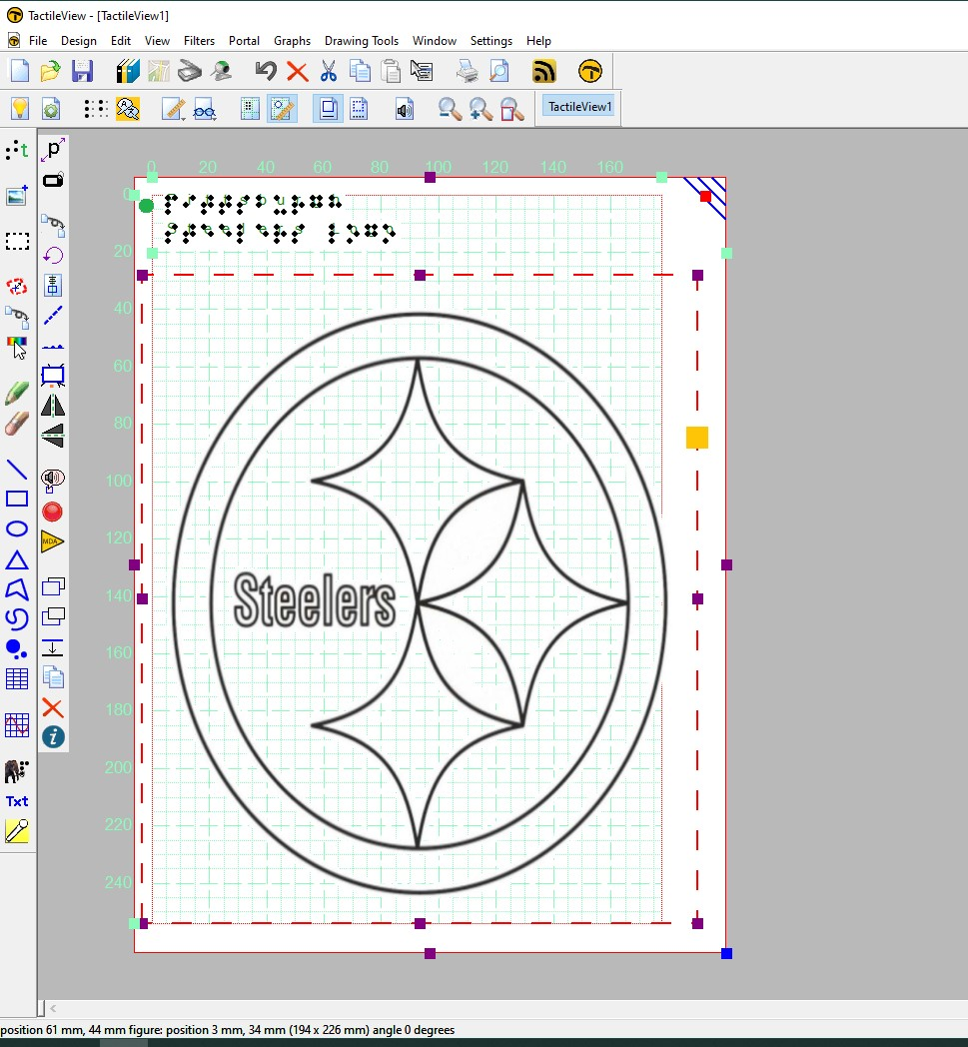
Tactile View software
Notes:
The Tactile View software is another tool that we use to create tactile graphics and documents. With Tactile View a user is able to manipulate and edit graphics, add Braille and print, add an orientation mark in the upper righthand corner, and then either print to a Braille embosser or to an ink printer, which may later be processed to Swell Form. Manufacturer documentation states fully accessible with a screen reader.
In this slide we have the software work area. There are Graphic tool icons that span the top and left hand side of the software window. The graphic that is being worked on in this space is the Pittsburgh Steelers football team logo consisting of a circle around three four-pointed stars.

Slide 12
LulzBot TAZ Pro Dual Extruder 3D Printer: $4950 Filament: $21 and up
Notes:
We learned about this printer and many as well as the Index Everest from our good friends at Andrew Heiskell Library in New Your at the last conference in New York in 2019-Sorry Jill Rothstein nor Chaucy Fleet could be with us today here.
We like the open design of this printer which allows for tactile exploration of it to understand the concept of 3D printing.
This slide shows the Lulzbot Taz Pro Dual 3D printer sized 32.67 in x 28 in x 20.47 with a spool of white plastic filament on the top and brown plastic filament on the side of the printer. In the foreground 3 dimensional prints of the capital building and glasses.
LulzBot TAZ Pro Dual Extruder 3D Printer: $4950 Filament: $21 and up

Slide 13
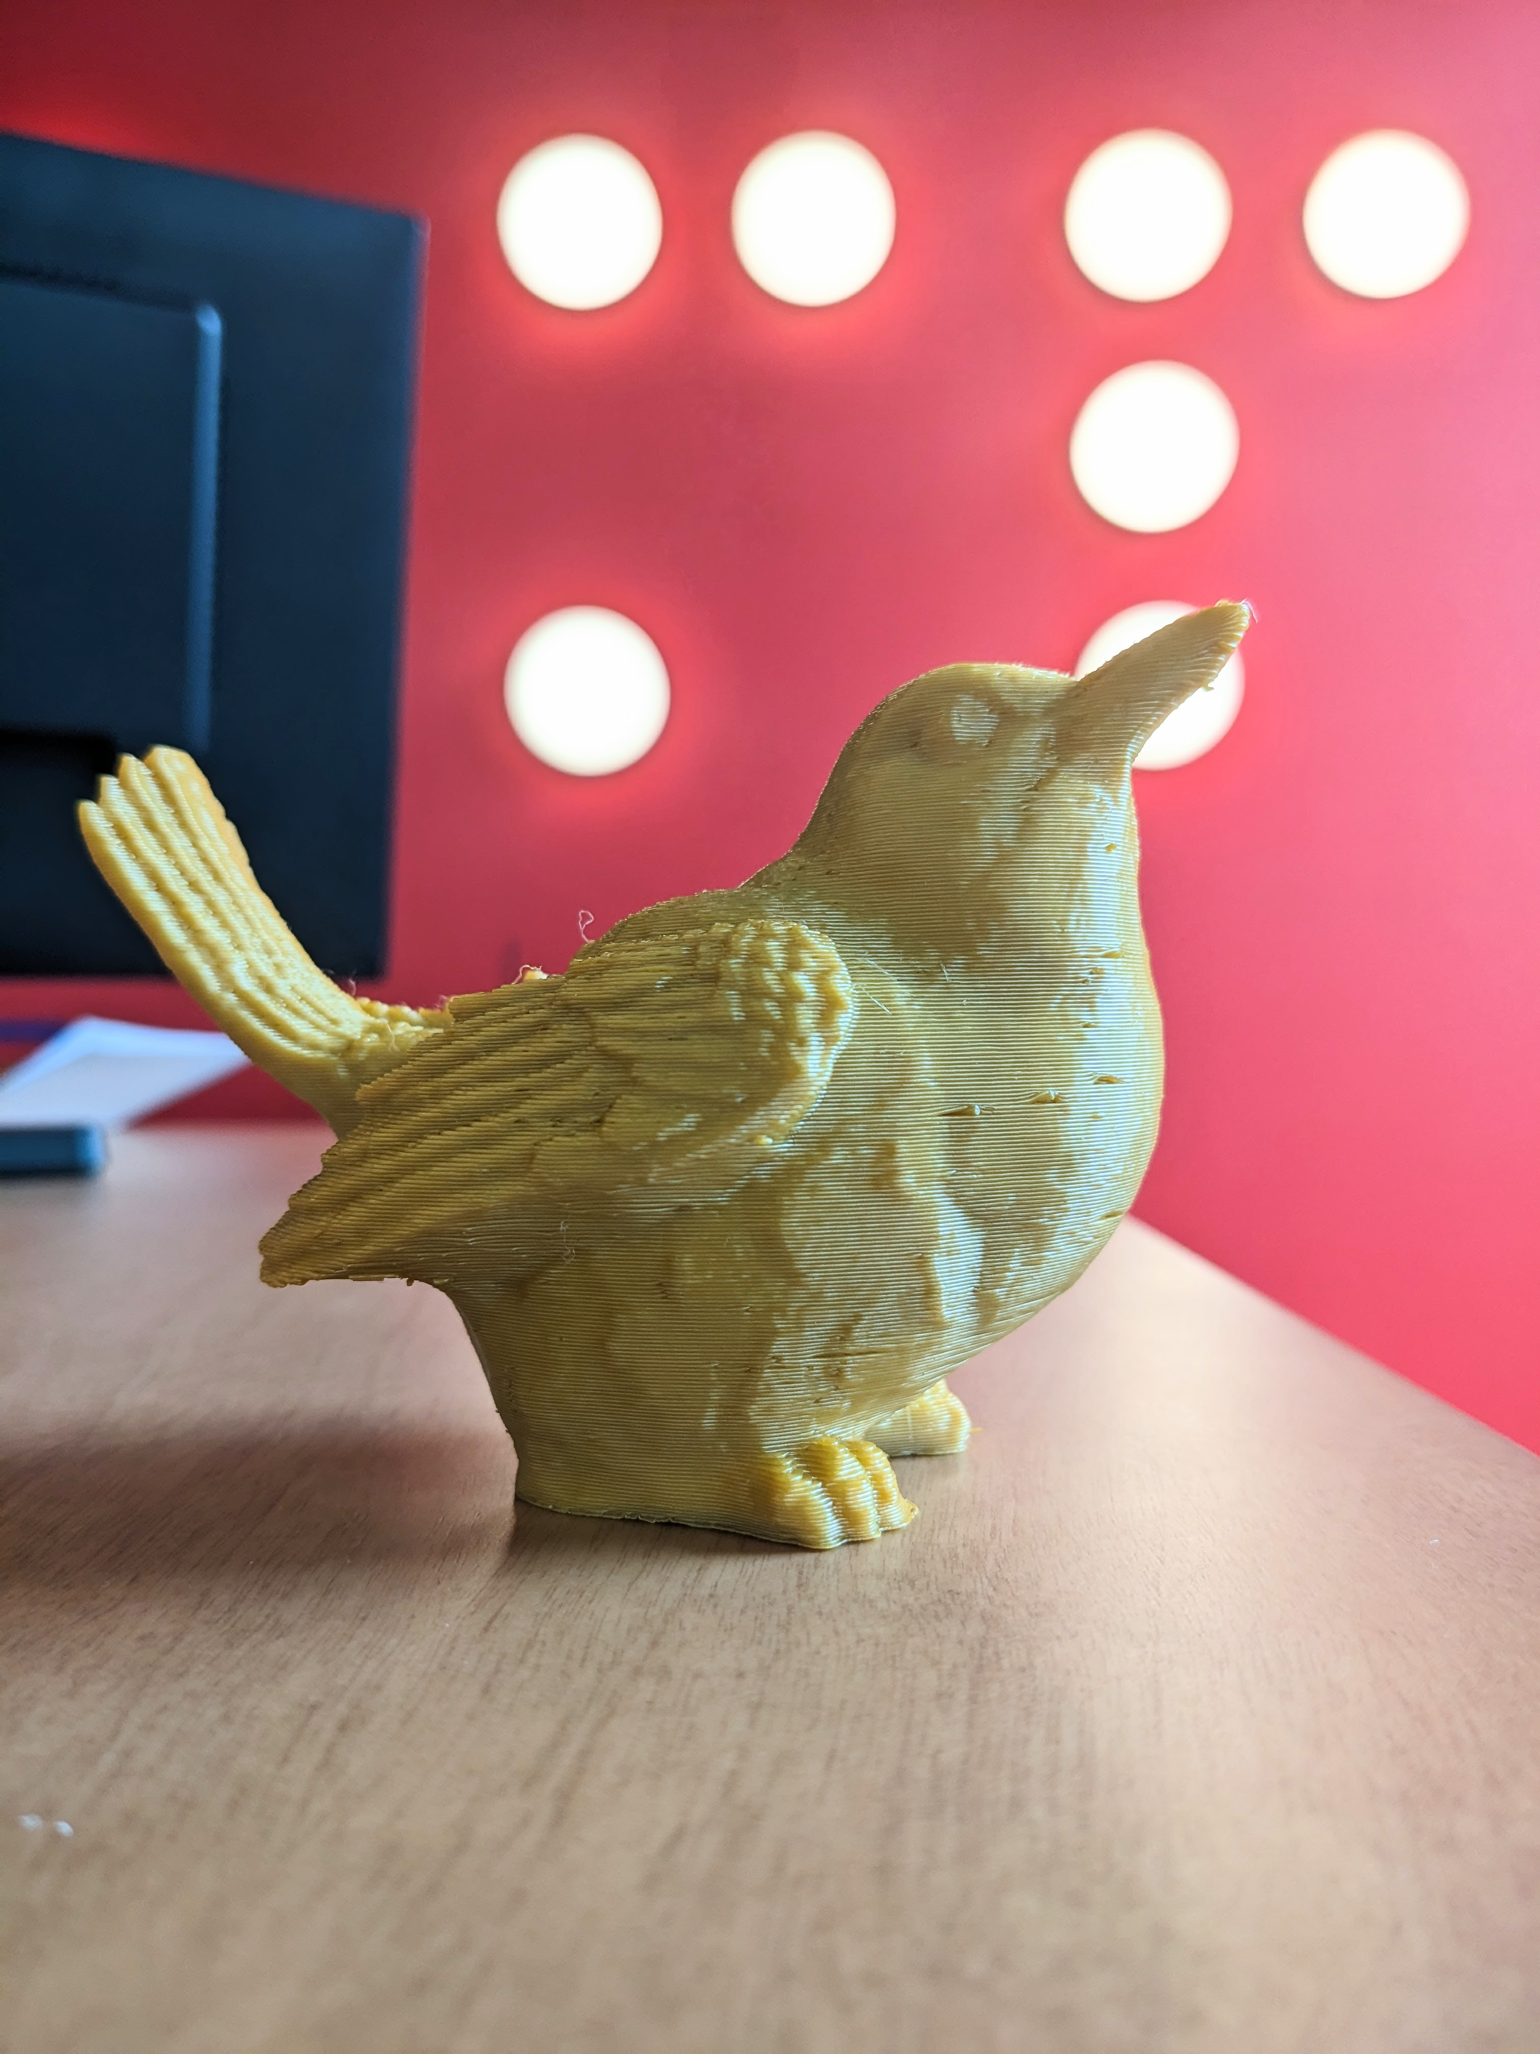
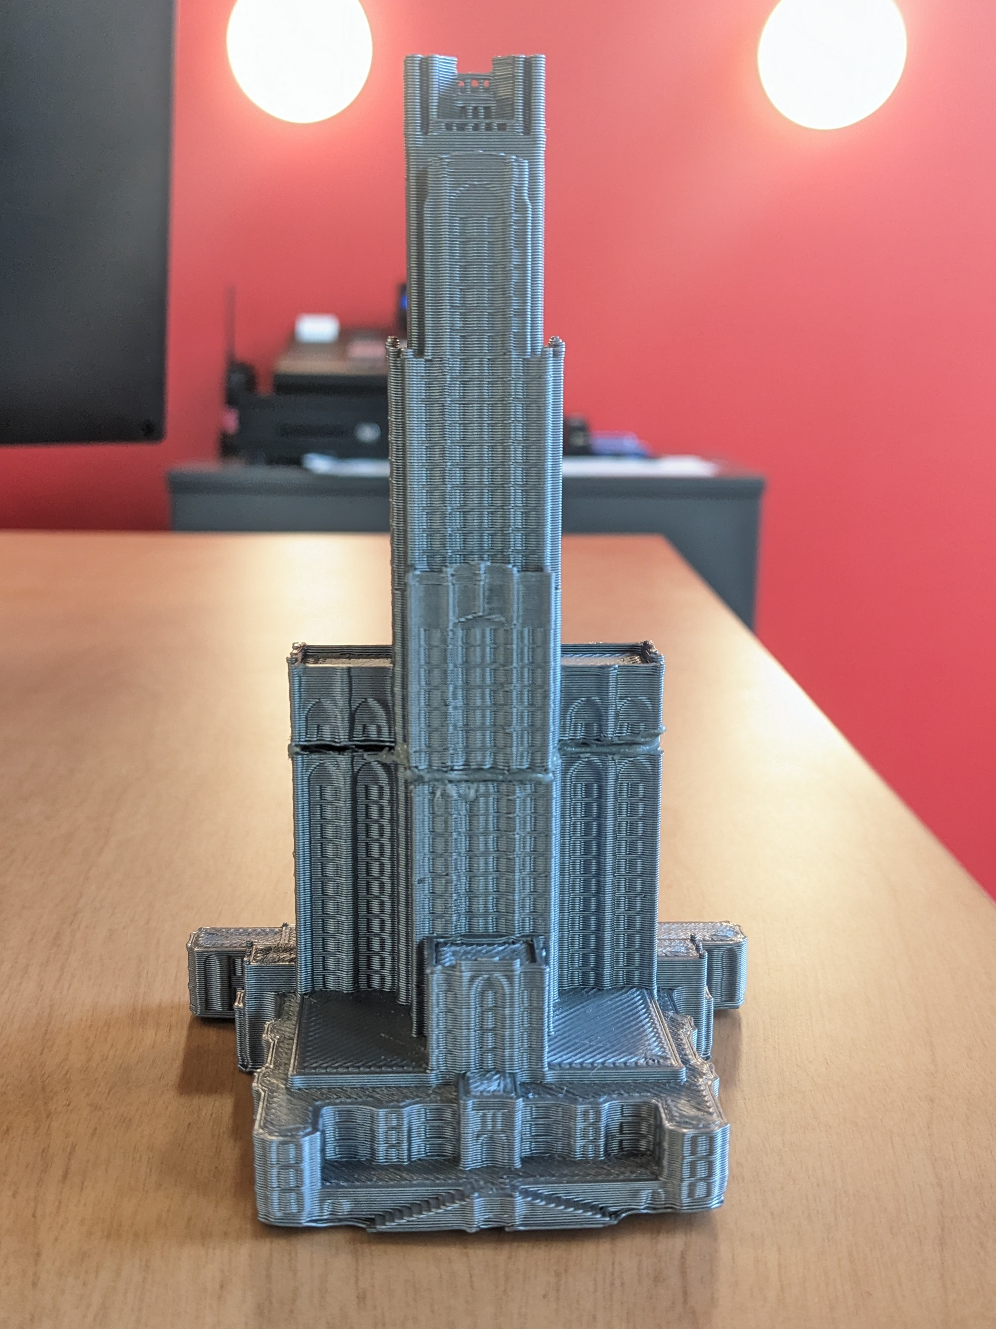
3D Prints
Notes:
On this slide we have three examples of items that we have 3D printed using the LulzBot printer. The first image on the left hand side is a representation of the University of Pittsburgh’s Cathedral of Learning building. The second image, in the middle, is a representation of a bird. The third image is a representation of the mid section of the Capitol building in Washington DC. The two outer images might be considered good candidates for tactile production due to the originals being too large to fully experience by touch. The bird could be considered a good candidate for tactile production due to the originals unavailability to fully experience by touch.

Slide 14
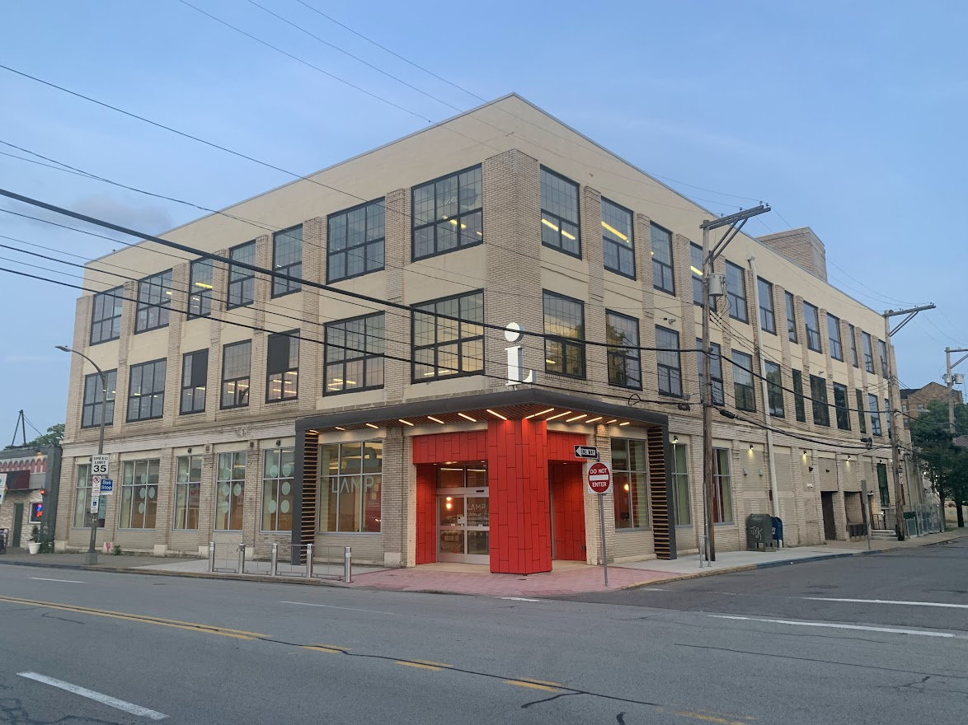
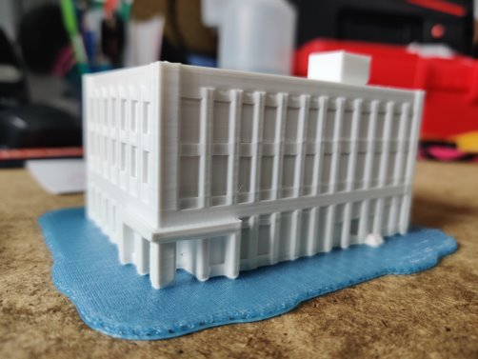
3D Model Print of LAMP Pittsburgh Leonard C. Staisey Building
Notes:
In this slide we have an example of modeling an existing item or structure in software and then printing to 3D.
Image one is a photo of the actual LAMP Leonard C. Staisey building in Pittsburgh.
Image two is of a scale recreation in the 3D design software (Autodesk Tinkercad).
Image number three is the finished product, a 3D printed representation of the Pittsburgh Library of Accessible Media for Pennsylvanians.

Slide 15
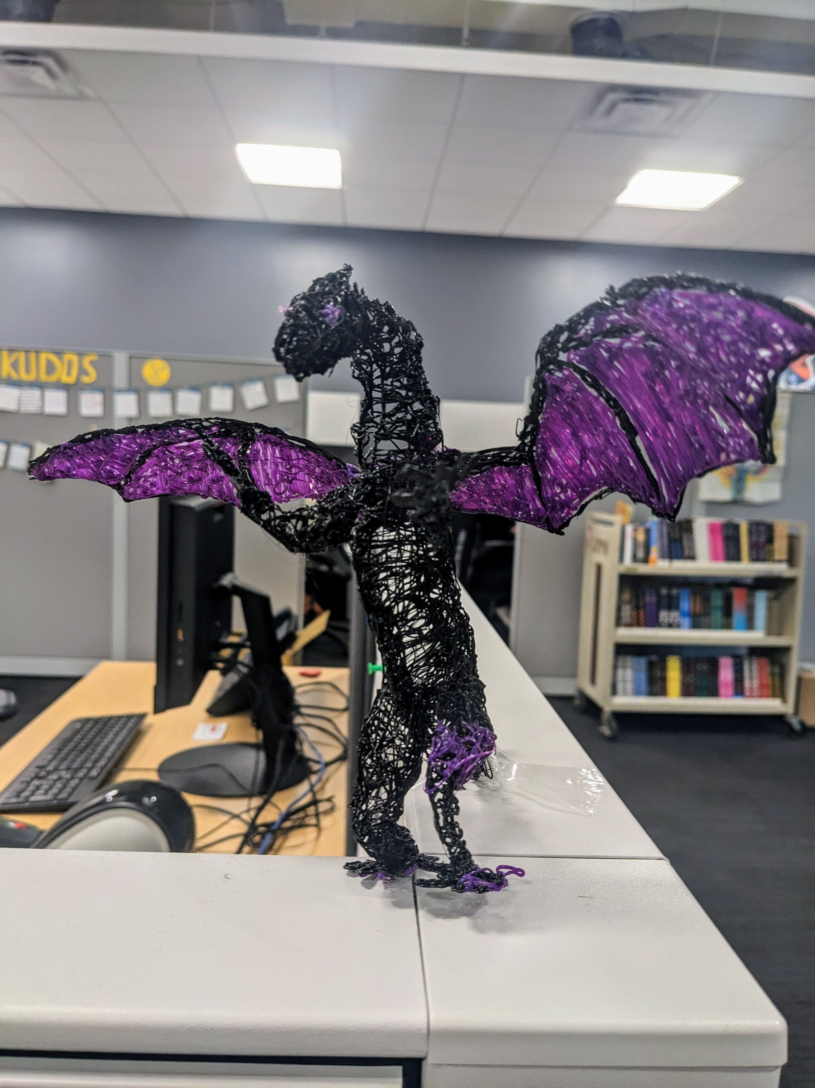
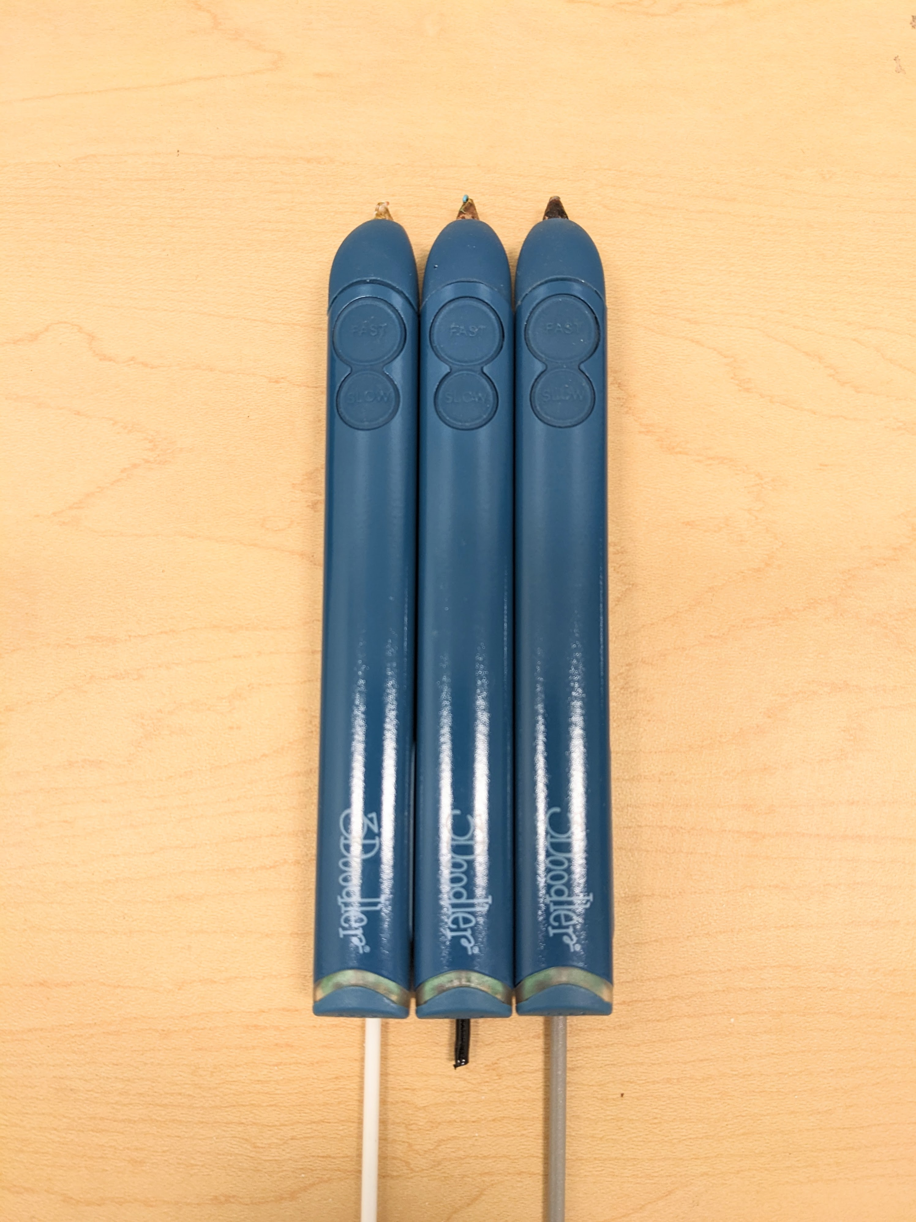
3D Pens: Practical use examples
Notes:
We have 3D pens which we purchased to utilize in programming or to quickly create a tactile representation of an object to aid in the communication of a given concept.
Pens with filament protruding from their base
Real-world Example Karen Kenniger at Andrew Heiskell (we learned a great deal from our friends in New York) Met Accessible tour of Jackson Pollack involved no touch so later I mocked up a Jackson Pollack

Slide 16
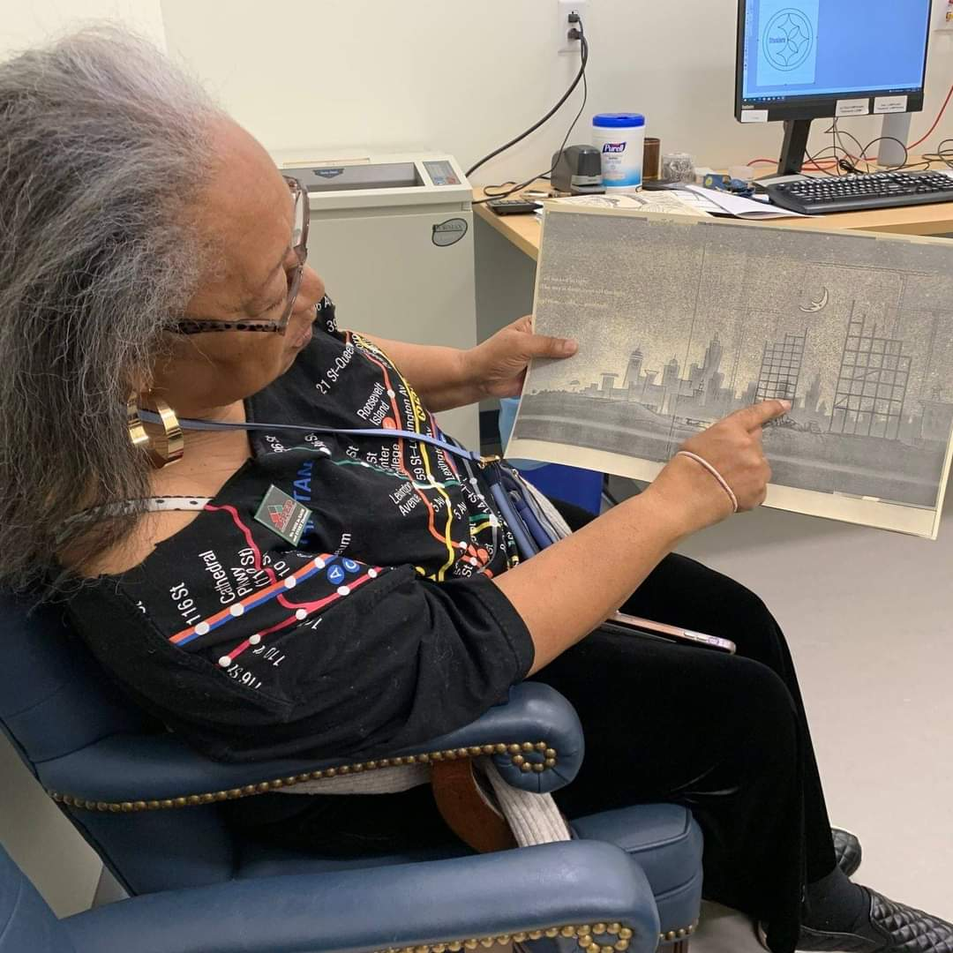
Support for Individual Requests
Notes:
Supporting Individual Requests. An educational consultant from the Golden Pillow Project, that works with disadvantaged kids in Pittsburgh, requested Swell Form images from books that are used for teaching. In both images we have the educational consultant displaying the newly created tactile documents.

Slide 17
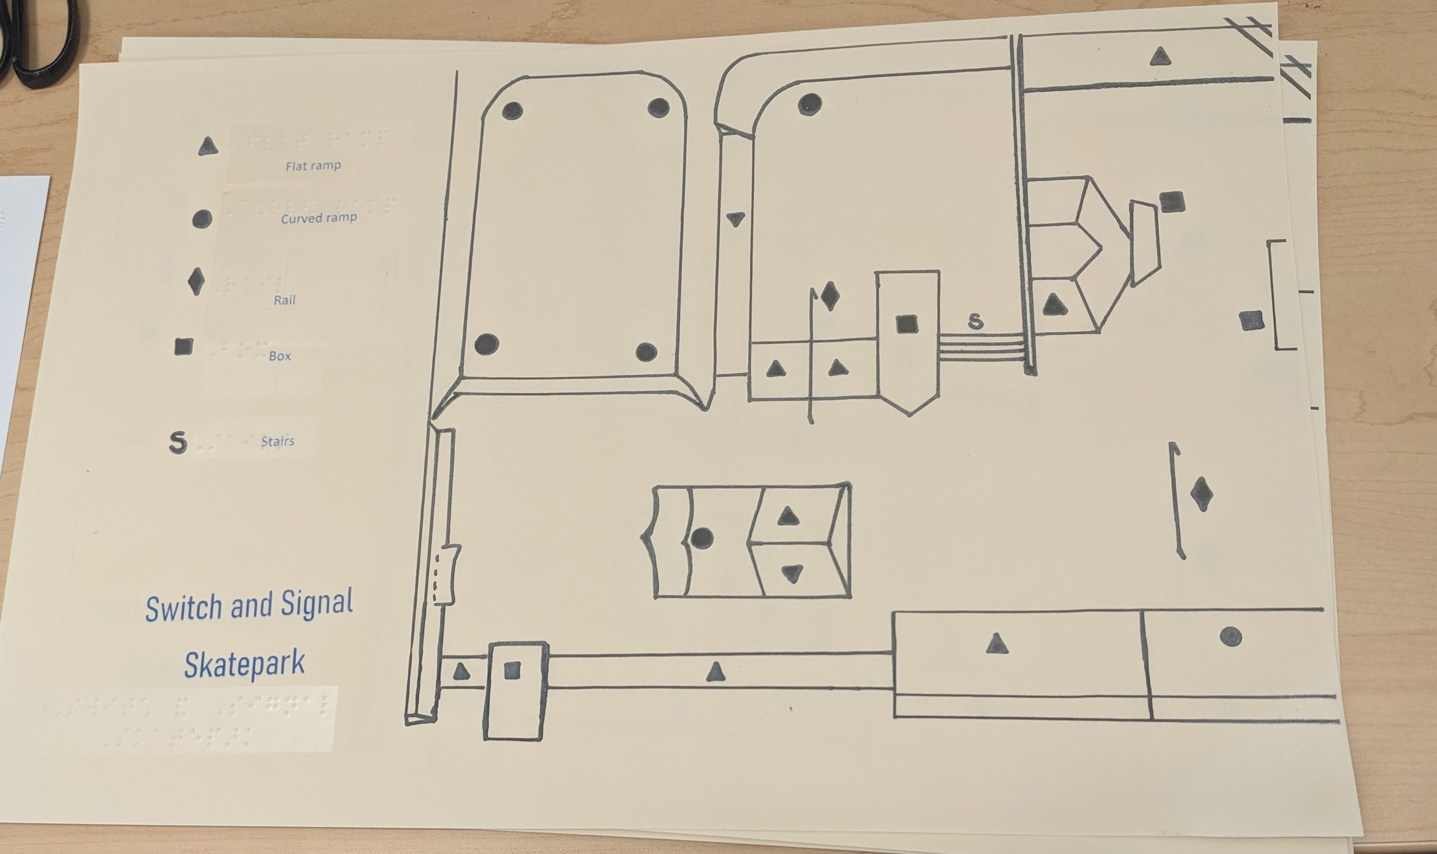
Support for Community Projects & Events
Notes:
An example of supporting community projects and events we were contacted by University of Pitt Graduate Student Hana Goodman that was coordinating an event between the Switch and Signal Skatepark and members of Western PA Blind Outdoor Leisure Development (BOLD).
Image on the left is a Swell Form map of the indoor skateboard park with a guide key in both print and Braille. The image on the right is a photo of the creator Hana holding the map.

Slide 18
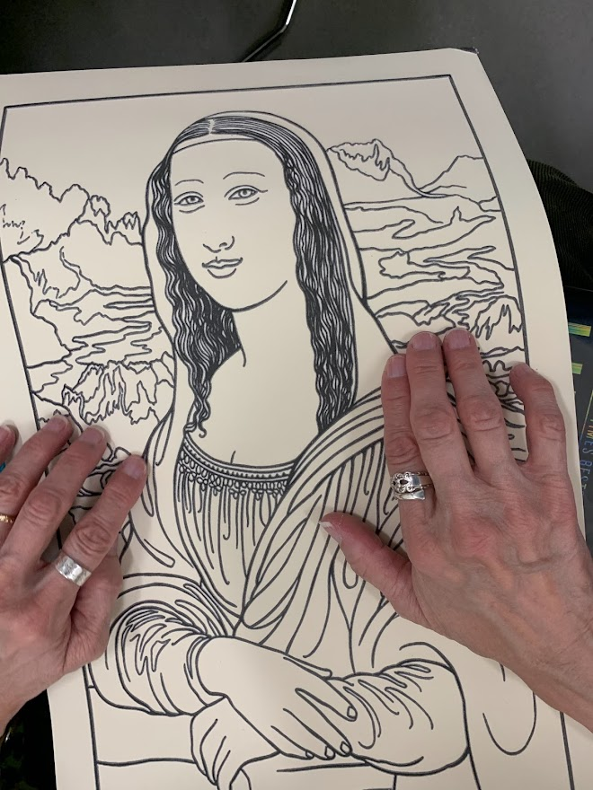
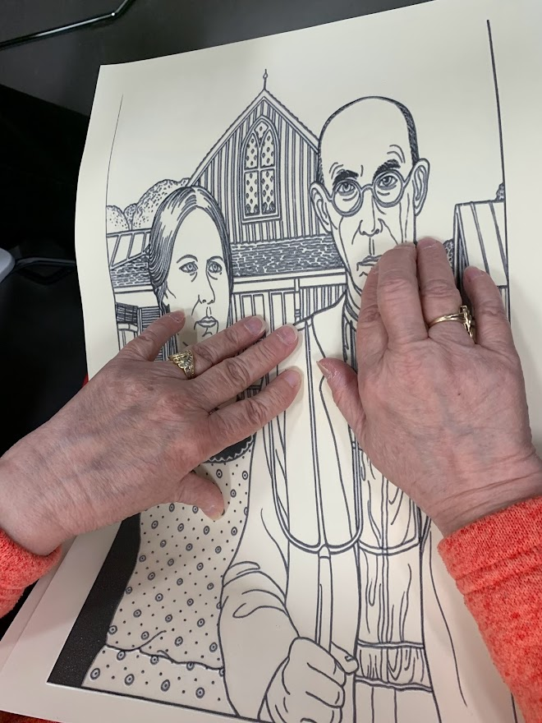
Tactile Tuesday Discussion Group: Swell Form Master Paintings
Notes:
There are three images of Swell Form representations of famous master paintings being examined by our Tactile Tuesday program participants. From left to right, The Mona Lisa, The Scream, and American Gothic.
What we discovered from our Master Paintings Swell Form experiment, was that many of the participants were aware and had heard of these paintings, but they had no connection or experience of them. Some had commented about how they differed from their expectations. And although these are representations of the originals, the over all feedback was that of an enriching experience.

Slide 19
The End
Library of Accessible Media for Pennsylvanians
http://mylamp.org
Mark Lee Library Services Administrator
Stephen McMillen LAMP Service Integration Lead
Notes:
The End
Library of Accessible Media for Pennsylvanians
http://mylamp.org
Mark Lee, Library Services Administrator
Stephen McMIllen, LAMP Service Integration Lead

