Slide 1
Staff Training from Carnegie Library of Pittsburgh
Library for the Blind and Physically Handicapped

Slide 2
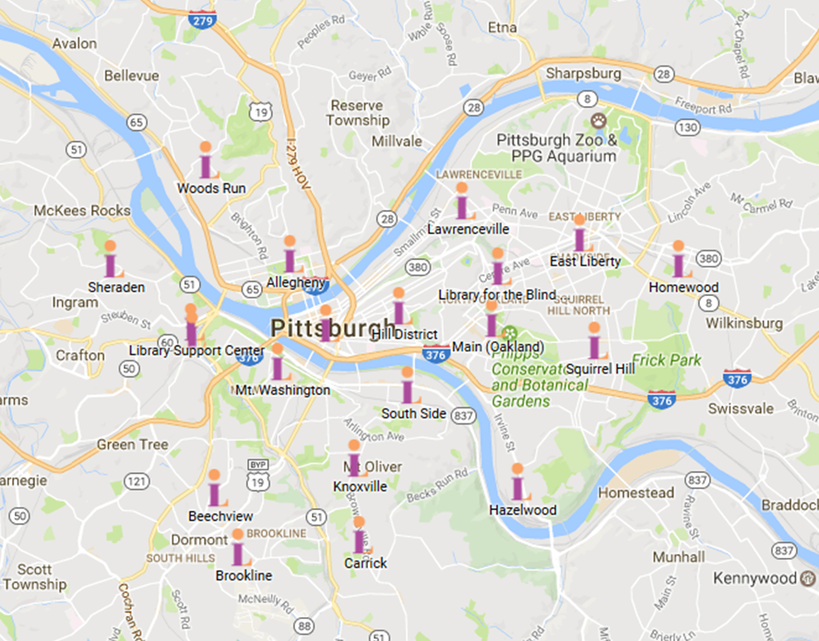
Carnegie Library of Pittsburgh System

Slide 3
The Libraries of Allegheny County

Slide 4
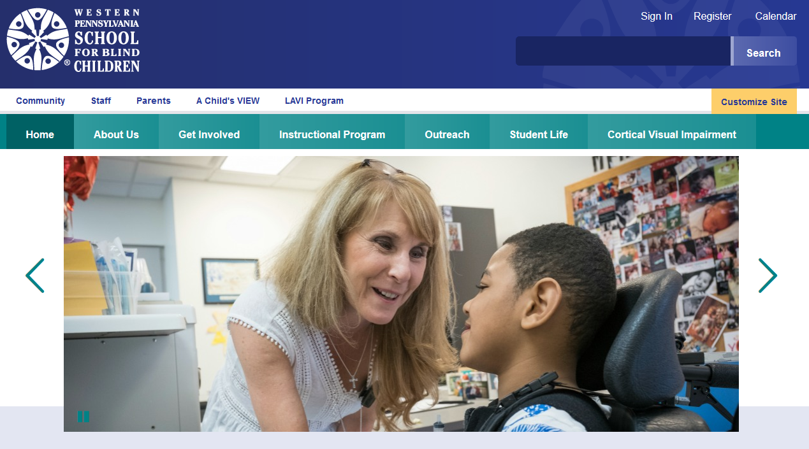
Staff Training Beyond the Library

Slide 5
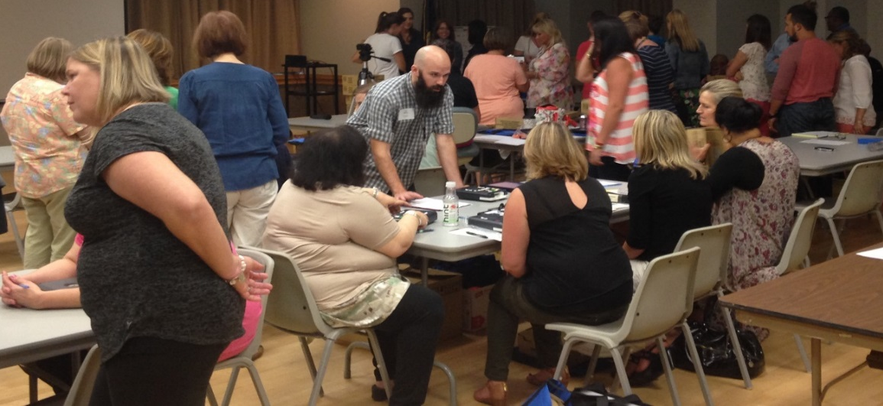
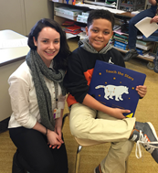
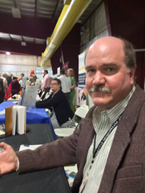
The Staff…
… of Staff Training

Slide 6
The Benefits of Staff Training

Slide 7
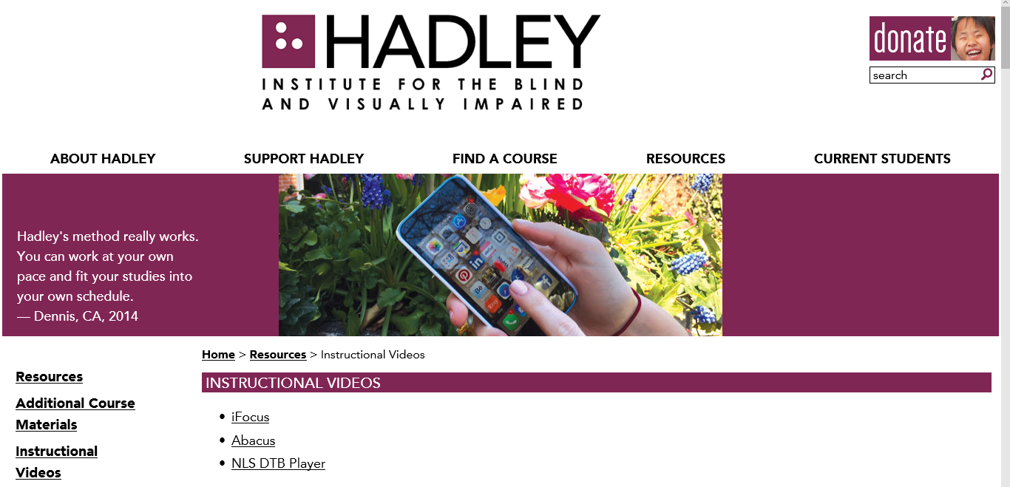
Online Resources: Assistive Technology

Slide 8
Customer Service Video from the Mid-Atlantic ADA Center

Slide 9
Some Things to Consider When Working with Volunteers Who Have Disabilities

Slide 10
Does your Library have the necessary technology and equipment to provide special needs access to computers and the physical environment of the Library?

Slide 11
Are your staff and other volunteers trained in assisting Volunteers with special needs?

Slide 12
Does your Library have a reasonable expectation of what equal access to all aspects of volunteer opportunities means for someone with a barrier to higher level volunteer roles such as Narration?

Slide 13
Do your volunteer position descriptions include persons with disabilities in the language of the established requirements?

Slide 14
Are you willing to take a chance in permitting a volunteer to try something that might seem impossible, or has a high probability of failure?

