Slide 1
NLS Tech Update
Neil Bernstein
Research & Development Officer, NLS
June 6, 2017

Slide 2
MVNE
BARD
BARD Express
BARD Mobile iOS
BARD API
Microservices
Gutenberg
BARD Mobile Android
TBM-NG
Synthetic Speech
,brl
Future

Slide 3
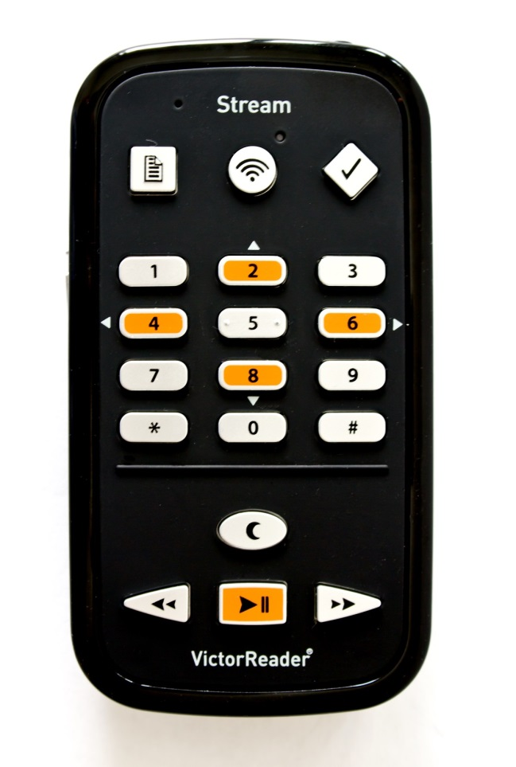
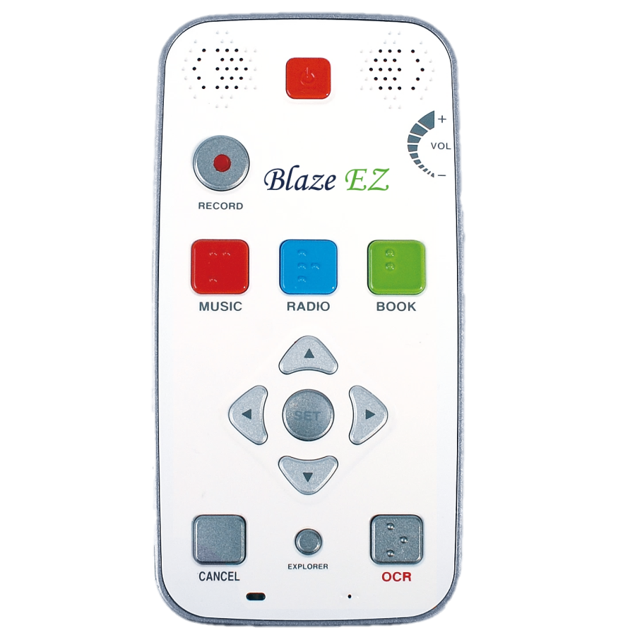
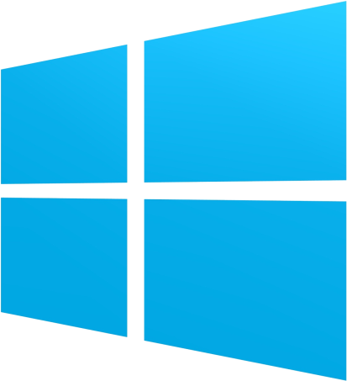
BARD
Express
Mobile iOS
API
Mobile Android

Slide 4
MVNE
BARD
BARD Express
BARD Mobile iOS
BARD API
Microservices
Gutenberg
BARD Mobile Android
TBM-NG
Synthetic Speech
,brl
Future

Slide 5
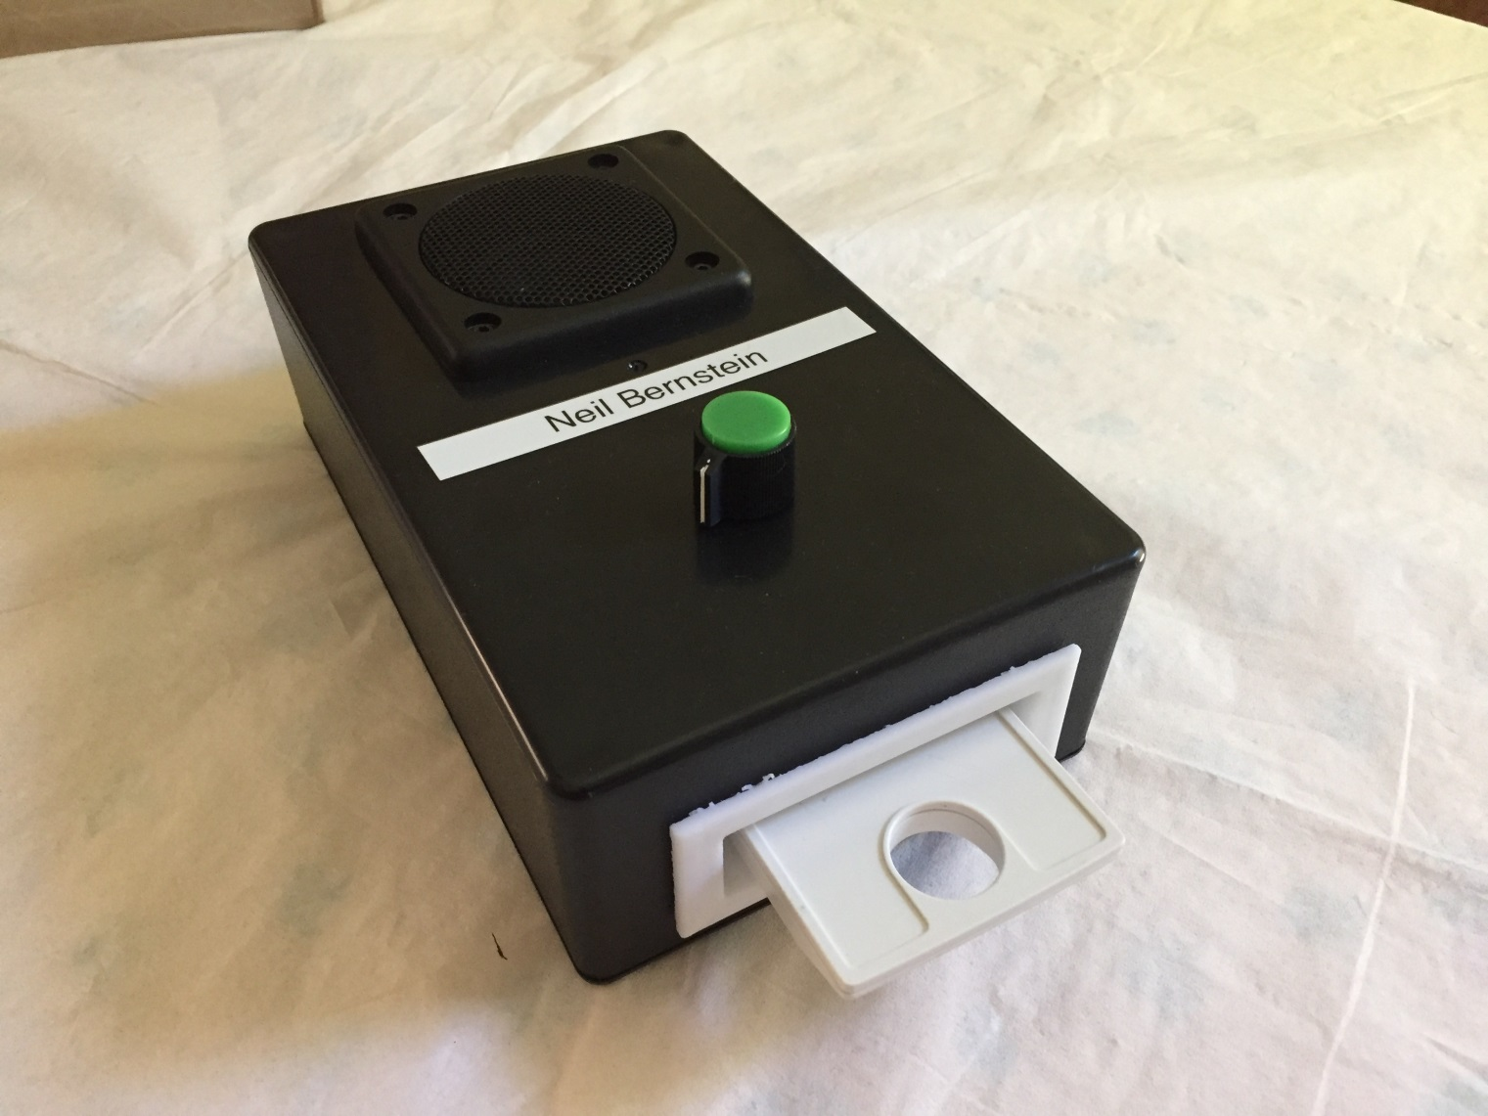
MVNE

Slide 6
MVNE
BARD
BARD Express
BARD Mobile iOS
BARD API
Microservices
Gutenberg
BARD Mobile Android
TBM-NG
Synthetic Speech
,brl
Future

Slide 7
Databases/Storage
User interface
Catalog
Authentication
Authorization
Messaging
Help
Reports
Logging/Accounting
API
Application
Search
Preferences
Wish list
History
Download
Keys
Encryption
Device registration
MOC system
Administration UI
Local books upload and other functions
Service alerts
DDoS defense
Databases/Storage
User interface
Catalog
Authentication
Authorization
Messaging
Help
Reports
Logging/Accounting
API
G
Microservices

Slide 8
Microservices
Databases/Storage
User interface
Catalog
Authentication
Authorization
Messaging
Help
Reports
Logging/Accounting
API
Application
Search
Preferences
Wish list
History
Download
Keys
Encryption
Device registration
MOC system
Administration UI
Local books upload and other functions
Service alerts
DDoS defense
Databases/Storage
User interface
Catalog
Authentication
Authorization
Messaging
Help
Reports
Logging/Accounting
API
G

Slide 9
Microservices
Authentication
Authorization
Accounting
G
Logging
Reporting
Messaging
Catalog

Slide 10
Microservices
Authentication
Authorization
Accounting

Slide 11
MVNE
BARD
Microservices
BARD Express
BARD Mobile iOS
BARD API
Gutenberg
BARD Mobile Android
TBM-NG
Synthetic Speech
,brl
Future

Slide 12
Thanks! Neil Bernstein nber@loc.gov

