Slide 1
Library Services to
People With Print Disabilities:
Today and Tomorrow
A Presentation to the 2017 Midlands/Northern Conference of Libraries for the Blind and Physically Handicapped
Ann Arbor, Michigan
Karen Keninger, director, NLS
June 6, 2017
Notes:
Library Services to
People With Print Disabilities:
Today and Tomorrow
A Presentation to the 2017 Midlands/Northern Conference of Libraries for the Blind and Physically Handicapped
Ann Arbor, Michigan
Karen Keninger, director, NLS
June 6, 2017

Slide 2
IFLA/LPD
International Federation of Library Associations and Institutions
Standing Committee on Libraries Serving Persons with Print Disabilities
Karen Keninger, Chair, 2015–2017
Notes:
IFLA/LPD
International Federal of Library Associations and Institutions
Standing Committee on Libraries Serving Persons with Print Disabilities
Karen Keninger, Chair, 2015-2017
(IFLA logo dissolves into view at bottom of slide)

Slide 3
The mission of IFLA/LPD is to advocate for library services that are equitable and accessible for persons with a print disability.
IFLA/LPD’s mission is supported by the United Nations Convention on the Rights of Persons with Disabilities, which holds that print disabled people have the right to equal access to books, knowledge and information at the same time, cost and quality as everyone else.
As of today only 5 percent of the world's published information is fully accessible to persons with a print disability.
Notes:
The mission of IFLA/LPD is to advocate for library services that are equitable and accessible for persons with a print disability.
IFLA/LPD’s mission is supported by the United Nations Convention on the Rights of Persons with Disabilities, which holds that print disabled people have the right to equal access to books, knowledge and information at the same time, cost and quality as everyone else.
As of today only 5 percent of the world's published information is fully accessible to persons with a print disability.
(Each sentence dissolves into view in sequence)

Slide 4
IFLA/LPD Goals
Establish a global library of accessible material
Influence international policy on access to knowledge and information
Establish and support best practice guidelines
Raise the profile of LPD and accessible library services within the library community
Promote the Marrakesh Treaty
Notes:
IFLA/LPD Goals
Establish a global library of accessible material
Influence international policy on access to knowledge and information
Establish and support best practice guidelines
Raise the profile of LPD and accessible library services within the library community
Promote the Marrakesh Treaty

Slide 5
IFLA/LPD’s Membership is Worldwide
Finland
Norway
Sweden
Russia
USA
Belgium
Netherlands
France
Japan
Egypt
Argentina
Chile
South Africa
Australia
Notes:
IFLA/LPD’s Membership is Worldwide
Argentina; Chile, Australia; Norway, Sweden, Finland, Russia, Belgium, Egypt, Netherlands; South Africa; France, Japan
(Spinning globe floats into view and the names of countries, grouped by region, dissolve into view.)

Slide 6
Share
Promote
Collaborate
Liaise
Present
Notes:
Share
Promote
Collaborate
Liaise
Present
(Words dissolve into view, one after the other)
Text in script:
IFLA/LPD Activities
Share information through listserv
Share information in 3 in-person meetings/year
Share information across borders through satellite conferences
Collaborate on guidelines for service
Promote the Marrakesh treaty through statements and symposia
Liaise with Daisy, the Accessible Book Consortium, and other relevant organizations
Present a program at annual world Library Information Congress (WLIC)

Slide 7
Join the conversation!
www.ifla.org/lpd
www.ifla.org/lpd/mailing-lists
www.facebook.com/iflalpd
Notes:
Join the conversation!
www.ifla.org/lpd
www.ifla.org/lpd/mailing-lists
www.facebook.com/iflalpd
(IFLA logo on screen)

Slide 8
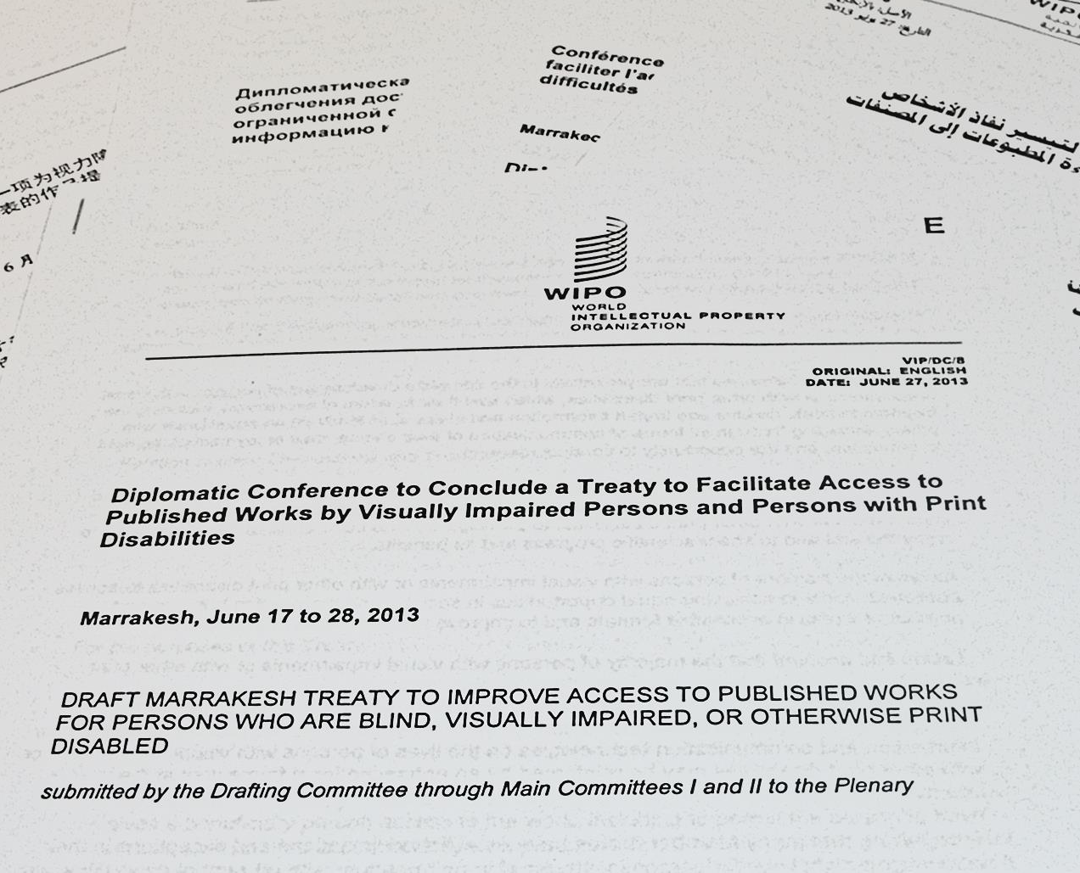
Marrakesh: The road to implementation
Notes:
Marrakesh: The road to implementation
(Graphic display of first page of Marrakesh treaty)

Slide 9
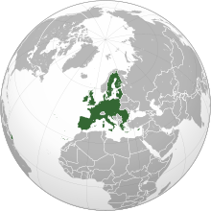
On May 15 Kyrgyzstan became the 28th country to ratify the treaty
The European Union is expected to ratify this summer
Notes:
On May 15 Kyrgyzstan became the 28 th country to ratify the treaty.
The European Union is expected to ratify this summer.
(Graphics of two globes with arrows pointing to Kyrgyzstan and the EU.)

Slide 10
In the U.S., the Marrakesh Treaty would expand eligibility under the Chafee Amendment
Article 3: Beneficiary Persons
A beneficiary person is a person who:
is blind;
(b) has a visual impairment or a perceptual or reading disability which cannot be improved to give visual function substantially equivalent to that of a person who has no such impairment or disability and so is unable to read printed works to substantially the same degree as a person without an impairment or disability; or
(c) is otherwise unable, through physical disability, to hold or manipulate a book or to focus or move the eyes to the extent that would be normally acceptable for reading; regardless of any other disabilities.
Notes:
In the U.S., the Marrakesh Treaty would expand eligibility under the Chafee Amendment
Article 3: Beneficiary Persons
A beneficiary person is a person who:
is blind;
(b) has a visual impairment or a perceptual or reading disability which cannot be improved to give visual function substantially equivalent to that of a person who has no such impairment or disability and so is unable to read printed works to substantially the same degree as a person without an impairment or disability; or
(c) is otherwise unable, through physical disability, to hold or manipulate a book or to focus or move the eyes to the extent that would be normally acceptable for reading; regardless of any other disabilities.

Slide 11
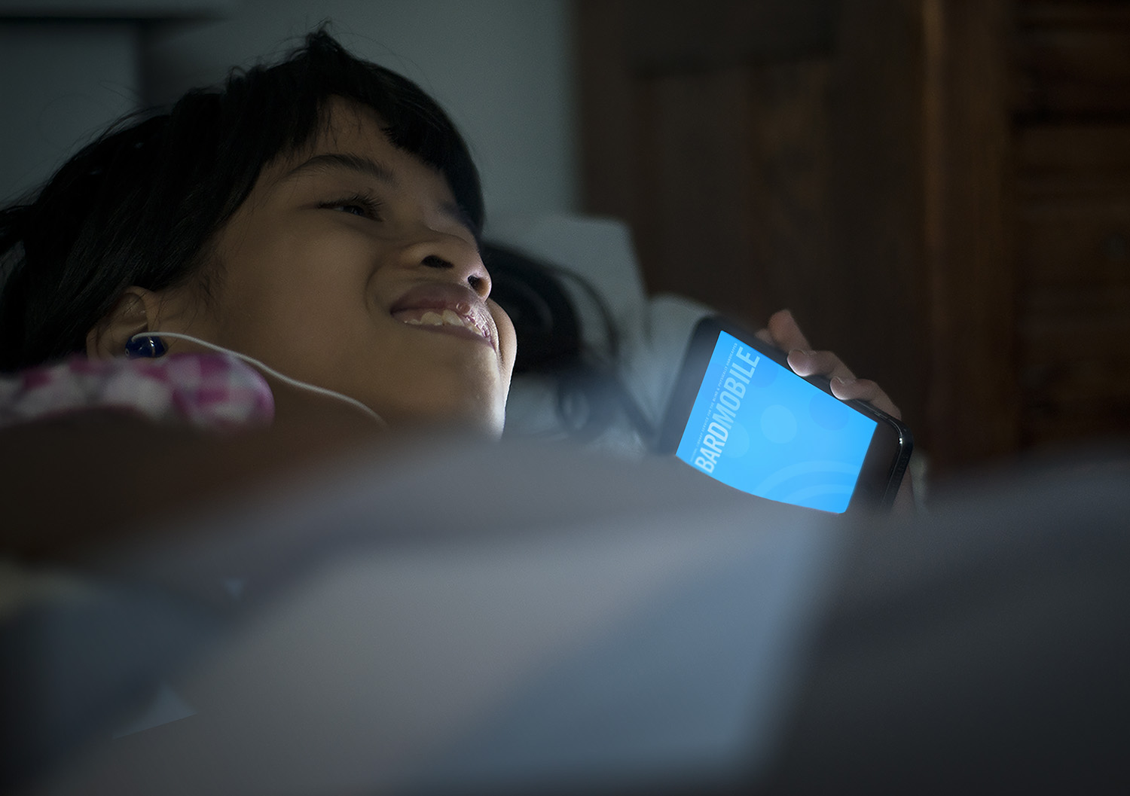
Developments and Trends at NLS
Notes:
Developments and Trends at NLS
(Three photos of patrons dissolve into view: Young woman in wheelchair inserting cartridge into a DTBM, girl in bed reading with BARD Mobile, older man in chair reading with a DTBM)

Slide 12
Priorities
Maintain quality of materials
Increase number and scope of titles available
Leverage technology to improve patron experience
Increase number of patrons served
Modernize the NLS braille program to enhance literacy
Notes:
Priorities
Maintain quality of materials
Increase number and scope of titles available
Leverage technology to improve patron experience
Increase number of patrons served
Modernize the NLS braille program to enhance literacy

Slide 13
Goals: 1 to 3 years
BARD Express
Duplication on Demand
Hardware that, when coupled with a library’s circulation system, will enable libraries to readily duplicate titles for their patrons. Libraries will then be able to choose their level of participation as they move toward a shelfless paradigm.
Notes:
Goals: 1 to 3 Years
BARD Express
Duplication on Demand
Hardware that, when coupled with a library’s circulation system, will enable libraries to readily duplicate titles for their patrons. Libraries will then be able to choose their level of participation as they move toward a shelfless paradigm.
(There is a check mark next to BARD Express since it has been implemented.)

Slide 14
Libraries will be invited to participate in Duplication on Demand at any of four levels:
Duplicate copies of digital talking books for which NLS has not provided a physical copy
Duplicate, when needed, copies of titles that are not available on their shelves (libraries maintain collections limited to the newest titles)
Opt out of copy allotment for some new titles
No longer maintain a collection but provide service by duplicating all titles on demand
Libraries will not be required to participate
Notes:
Libraries will be invited to participate in Duplication on Demand at any of four levels:
Duplicate copies of digital talking books for which NLS has not provided a physical copy
Duplicate, when needed, copies of titles that are not available on their shelves (libraries maintain collections limited to the newest titles)
Opt out of copy allotment for some new titles
No longer maintain a collection but provide service by duplicating all titles on demand
(The words “invited” and “will not be required” are in bold, highlighted in green)

Slide 15
Goals: 3 to 5 years
Braille eReaders
eText
Notes:
Goals: 3 to 5 Years
Braille eReaders
eText

Slide 16
Goals: 5+ years
Next-generation digital player
Wireless delivery of books
Notes:
Goals: 5+ Years
Next-generation digital player
Wireless delivery of books

Slide 17
2016 GAO Report on NLS
What would be the impact on NLS programs if eligibility were expanded to included people with dyslexia and other perceptual reading disabilities?
Should NLS build or buy its next-generation digital player?
Would NLS patrons accept synthesized speech?
How can NLS document the impact of its advertising on registrations?
Can the NLS authorizing legislation be changed to allow NLS to provide braille eReaders to patrons?
Notes:
2016 GAO report on NLS
What would be the impact on NLS programs if eligibility were expanded to included people with dyslexia and other perceptual reading disabilities?
Should NLS build or buy its next-generation digital player?
Would NLS patrons accept synthesized speech?
How can NLS document the impact of its advertising on registrations?
Can the NLS authorizing legislation be changed to allow NLS to provide braille eReaders to patrons?
(Key words—eg, “eligibility were expanded”—are highlighted)

Slide 18
NLS Pilot Projects
Braille eReader
Synthetic speech
Mobile Virtual Network Enabler (MVNE)
Duplication on Demand with WebREADS
Notes:
NLS Pilot Projects
Braille eReader
Synthetic speech
Mobile Virtual Network Enabler (MVNE)
Duplication on Demand with WebREADS

Slide 19
What’s ahead: 12 months
Results of Accenture studies
Results of pilots
More titles on BARD
Decisions about next-generation digital player
Nationwide TV/radio/online ad campaign
Notes:
What’s ahead: 12 months
Results of Accenture studies
Results of pilots
More titles to on BARD
Decisions about next-generation digital player
Nationwide TV/radio/online ad campaign

Slide 20
What’s ahead: 1 to 3 years
Braille eReader implementation
Introduction of next-generation digital player
Expansion of patron base
Notes:
What’s ahead: 1 to 3 years
Braille eReader implementation
Introduction of next-generation digital player
Expansion of patron base

Slide 21
What’s ahead: 3 to 6 years
Paradigm shift in delivery methods
Option for shelfless library
Decreased need for materials handling at network libraries
Increased need for technical support at network libraries
Increased importance of reader advisory work at network libraries
Notes:
What’s ahead: 3 to 6 years
Paradigm shift in delivery methods
Option for shelfless library
Decreased need for materials handling at network libraries
Increased need for technical support at network libraries
Increased importance of reader advisory work at network libraries

Slide 22
NLS Open Forum
4:45–5:30 p.m.
Questions
Answers
Discussion
Notes:
NLS Open Forum
4:45-5:30 p.m.
Questions
Answers
Discussion
(Top of screen has NLS logo banner. Bottom of screen has That All May Read flying-book banner.)

