Slide 1
Mass Digitization of Books and the Potential for Universal Access
Mike Furlough, HathiTrust
6 JUNE 2017
MIDLANDS/NORTHERN CONFERNCE OF NLS LIBRARIES SERVING
THE BLIND & VISUALLY IMPAIRED
ANN ARBOR DISTRICT LIBRARY, ANN ARBOR MICHIGAN

Slide 2
Outline of this talk
What is HathiTrust?
What we are, who we are, what we do…
Our collection
Some history
How does HathiTrust serve print disabled users?
Who is eligible?
What do we deliver?
What challenges do we face?
What are we working on for the future?
Questions….?

Slide 3
What is HathiTrust?

Slide 4
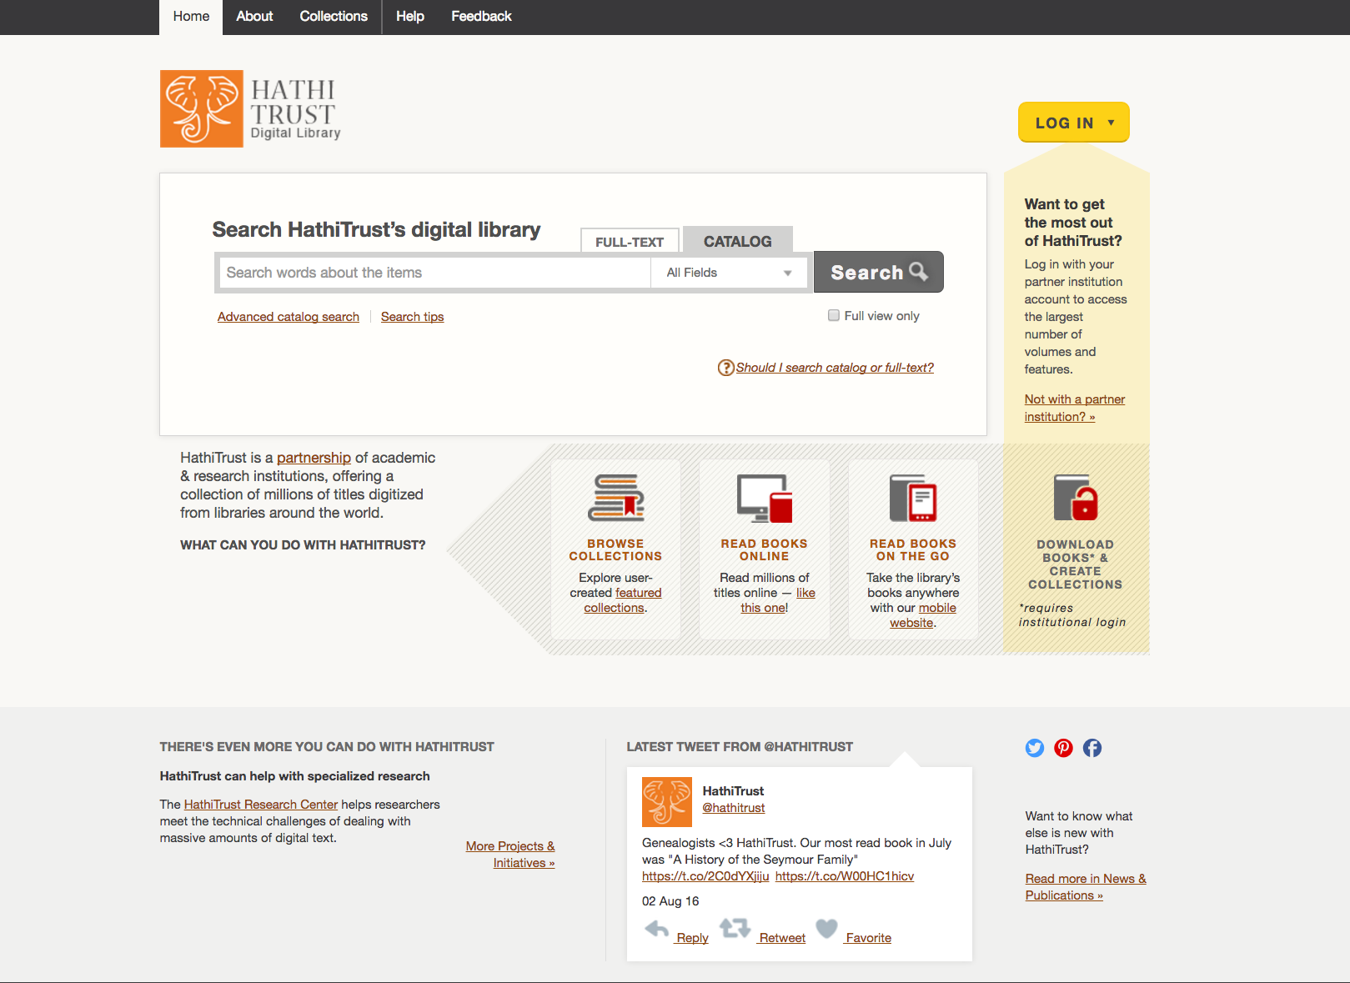
www.hathitrust.org
Notes:
This slide includes a graphic captured from a web browser which depicts the main page of the HathiTrust Website: www.hathitrust.org.

Slide 5
Mission and Purpose
To contribute to research, scholarship, and the common good by collaboratively collecting, organizing, preserving, communicating, and sharing the record of human knowledge.
A trusted digital preservation service enabling the broadest possible access worldwide.
An organization with over 125 research libraries partnering to develop its programs.
A range of transformative programs enabled by working at a very large scale.
Notes:
Our mission is a library mission: collect, organize, preserve, make accessible research materials.
To develop partnerships and services that ensure preservation of the materials in HathiTrust and the entire print and digital scholarly record.
These values amplify the public good foundation of HathiTrust and rationale for its financial model.
Specifically, the HathiTrust provides members with:
Managed, accessible, preserved corpus of public domain and in-copyright material
Shared corpus to support institutional rationalization of collection development
Enhanced discovery, access, and use of scholarly resources across disciplines
Capacity and infrastructure for digital preservation
Services in support of print disabled users
Massive data set and suite of tools for faculty and students to explore new forms of research, teaching, and learning.
HathiTrust, through its governance model, also provides members with a venue in which to amplify a position on key policies affecting library services and resources. As part of the HathiTrust mission, the organization provides an opportunity to develop at-scale solutions to common problems, not able to be addressed by a single institution acting alone.

Slide 6
Membership Model
The membership is committed to the collective development of a public good that can transform libraries, access, and preservation.
Membership is not another word for subscription.
Currently limited to academic/research institutions that operate a library (not individuals).
Member fees account for nearly all of our budget.

Slide 7
HathiTrust Collections Today
15.6 million total digitized items (volumes)
7.7 million book titles
423,000 serial titles
910,000 US federal government documents
5.85 million items open for reading
Includes public domain & CC-licensed items
The collection includes (mostly) published materials in bound form, (mostly) digitized from library collections.

Slide 8
Access in a Nutshell
Anybody anywhere
Full text search of entire collection (via web)
Text and data mining
In copyright data mining is in pilot mode (via HTRC)
Services require additional registration
Read public domain and open access works (via web)
Members only
Download public domain and open access works
Replacement access for lost and damaged print copies.
Access for users who are blind or with print disabilities
Details about our accessibility policies are at: https://www.hathitrust.org/accessibility

Slide 9
A little history…

Slide 10
Digitization: Universal Access?
1990s: Digitizing in research libraries for web access is new; U of Michigan Library is an early leader.
2002: Discussions between Google and Michigan to digitize entire collection (10 million+ books).
2004: Google announces partnership with Michigan & 4 others.
2007: Michigan and Big Ten libraries agree to develop a shared digital repository for digitized collections.
2008: University of California joins and HathiTrust is founded.
2017: Google is still scanning.

Slide 11
Why Form HathiTrust?
Google is not a library.
Google’s partner libraries were more ambitious than Google (in some ways).
It’s our job to steward cultural heritage.
We could do things Google could not.
Libraries have specific exemptions under US copyright law.
Libraries tailor access and services for their users.

Slide 12
Criticisms of Mass Digitization
Working with commercial partners
Poor quality
Bad metadata
OCR unreliable
“IT SO BLATANTLY VIOATES COPYRIGHT LAW THAT I’M BARELY ABLE TO SPEAK CLEARLY.”

Slide 13
Legal Challenges
2005: Google sued by both the American Association of Publishers and the Authors Guild
2007-2011: Proposed joint settlement is not approved by courts.
Publishers settle separately
Authors Guild keeps fighting
2011: Author’s Guild sues HathiTrust over orphan works project
National Federation of the Blind joins as co-defendant.
2012-2016: Courts ruled for both HathiTrust and Google.

Slide 14
What the lawsuit settled for HathiTrust
We could continue our work—we gained no new rights.
But….
Universities and colleges were clearly identified as “authorized entities” under section 121 of the Copyright Act.
Digitizing books for access by print disabled users is a clear fair use, in addition to section 121.
The additional clarity opened the door for us to expand our services for print disabled users.

Slide 15
Services for Print Disabled Users

Slide 16
For print-disabled users…
HathiTrust provides eligible users with access to any item in the HathiTrust collection, regardless of copyright status.
Eligibility is determined by the member institution following their own established practices.
Access for the user is managed by a service provider on campus.

Slide 17
Constraints on the service
On access:
User must be affiliated with a member institution.
Access is managed by user “proxies” on each campus.
We do not provide direct access to the eligible user (at this time).
On content:
Digital objects delivered are page images with OCR, formatted as a PDF.
Proxy works with individual to process as needed.

Slide 18
What we know about usage
Some services are provided in libraries, others in student services offices.
58 of 128 members are registered to provide the service.
85 individuals are supporting students.
5100 accesses in the last year.
Wide range of actual usage.

Slide 19
Observations and challenges
The collection is of limited use to new undergraduates.
Processes are “clunky”
Improving quality
Creating specialized formats
Providing better access while managing legal risk

Slide 20
What next?

Slide 21
Current and upcoming work
Collection of new e-books, such as ePub formats.
Monitoring the Marrakesh Treaty’s progress or lack thereof.
Partnership with National Federation of the Blind.

Slide 22
NFB partnership
Planned service:
NFB will certify US users as eligible and provide accounts.
NFB will facilitate user authentication to HathiTrust.
Authentication will use same methods as our members, plus….
2-factor authentication will be employed for these eligible users.
Additional security permits direct screen access.
Current status:
Testing authentication services this summer.
Very small pilot is planned for fall 2017.
NFB will not be a member of HathiTrust.
HathiTrust members will continue to have download access via proxy users.

Slide 23
Digitization: universal access?
Not even close.
We still have a lot to learn.
We still have a lot of books to get digitized.
We still have a lot of publishers who don’t understand the print disabled community.

Slide 24
THANK YOU and QUESTIONS?
Mike Furlough
furlough@hathitrust.org
@MikeFurlough
feedback@issues.hathitrust.org

