Slide 1
Books Beyond Our Boarders
Dr. Lisa Wadors Verne

Slide 2
What about this?
Notes:
What about this? Can all of the people we discussed previously use these?

Slide 3
Problem and Misconception
DIGITAL
≠
ACCESSIBLE

Slide 5
The Bookshare Global Collection
World’s largest library of accessible materials
700,000 titles, including free reading, textbooks, periodicals
Private label migrations will add ~100,000 titles
Continuously fed by publisher and on-the-ground operations
Bookshare adds ~5,000+ titles per month
Other private labels will add ~1000+ per month
5 different, accessible formats, including:
Audio, including human-narrated
BRF (for both books and music), including transcribed braille
DAISY, EPUB, Word, and PDF*
Support for >50 languages (and growing!) and Braille Music
Equivalent to >3.5 Million unique SKUs
Benetech Confidential. Do not distribute.

Slide 6
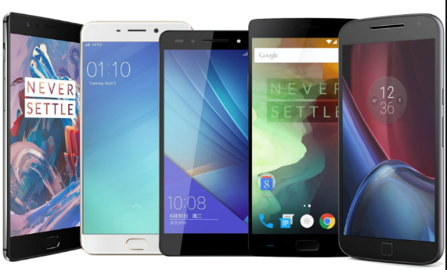
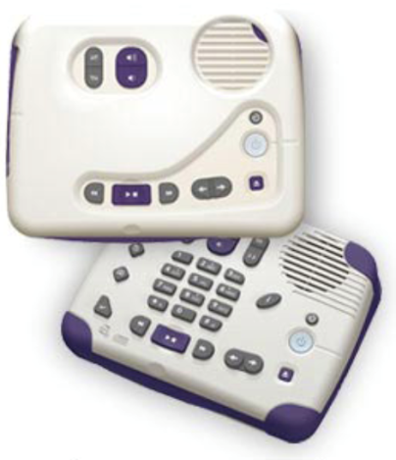
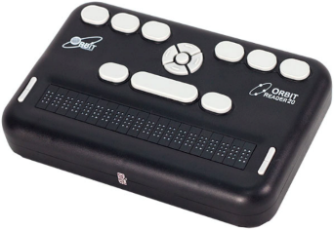
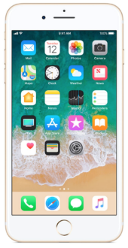
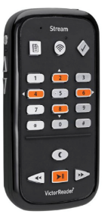
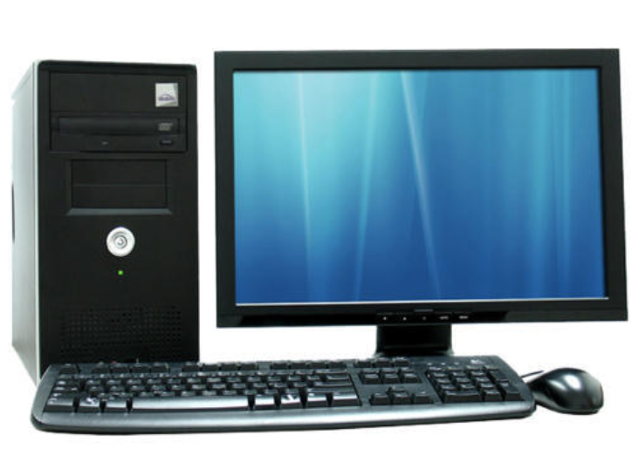
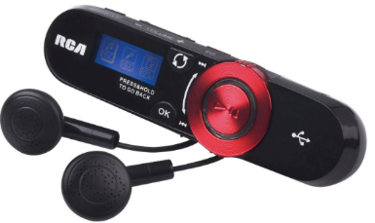
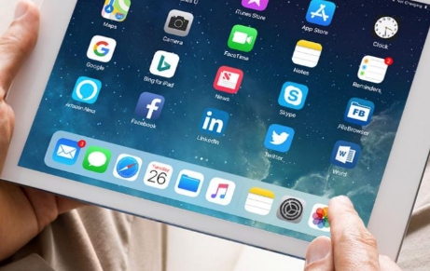
Patrons read in the ways that work for them
Refreshable Braille Display
Mobile Phone
DAISY Player
MP3 Player
Computer
Tablet
Benetech Confidential. Do not distribute.

Slide 7
Tip of the Iceberg
Bookshare
700,000
>2.5M
Notes:
* Nobody cares about books that aren’t relevant to them. Locally relevant content is super important.
Mother tongue language is important
And, all the content in the world doesn’t matter if you can’t get to it, and technology enables that.

Slide 8
Marrakech Treaty
An international treaty that was adopted in Marrakech in June 2013
By member states of WIPO
WIPO=World Intellectual Property Organization
Full title Marrakech Treaty to Facilitate Access to Published Works for Persons Who are Blind, Visually Impaired or Otherwise Print Disabled

Slide 9
What is the Treaty about?
An International legal framework
Countries who ratify the Marrakesh Treaty shall provide in their national copyright laws
A right to produce and distribute accessible copies of works for persons with print disabilities, and
A right to share accessible books across national borders (with other countries that have ratified the Marrakesh Treaty)
Permitted without the authorization of the copyright holder

Slide 10
The Treaty came into force on September 30, 2016
India was the first to ratify and Canada was the 20th
There are 54 parties contracting the Marrakech Treaty
US deposited the instrument and it will be ratified on May 8th, 2019
All together 81 countries have ratified the treaty

Slide 11
Changes to US Copyright
Revision of section 121 and relevant terminology in both sections
New section 121A
Notes:
the legislation which authorizes appropriations for the Library of Congress National Library Service for the Blind and Physically Handicapped was dropped as unsuitable for the purpose of defining such individuals in section 121A because the Marrakesh Treaty contains no similar requirement for determining whether such individuals ‘‘are eligible or may qualify’’ as such beneficiaries ‘‘in accordance with’’ a particular national law.
121A - New section 121A is intended to implement the obligations of the United States under the Marrakesh Treaty to permit the exportation and importation of accessible format copies of copyrighted works for use by eligible persons, that is persons who are blind or other persons with print disabilities.

Slide 12
What does this mean for Bookshare?
Partnerships with other Marrakech countries
National Libraries
Library sharing platforms - EMMA

Slide 13
UAE
National Libraries:
Bookshare Bangladesh, Bhutan, India, Nepal, Pakistan

Slide 14
Lisa Wadors Verne, PhD
lisaw@Benetech.org

